Slide 1
The
Niagara Fire Engine Company No.4:
The Restoration
1999-2019

Slide 2
This presentation will cover:
A Brief History of Niagara
The Vision: Jeff Hardin’s Dream
Community Service: volunteering & fundraising
State Grant from Cheryl Jacques, former MA state senator
Architectural Design: Marc Prufer’s hand-drawn plans for restoration
Community Preservation Act (CPA) Funding: phases one- four
Niagara Hall Grand Opening Ceremony
Notes:
Community service: Joe Hamm, contractor, that began the work for us along with volunteer efforts from Millis residents and commission members. Our efforts to begin this process inspired the need and decision to give a grant
Grant: front of the building and part of the siding- facade- doors, clapboards, paint, brackets, lettering, etc.
CPA phase 1: foundation & interior floor- the foundation sills were rotted away, the floor was just concrete (which was removed), and a new floor was framed. A new tongue and groove wood pine floor was installed on top of a newly poured concrete slab. The foundation was formed on top of the rubble foundation with a brick shelf.
CPA phase 2: exterior renovations-- handicap accessible ramp, rear exit door and landing, new windows and siding on the back of building, removal of the old exterior stairs, side door overhang and brackets, new roof, recreation of the hose tower and installation, two HVAC systems installed, complete electrical rewiring of the building, installation of new interior, rear staircase, new interior pine floors on first and second levels, patching and sanding of all floors, interior framing of new bathroom and storage closets, complete interior painting, new light fixtures and outlets throughout
CPA Phase 4: finalize electrical wiring, fixtures, flooring, interior storm windows,

Slide 3
How did CPC help this project?
The restoration was first funded by volunteer-lead fundraisers in town, public donations, and various donations from local businesses.
Although these efforts were great, costs were high and funds were limited: restoration came to a halt. A grant was secured from former State Senator Cheryl Jacques for $50,000. These funds were utilized to transform the facade and two sides back to their original condition. Timing was on our side when the citizens of Millis adopted the CPC Act in 1999.
Notes:
Photo of niagara with one door

Slide 4
Community Preservation Act (CPA) Funding:
Month/Year | Phase | Description of Contracted Work* | Public Funding Amount | Estimate Value of Free Work
Jun-09 | 1 | Foundation and plank floor on first floor | $60,000 | $13,900
Nov-11 | 2 | Roofing, exterior siding, trim, windows, ramp and stair, exterior painting, misc. | $120,000 | $84,700
May-14 | 3 | HVAC, hose tower, side entry brackets & awning, board & plaster, finish stair, interior wiring & partial installation Materials: wood flooring, partial lighting insulation, stair parts, doors, trim attic stair, misc. | $97,000 | $147,550
May-19 | 4 | Lighting installation Materials: partial lighting fixtures, alarms, kitchen casework & fixtures, trim, interior storms, glass for cases, misc. exhibits | $20,000 | $4,500
Grand Total: | $297,000 | $250,650

Slide 5
Funding other than CPA:
 | Source: | Description of Work: | Public Funding: | Estimate Value of Free Work:
1998-1999 | MA State Grant | Contracted: front facade restoration Pro Bono: Design- Prufer Oversight | $50,000 | $9,500
2011 | MHC Gift Fund | MHC Members | Misc. | $6,404.40
TOTAL PROJECT FUNDING: | Public Funding Amount: | Estimate Value of Free Work:
 | $347,000 | $266,554.40
Projected Cost before Free Work: $613,554.40

Slide 6
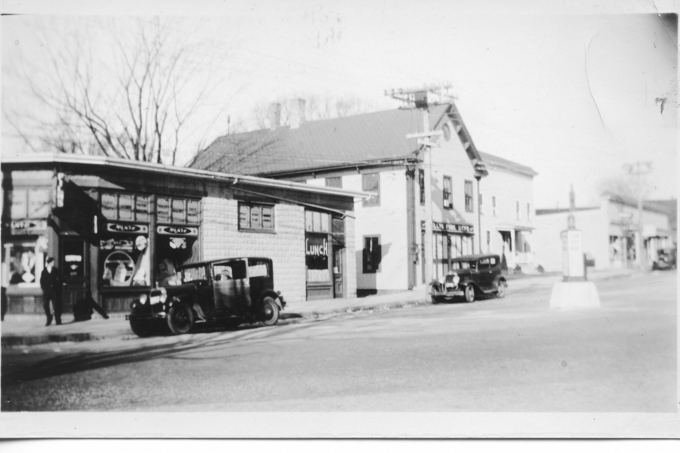
Notes:
built 1879 at a cost of $675 for the fire dept., which was established years earlier in 1857, which is the year that the Niagara Hand Tub was crafted.

Slide 7
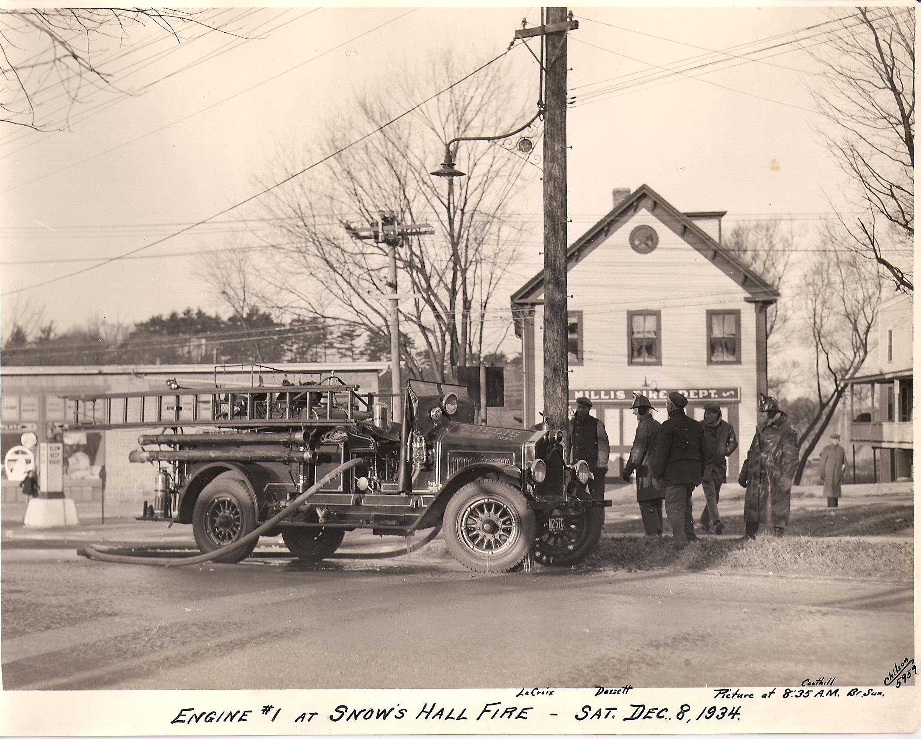

Slide 8
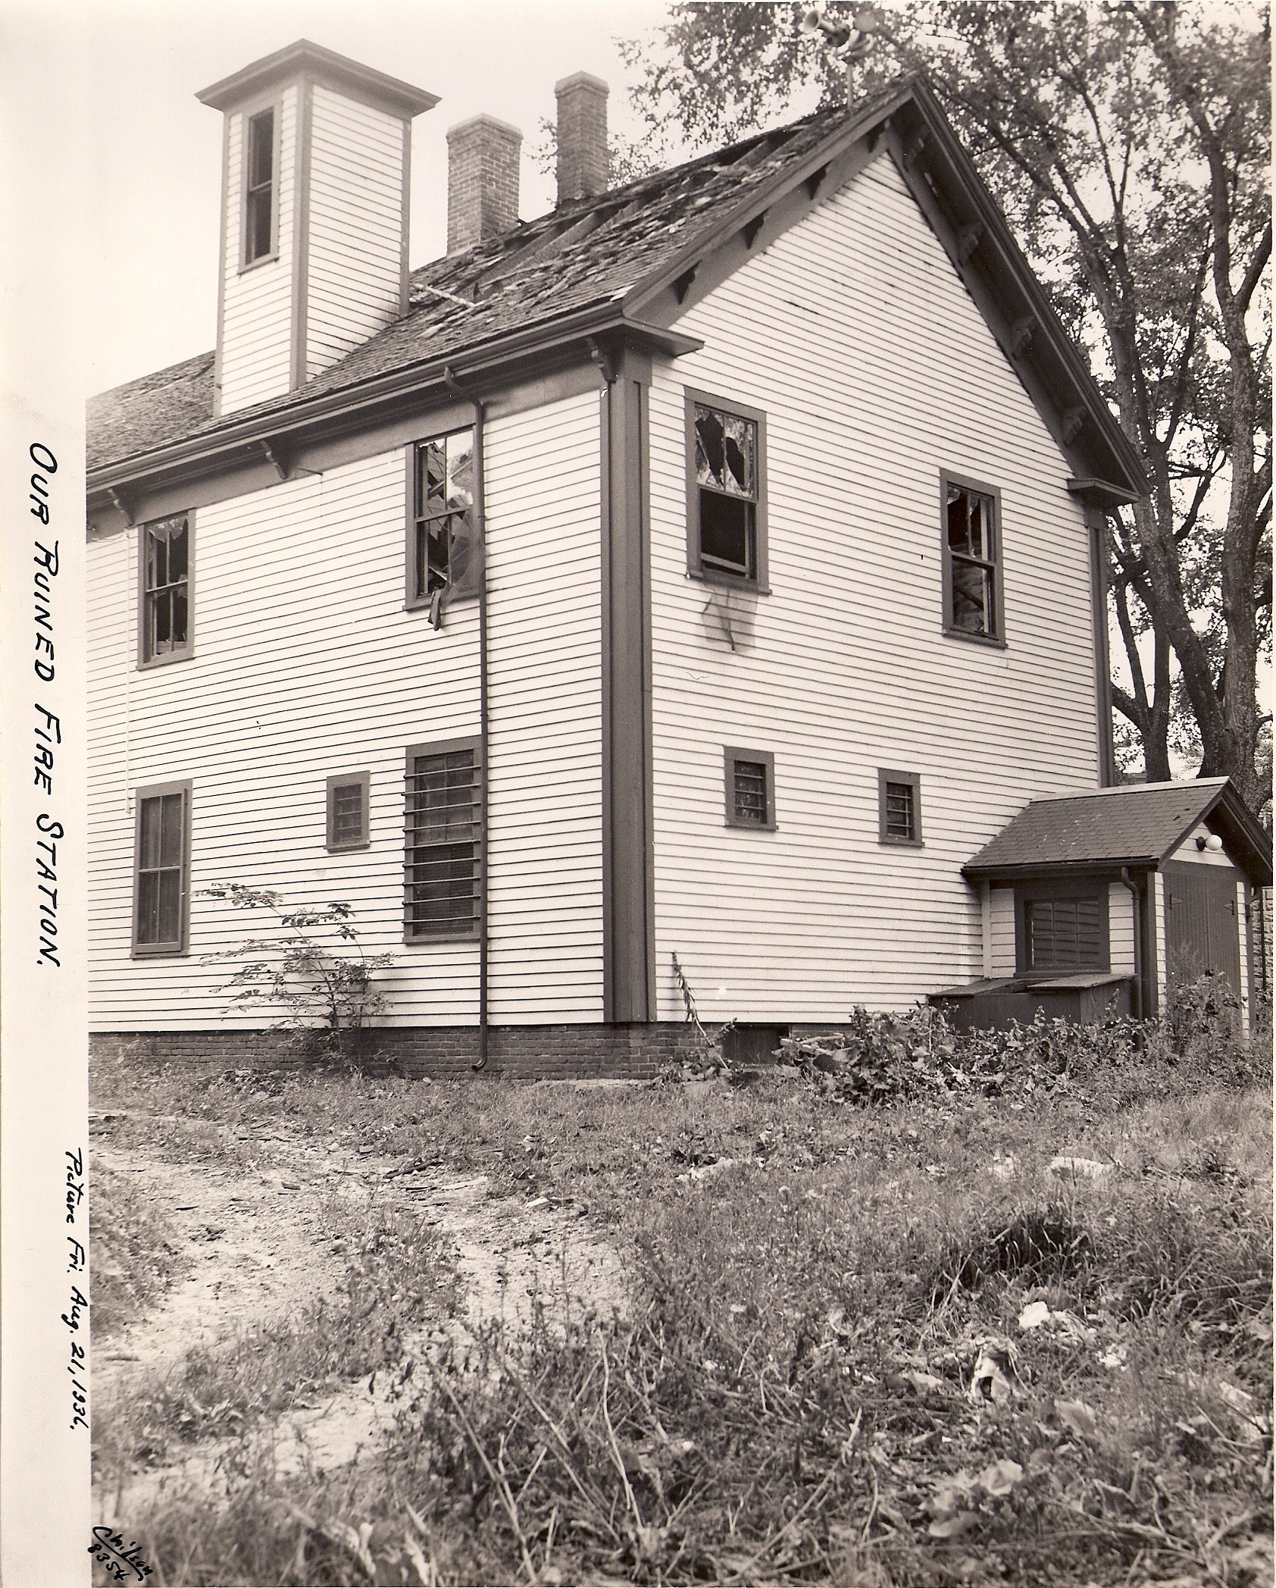
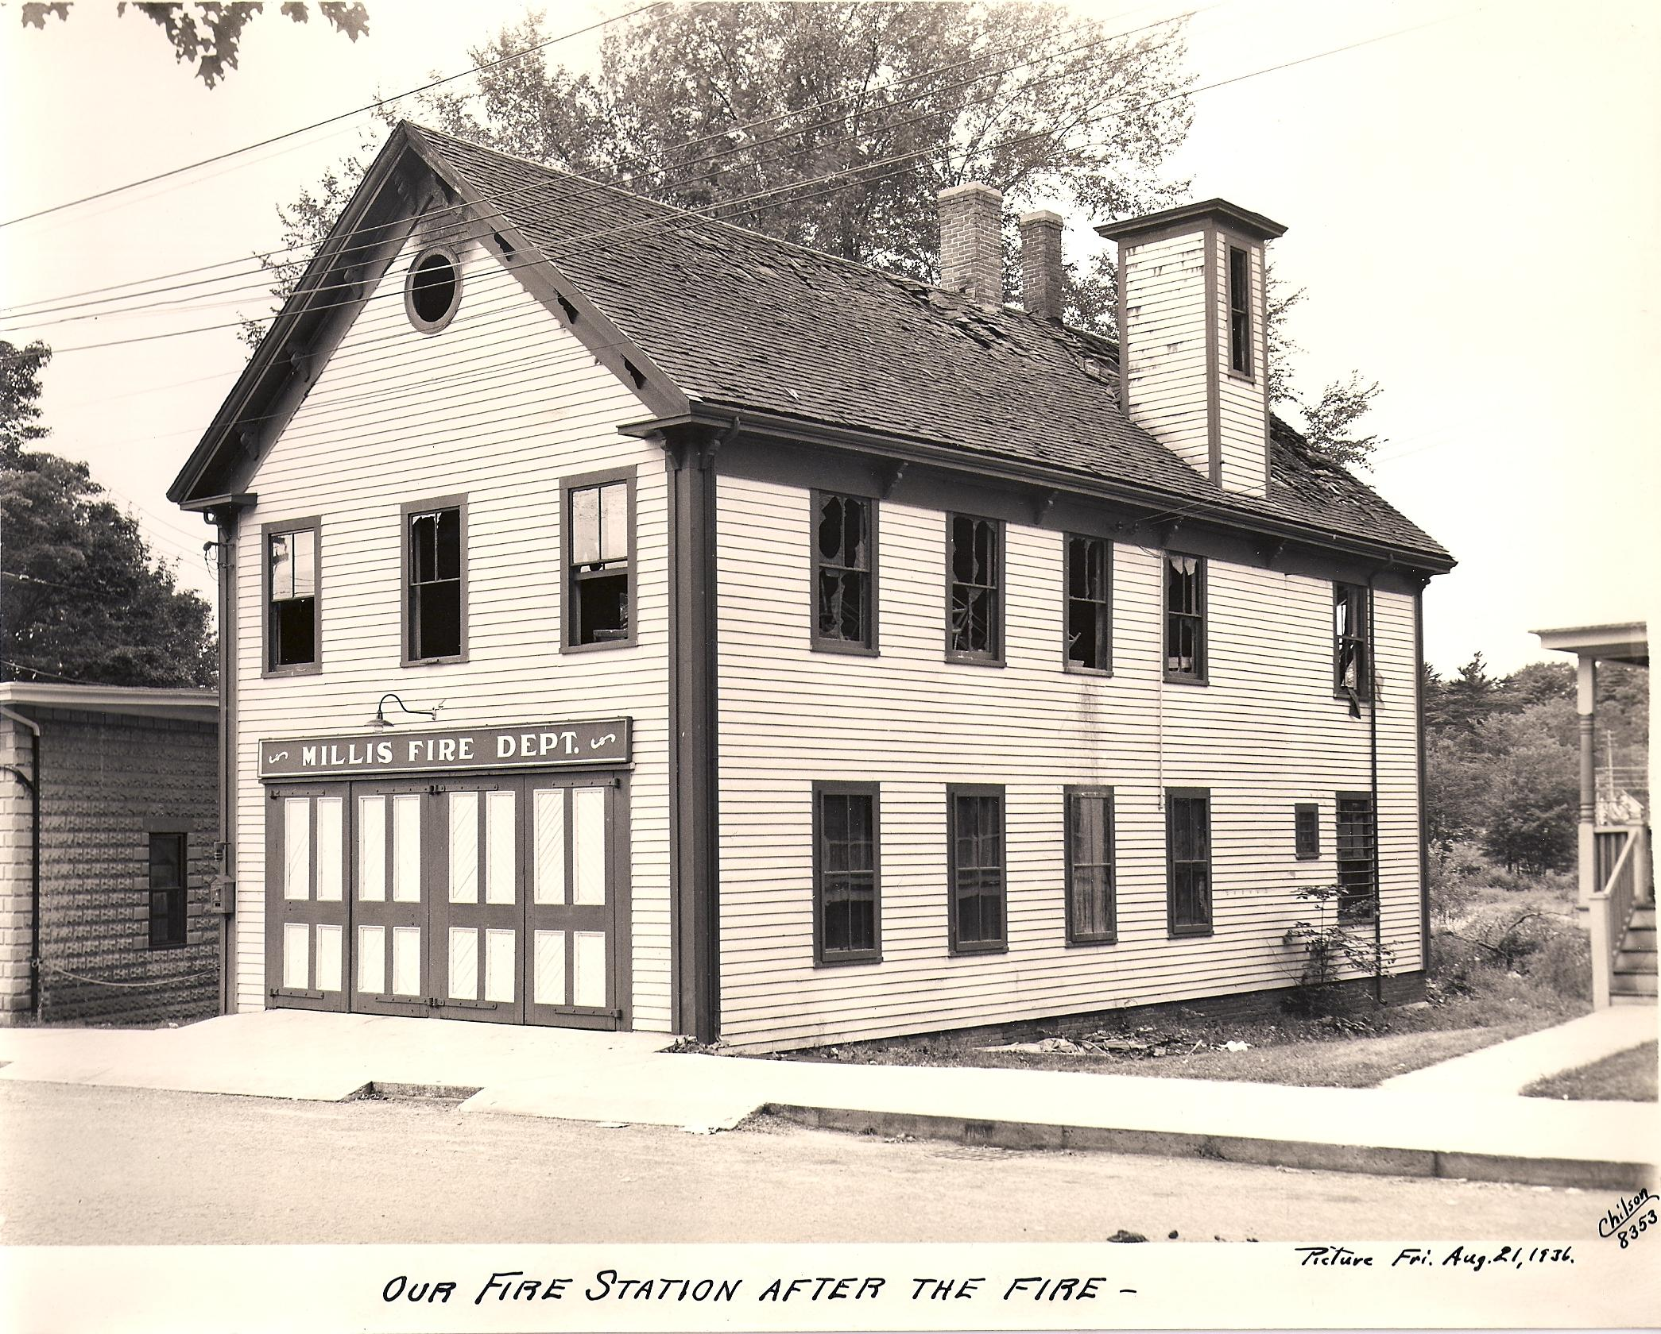
Notes:
Mention that jail was on fire, hose tower was in tact but extensive damage was done to the ceiling and rear of the building, which is still visible to this day (under the new drywall)

Slide 9
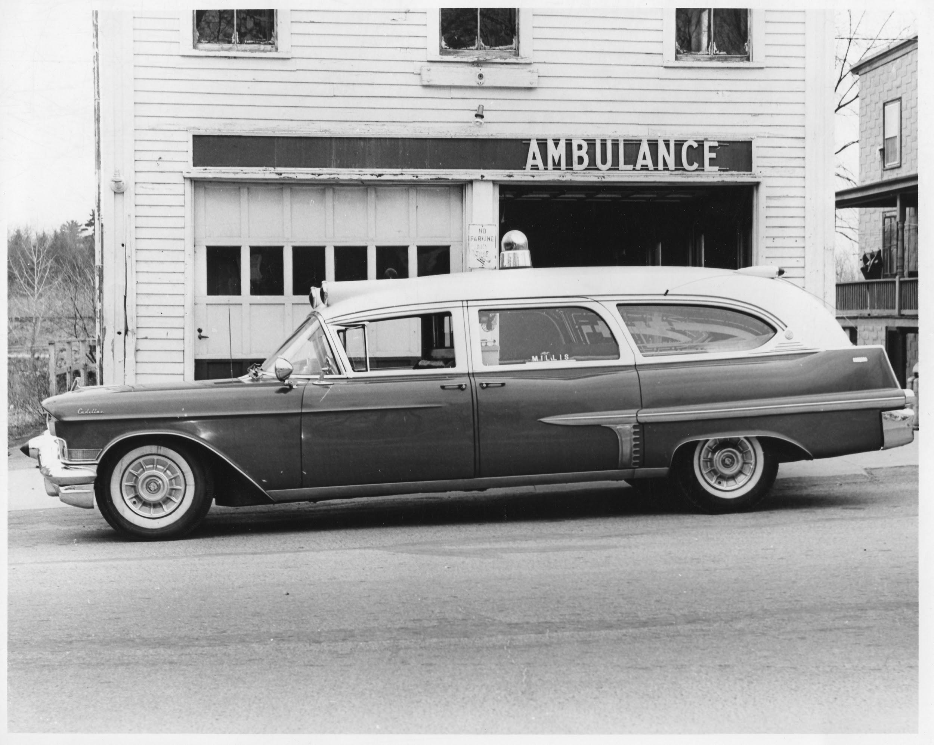
Notes:
Another use of the building. The folding doors were removed and two sliding garage doors were installed.

Slide 10
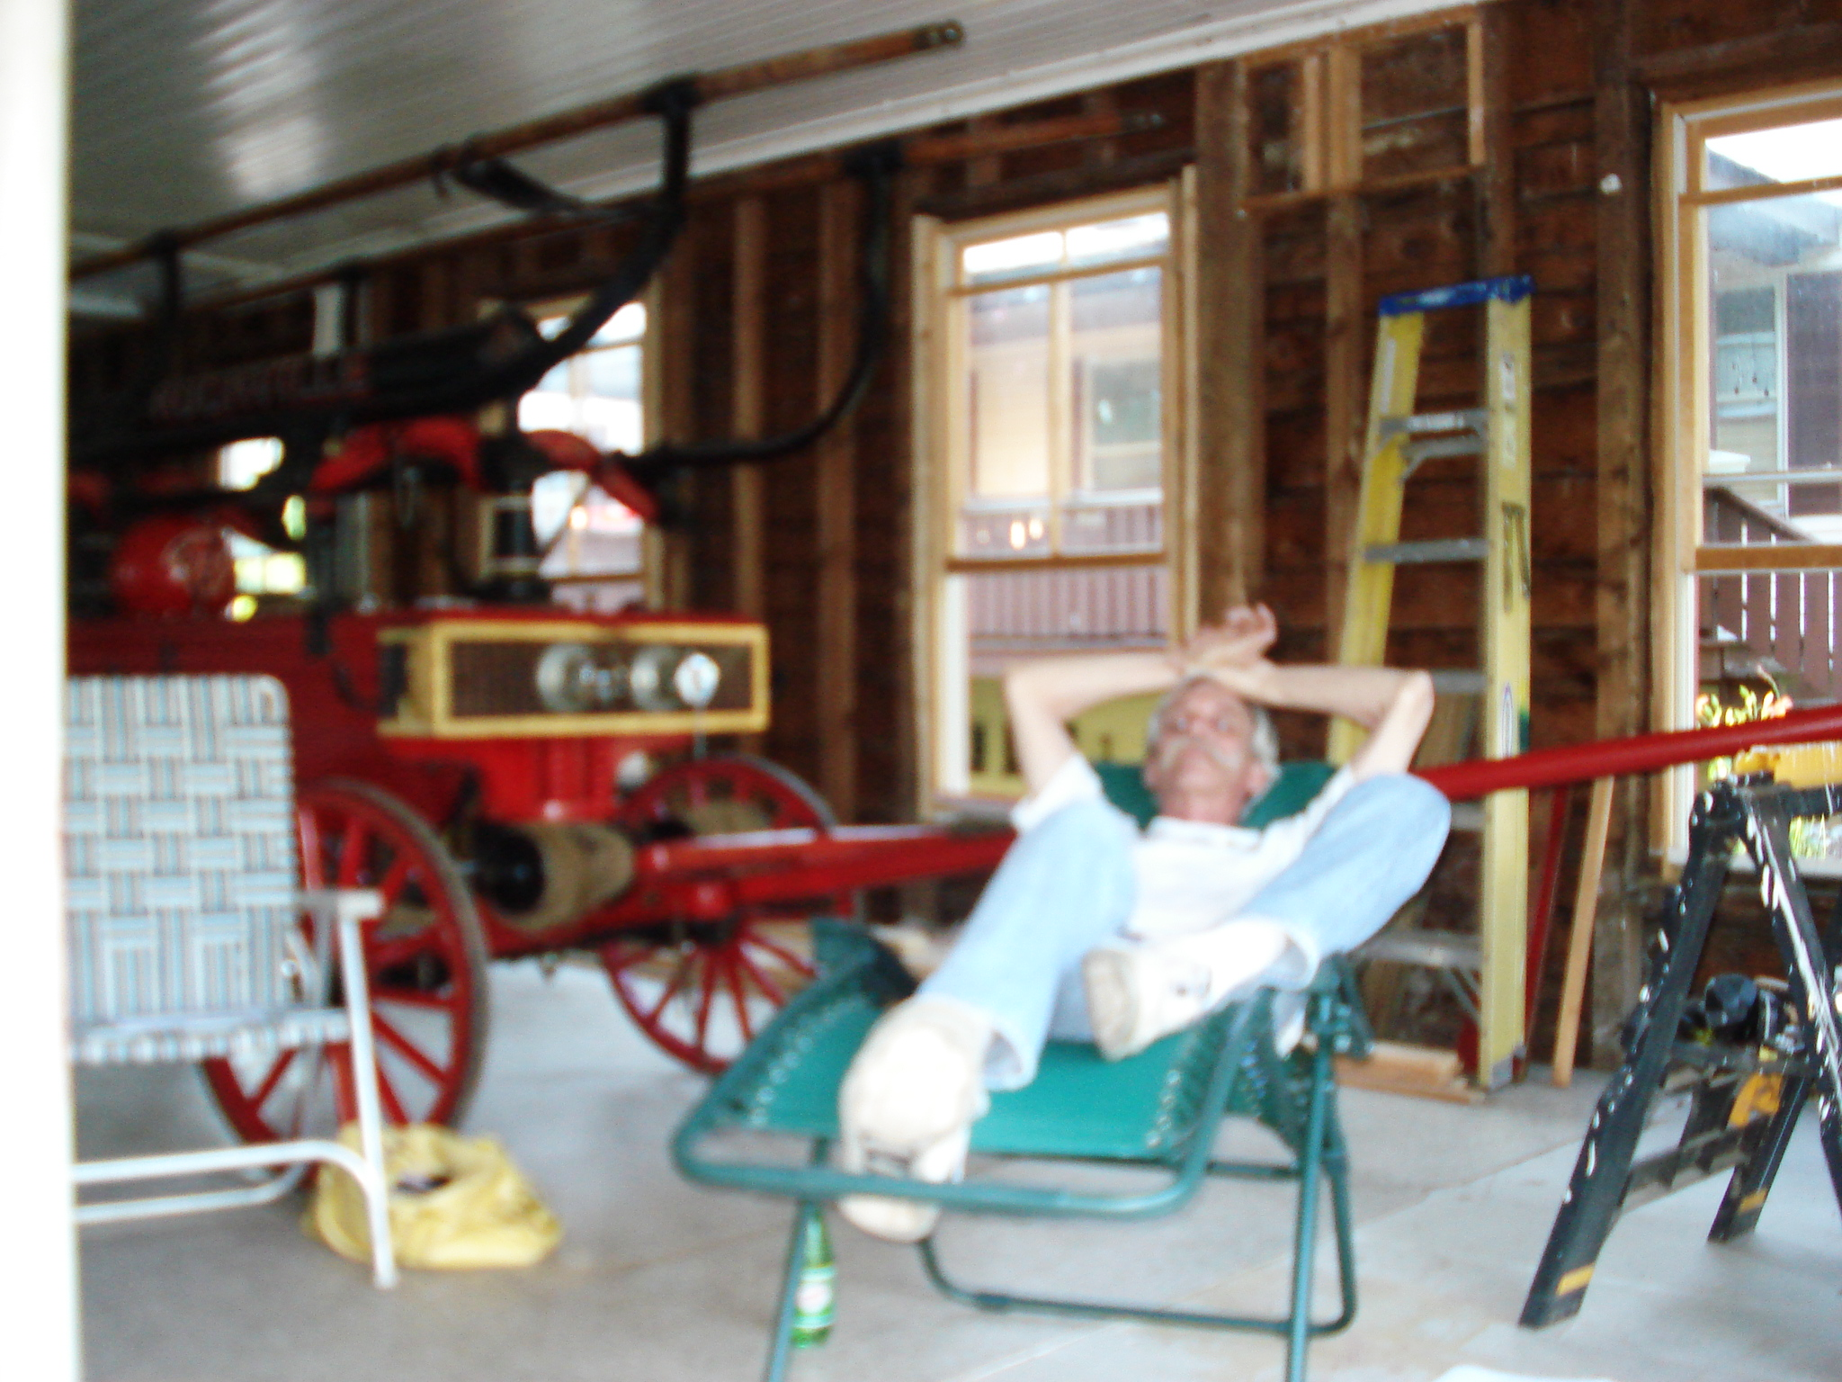
Mr. Jeff Hardin
Notes:
This entire process would’ve never taken place had Jeff Hardin not had the vision and dream to restore Niagara Hall to its original glory. Although Jeff passed away before the completion, I vowed to him that I would take on the job and that it would be completed.

Slide 11
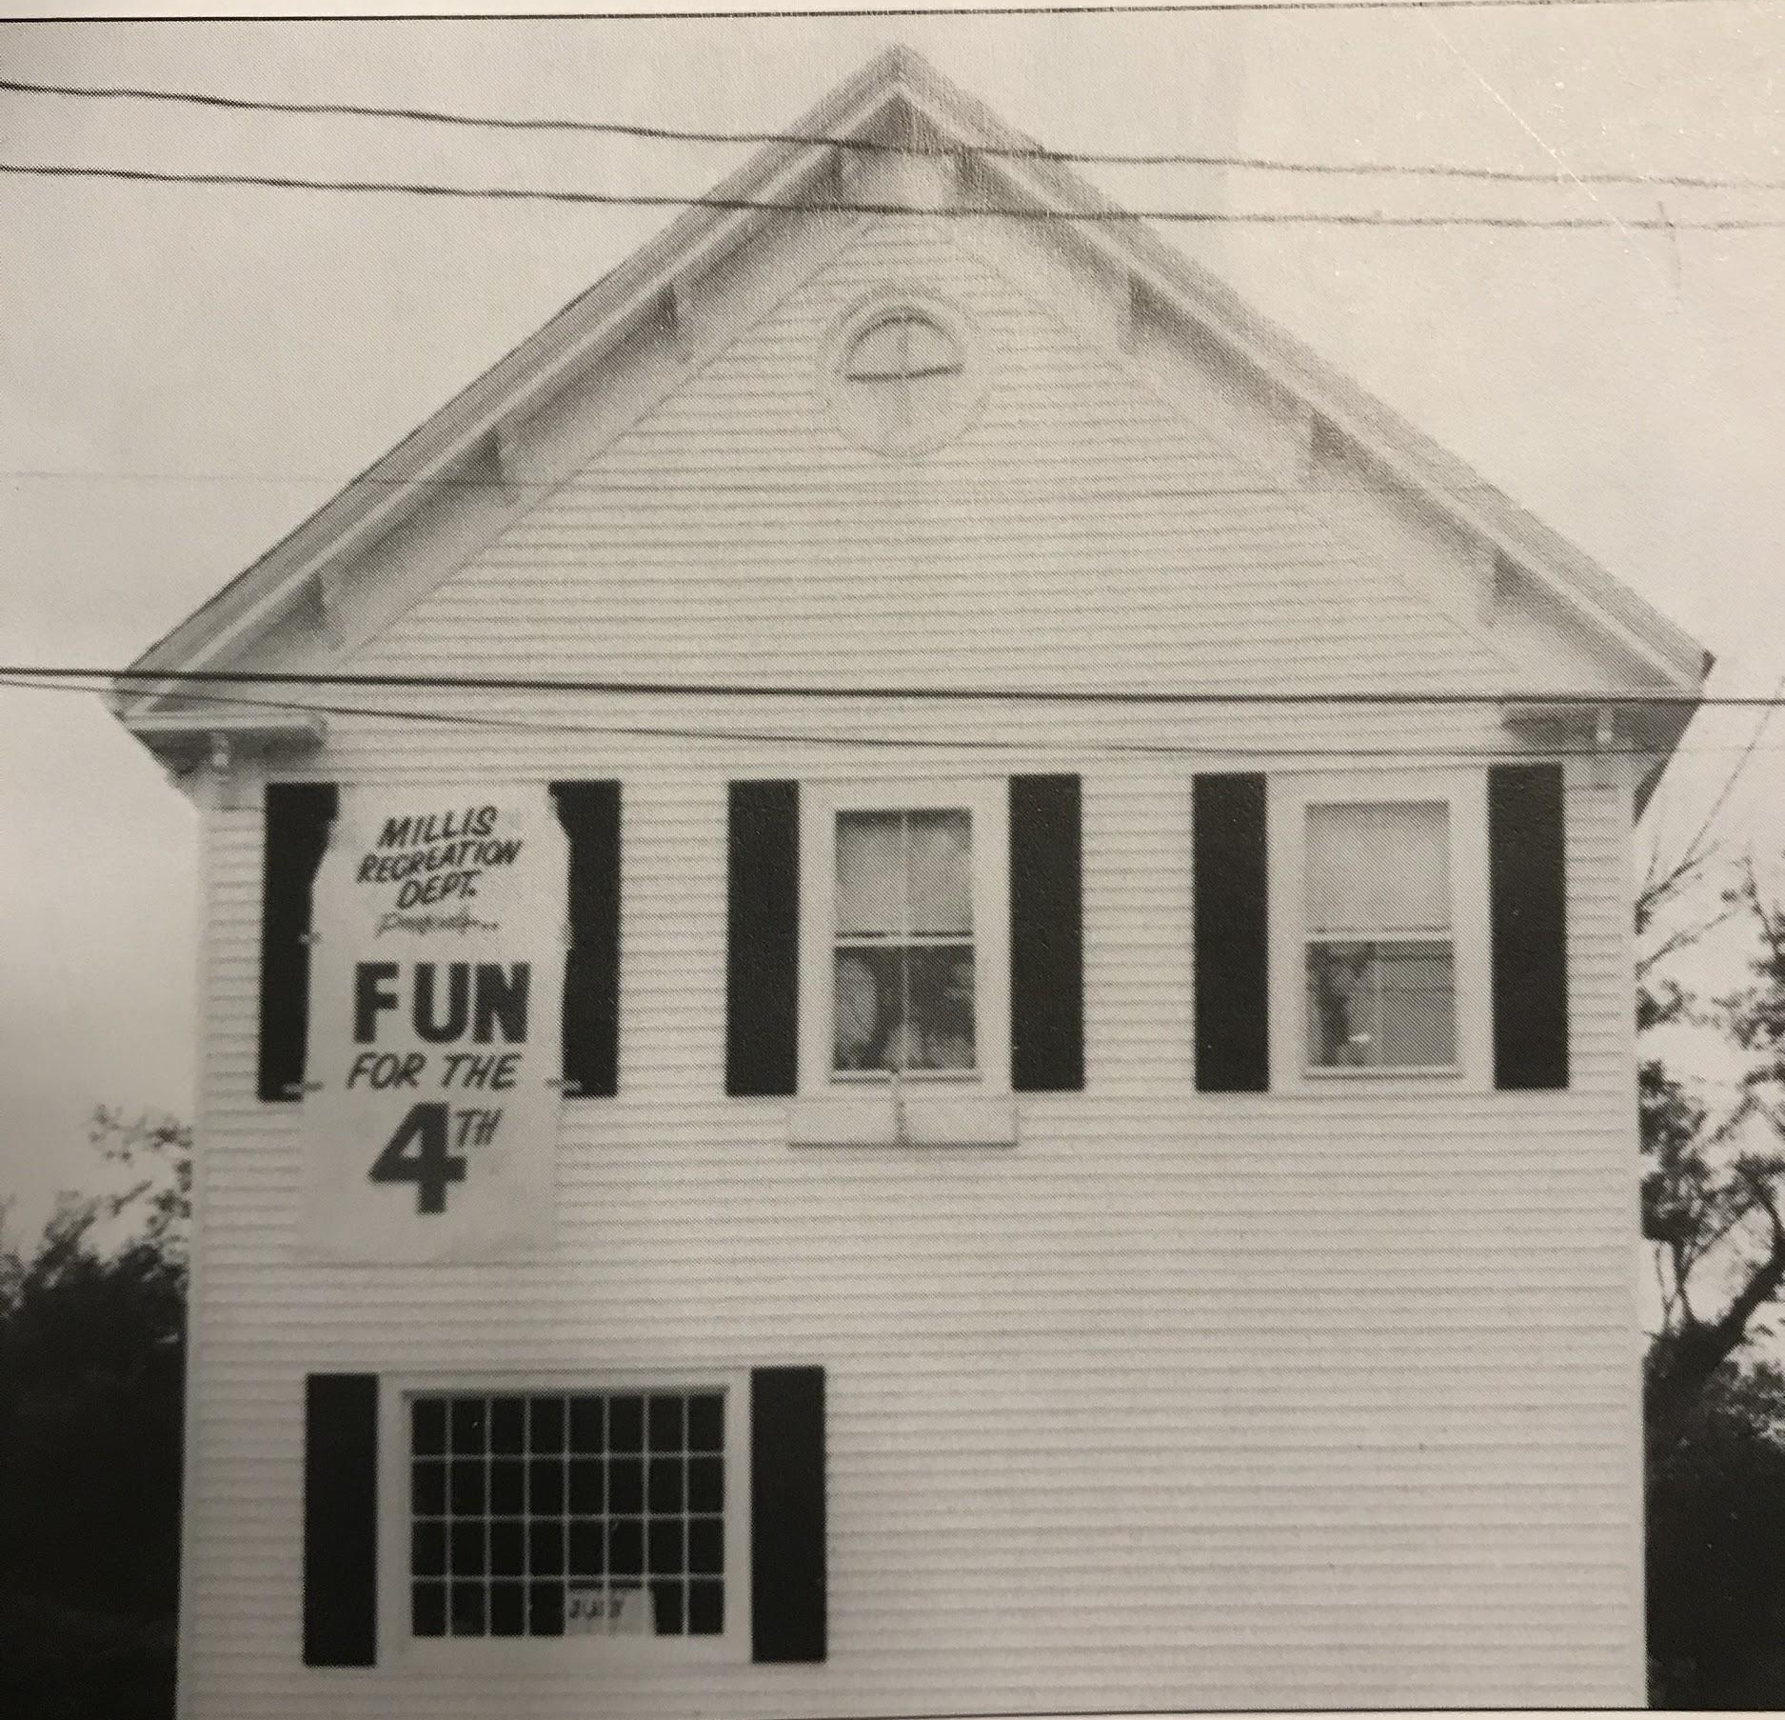
1978
Notes:
1978 the town remodeled the building for offices and replaced the double doors with a window. These offices then moved to the veterans memorial building in 1997 and then

Slide 12
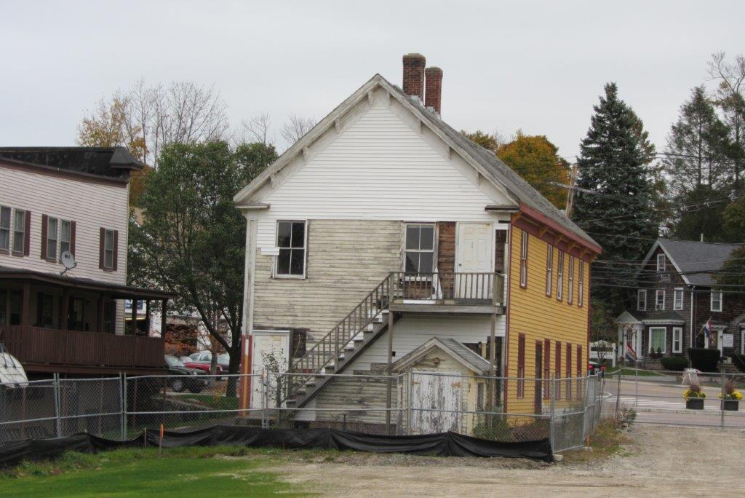

Slide 13
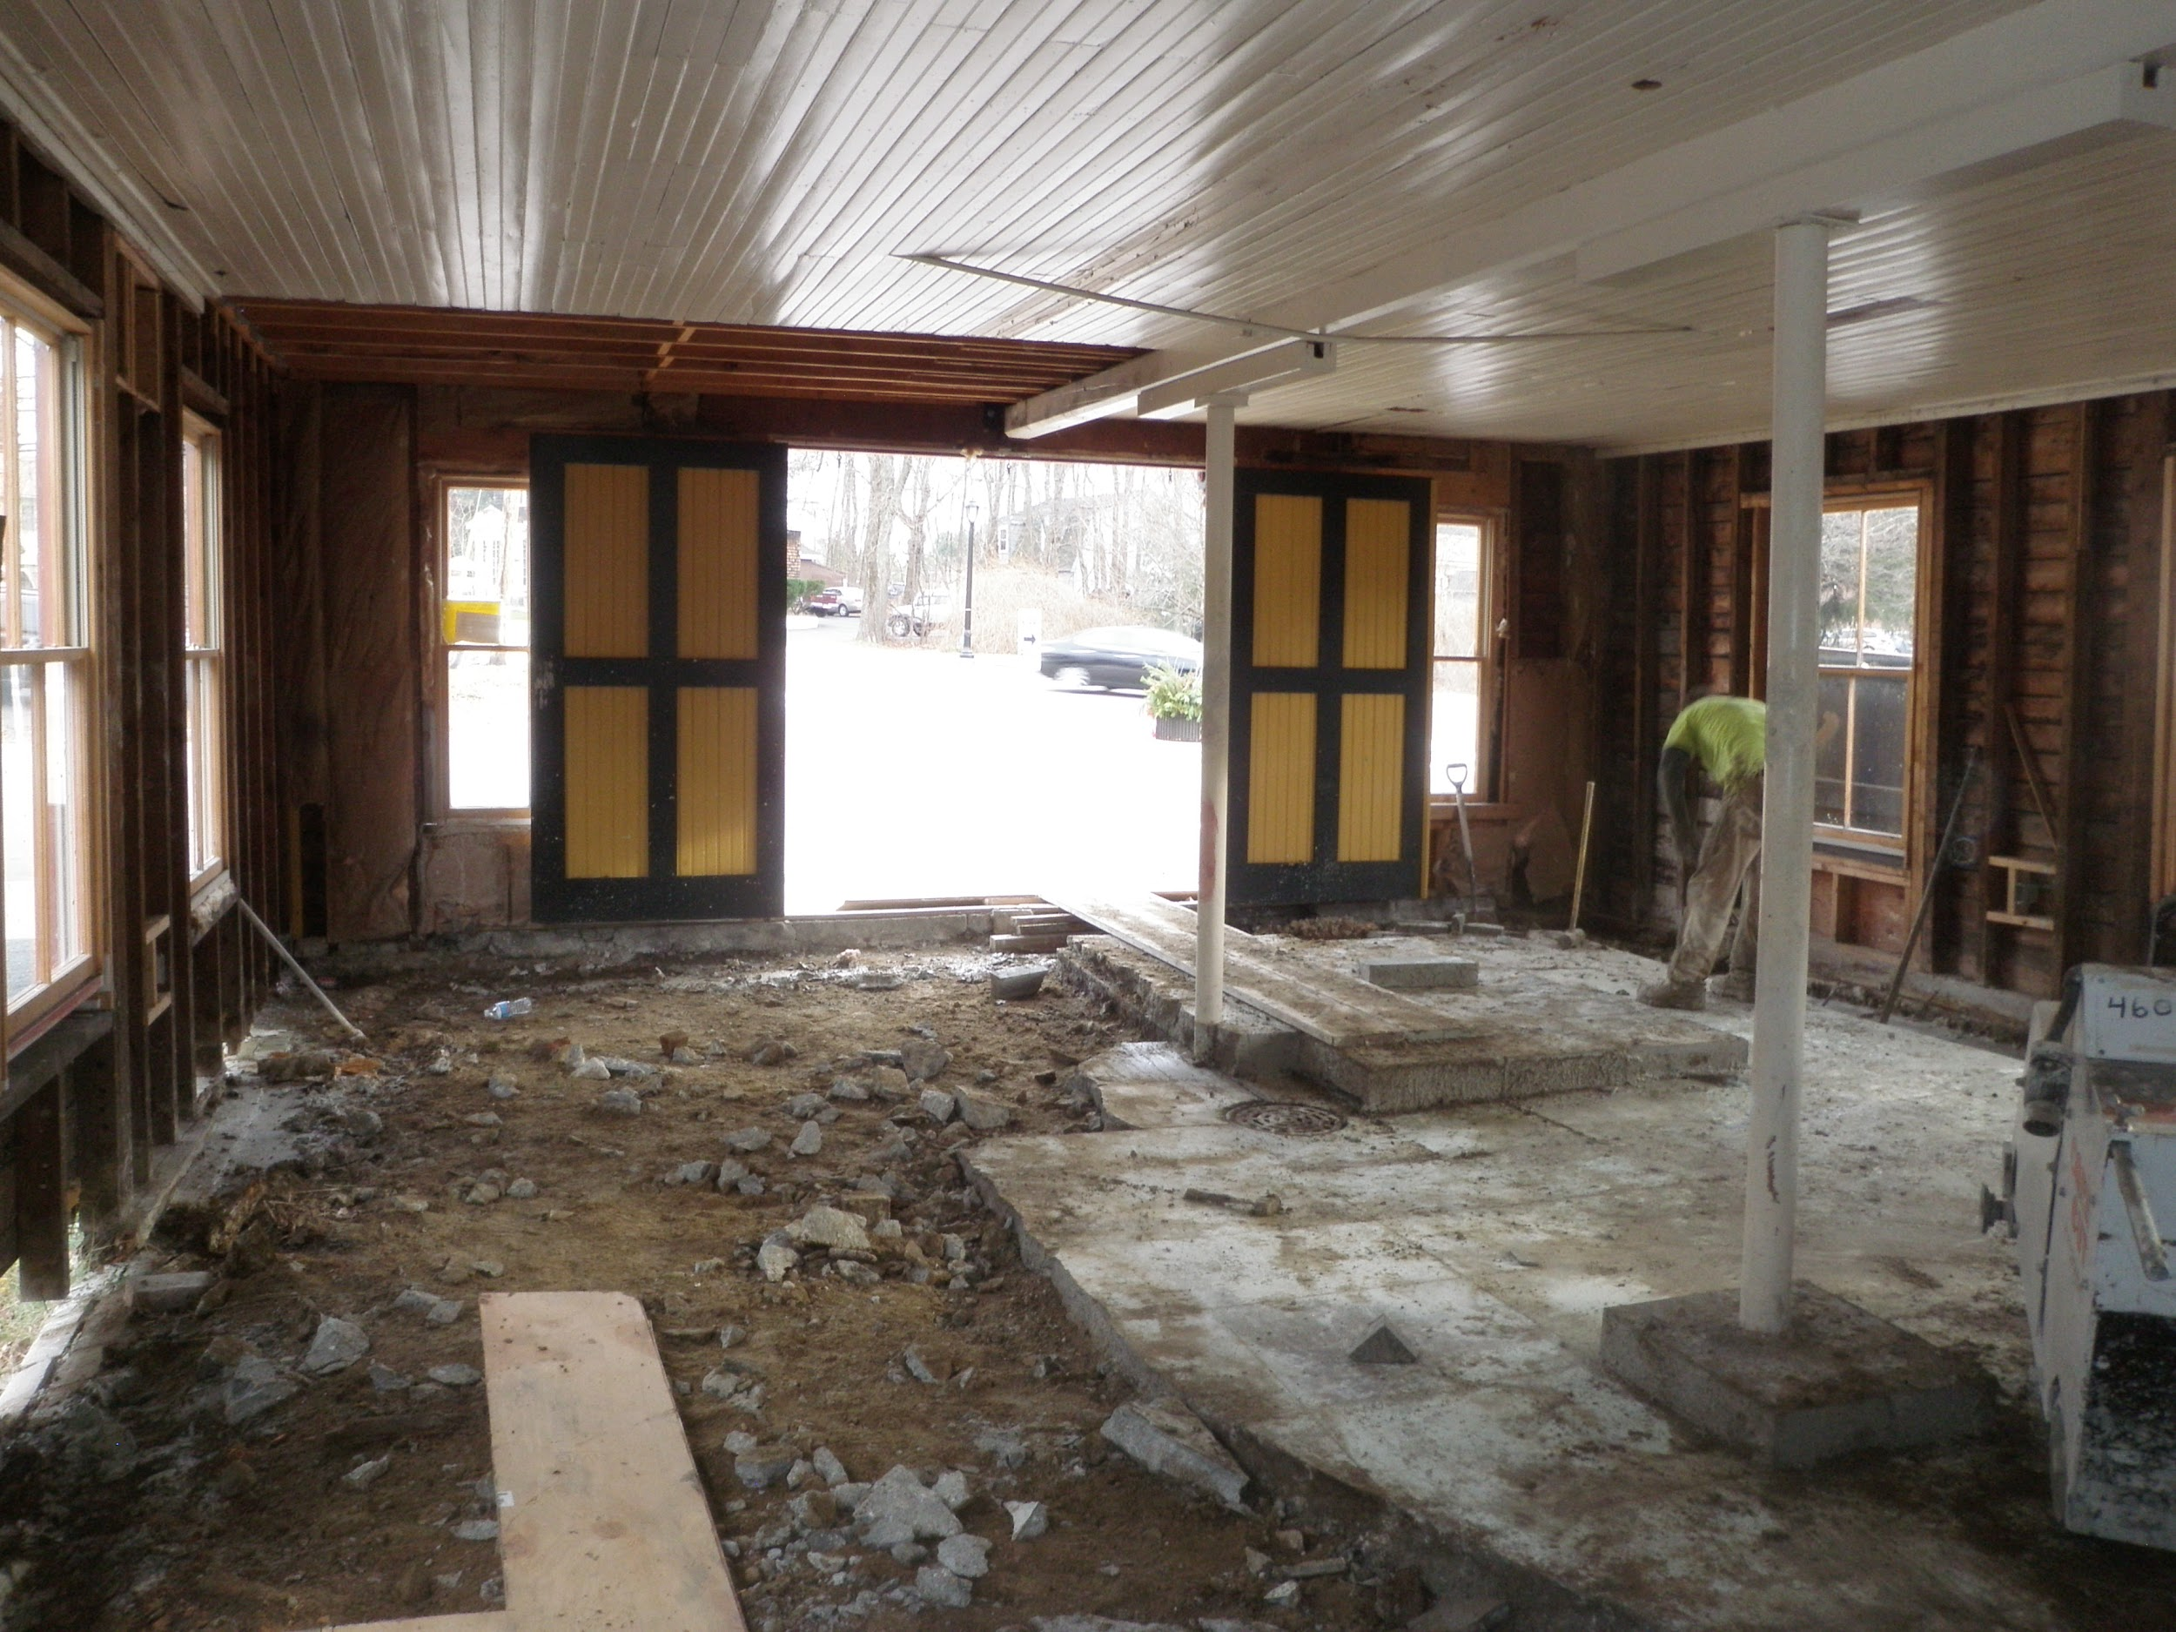

Slide 14
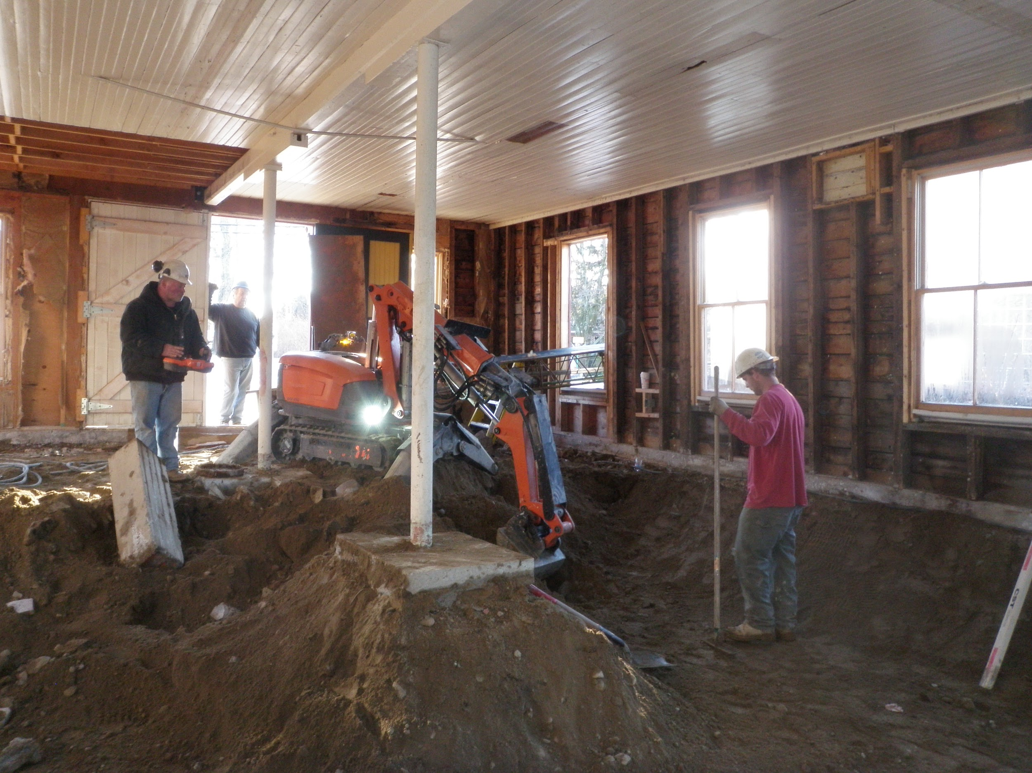

Slide 15
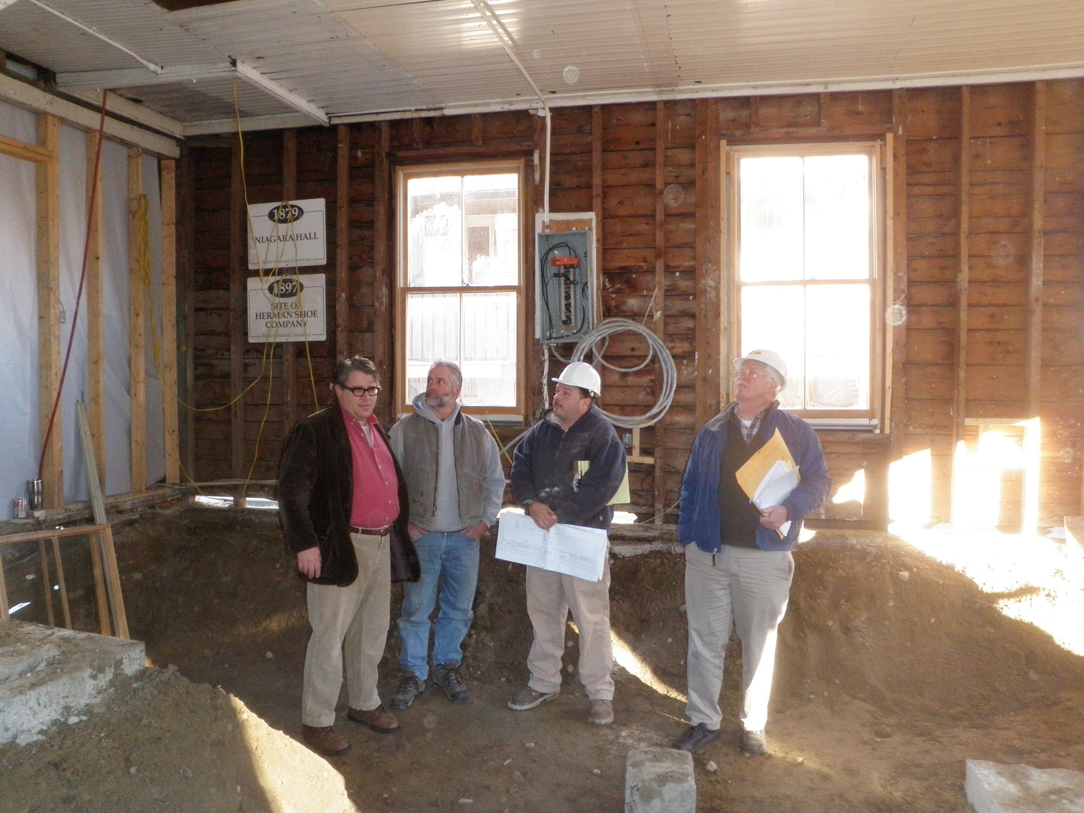

Slide 16
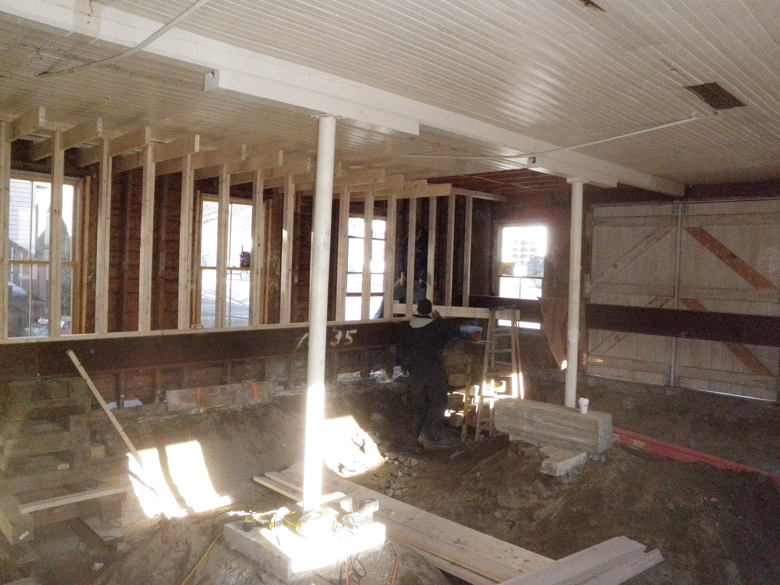

Slide 17
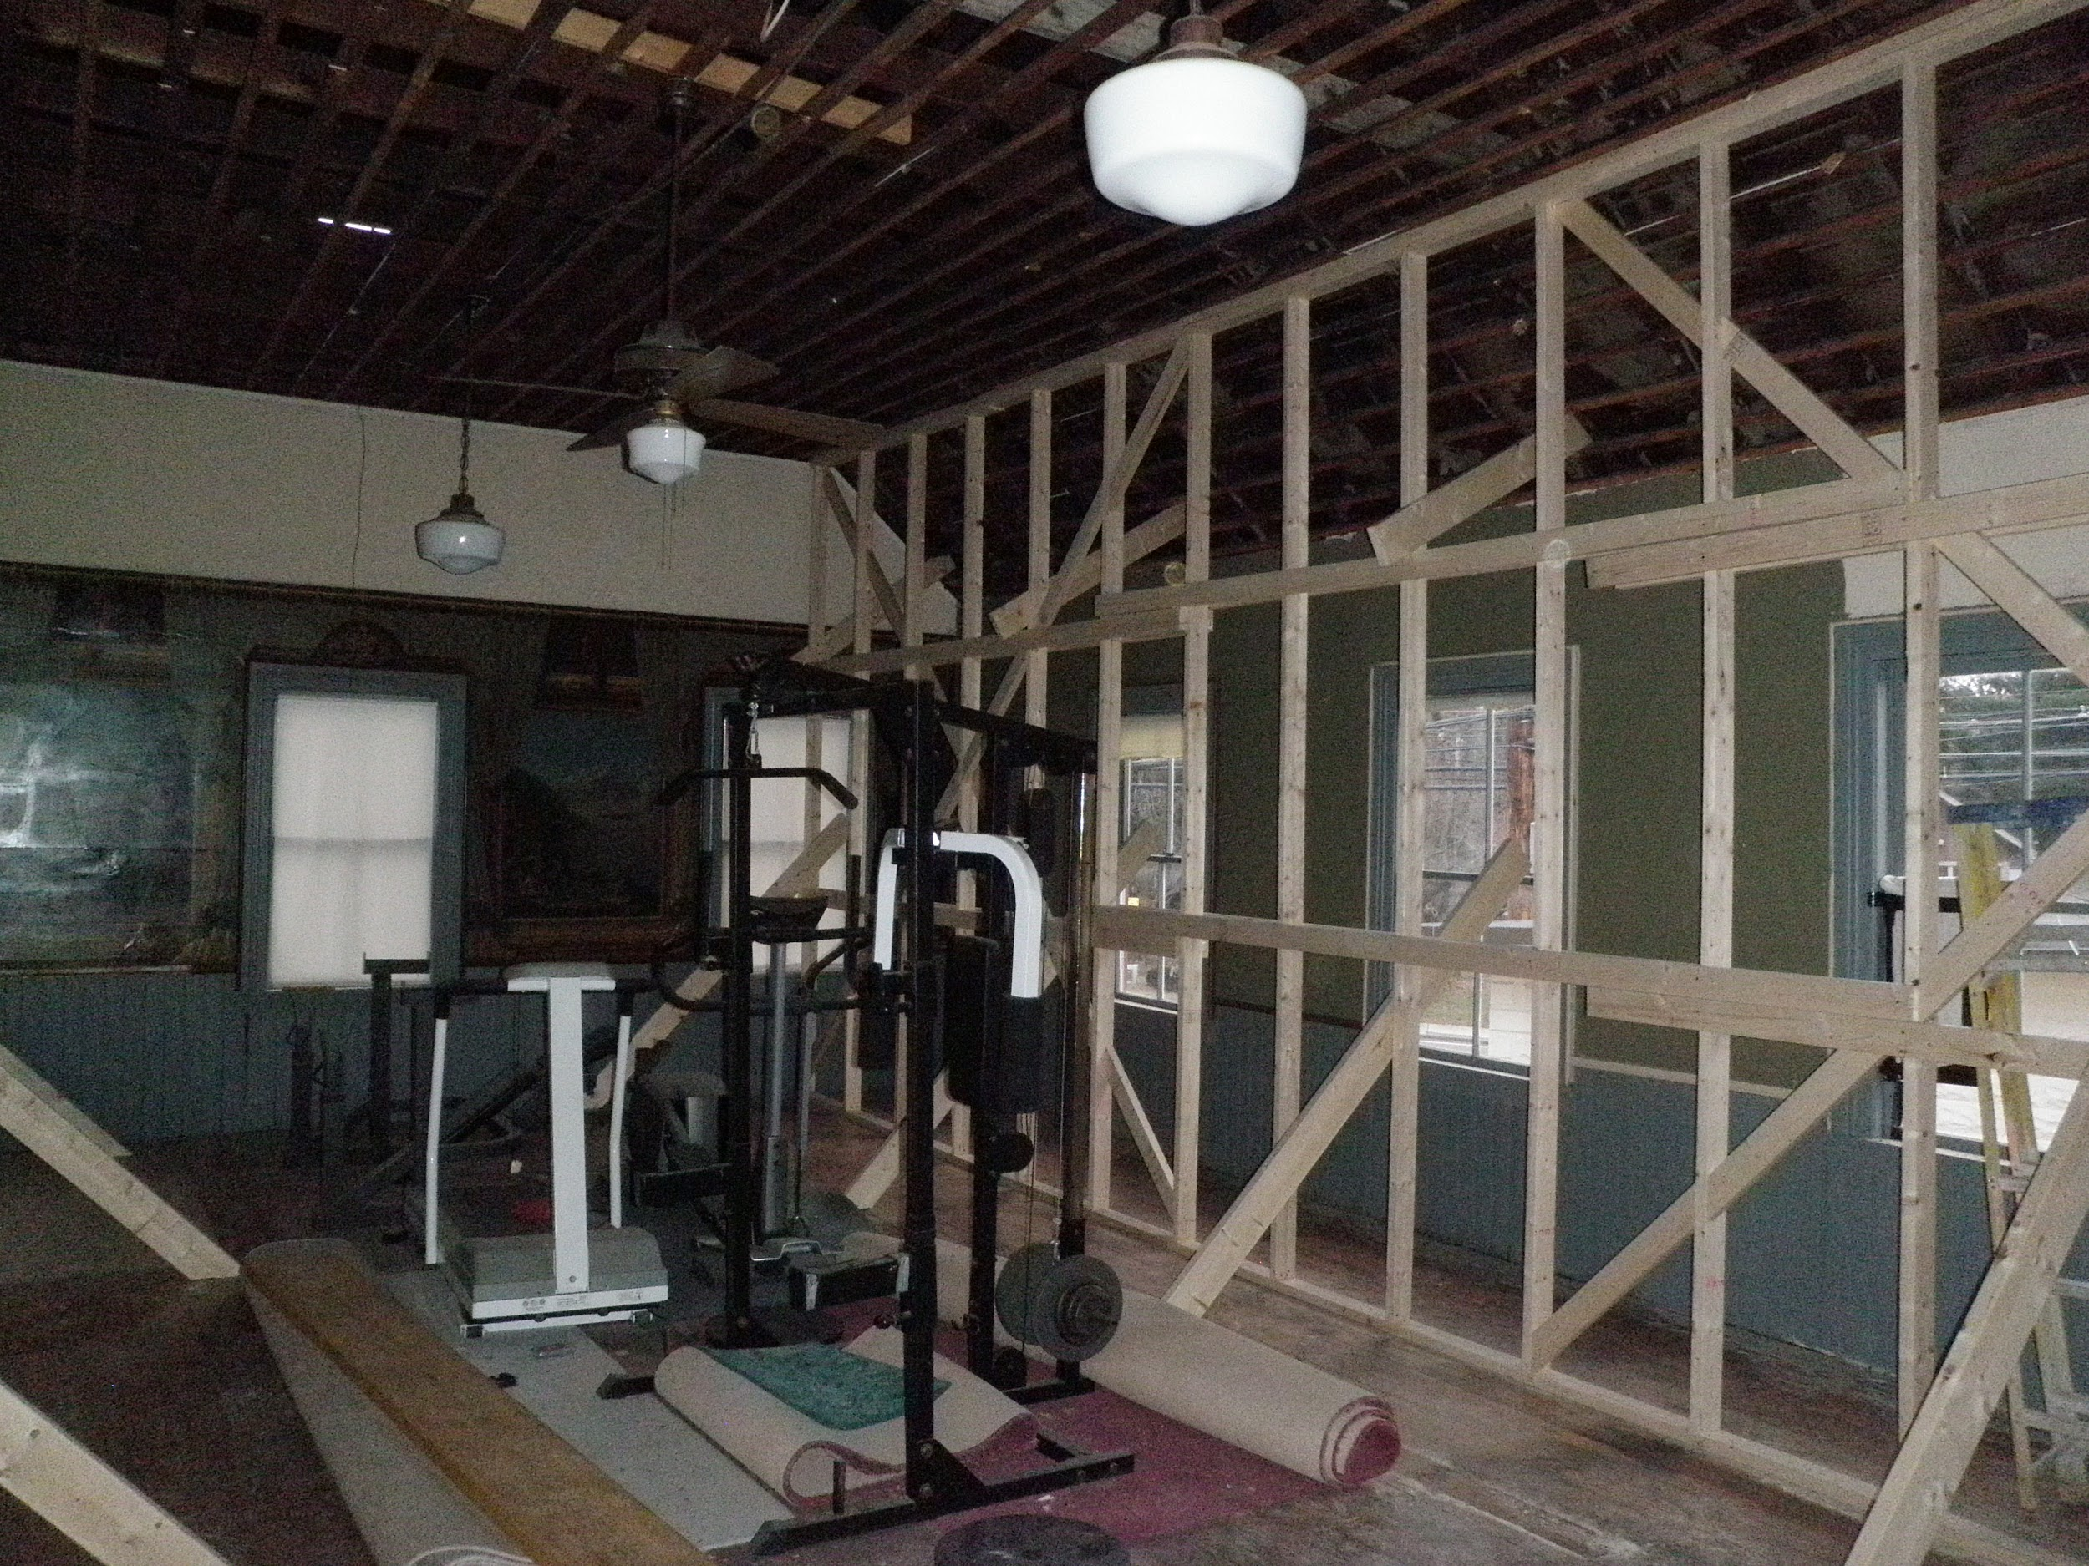

Slide 18
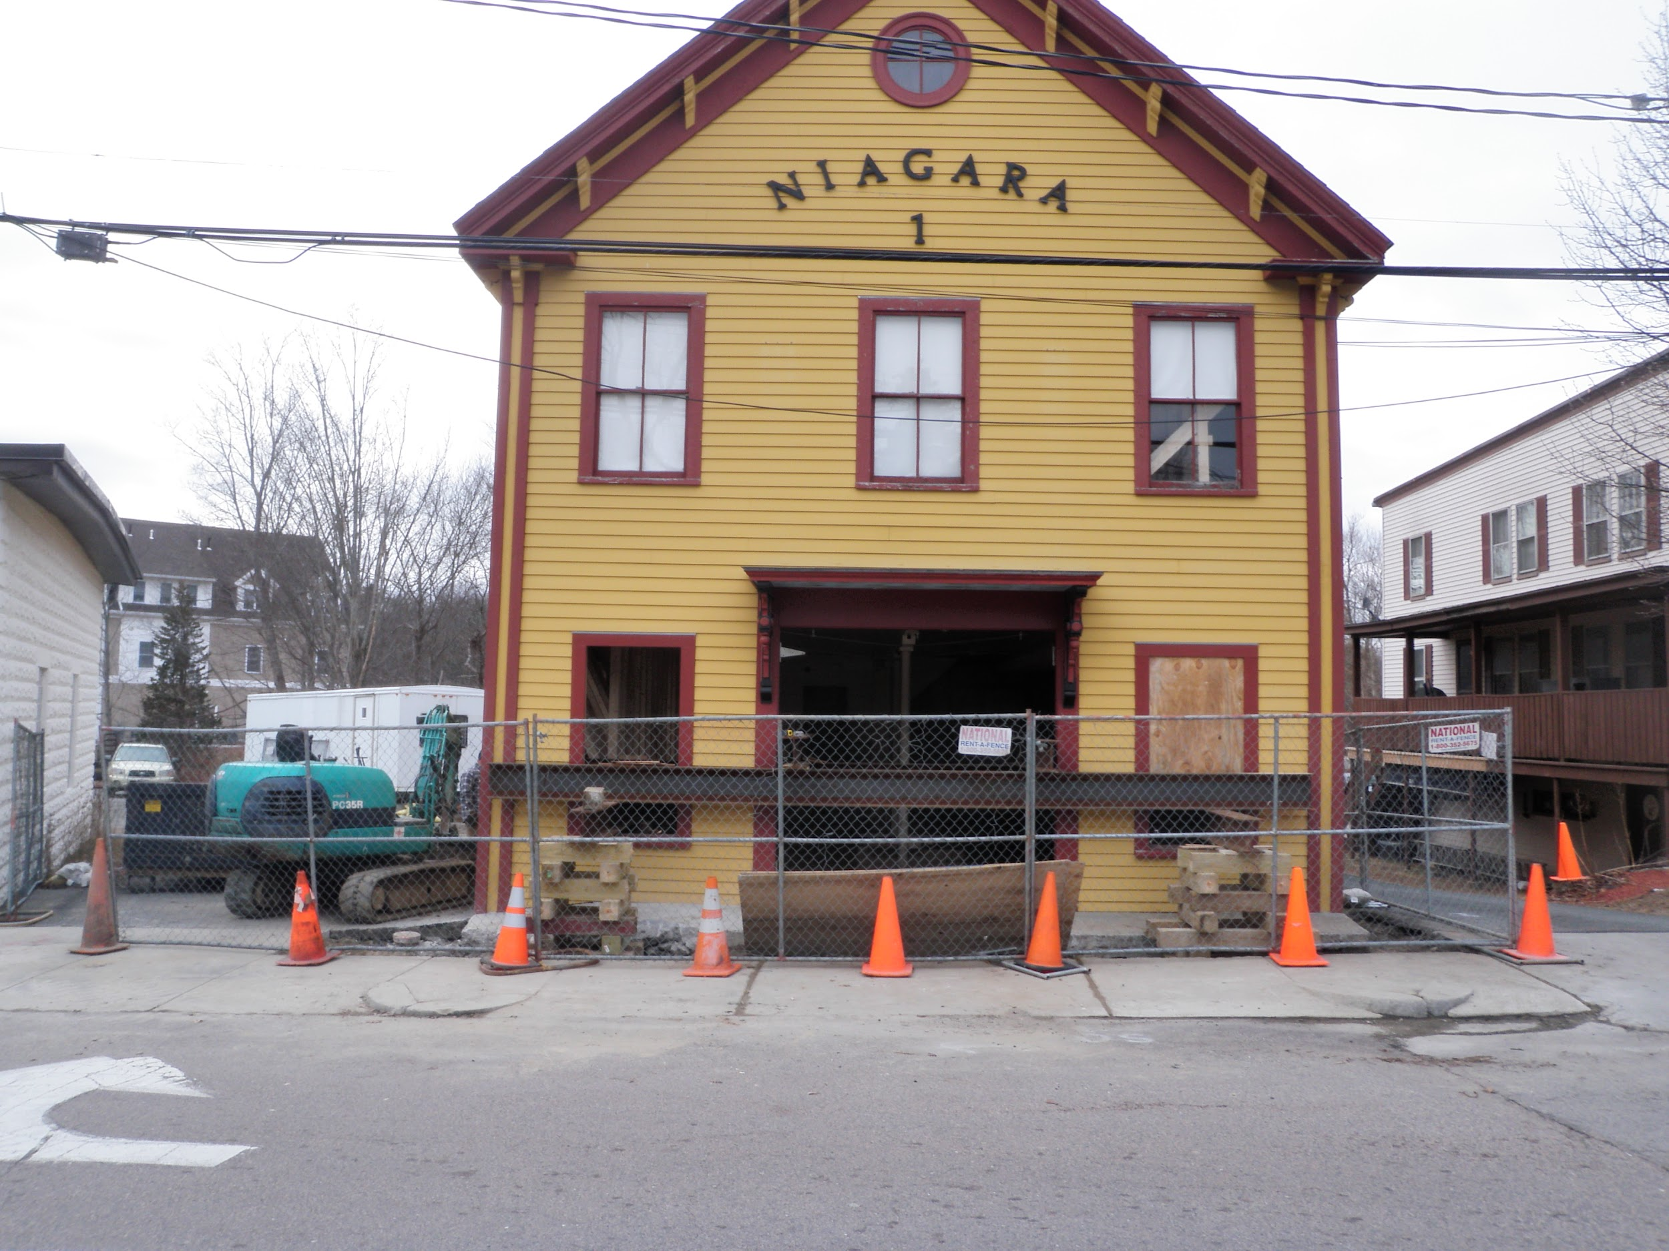

Slide 19
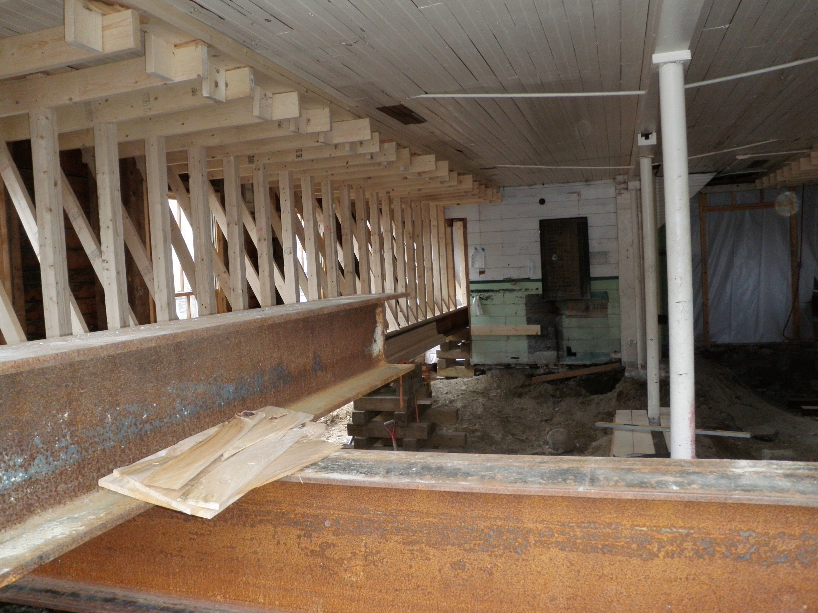

Slide 20
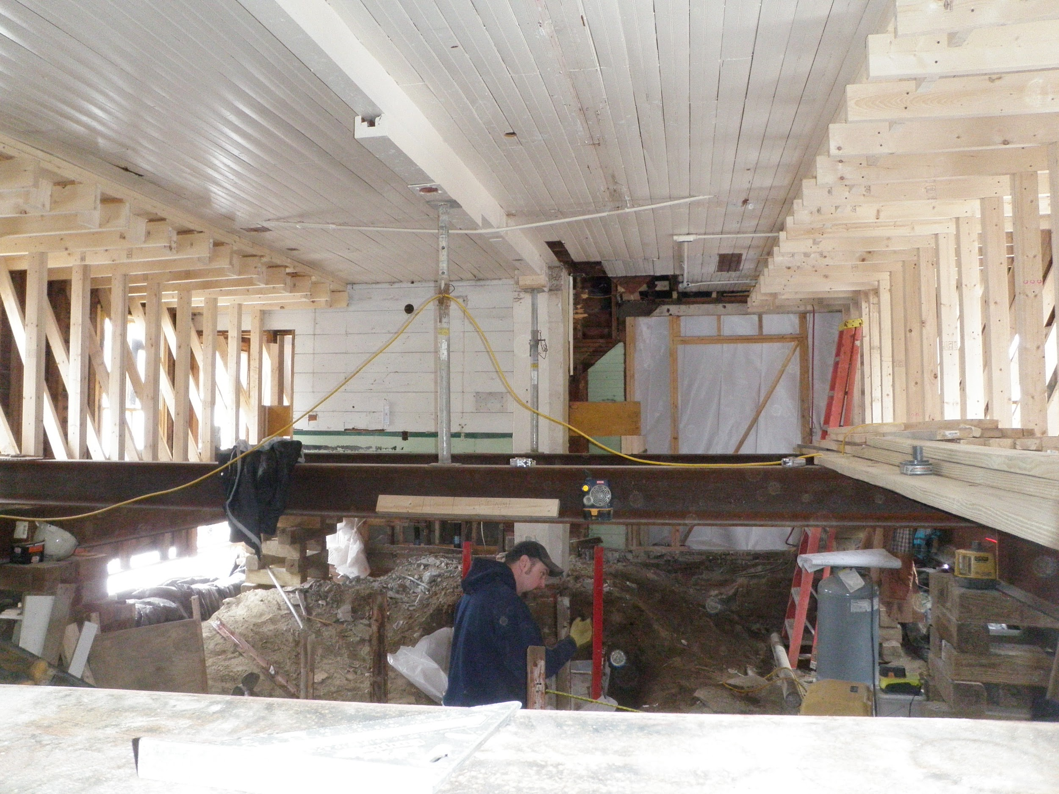

Slide 21
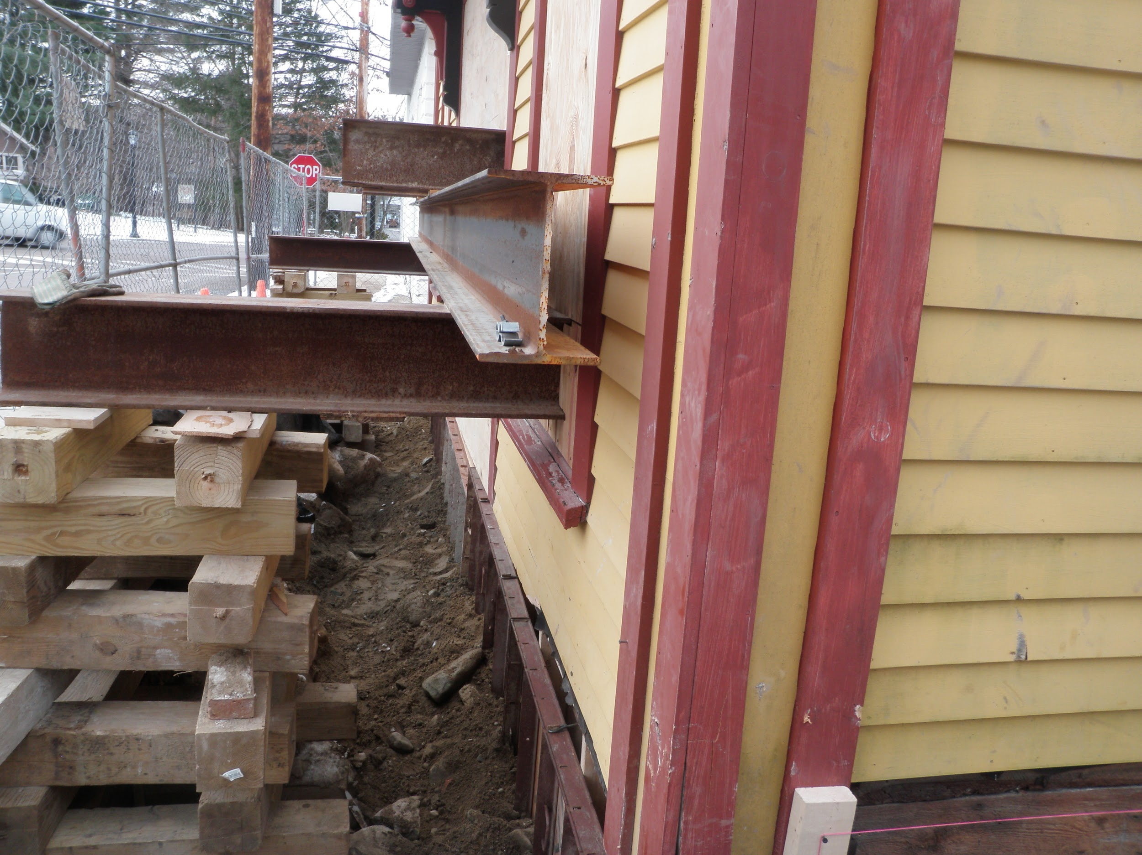
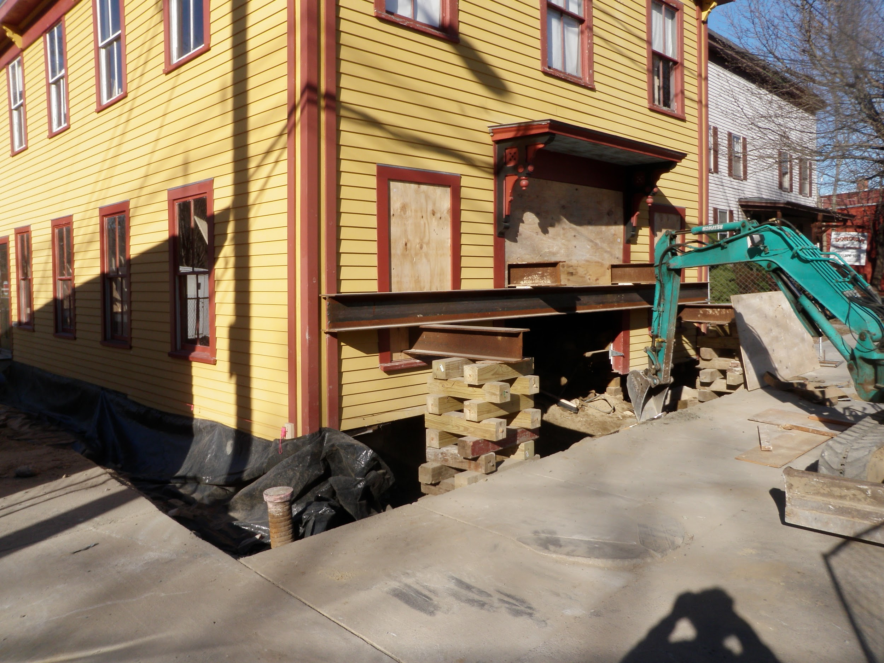

Slide 22
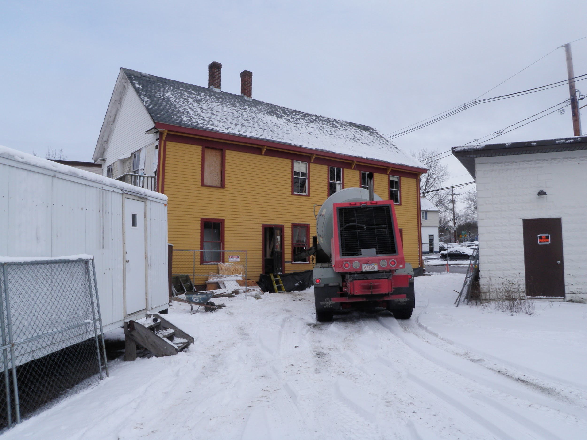

Slide 23
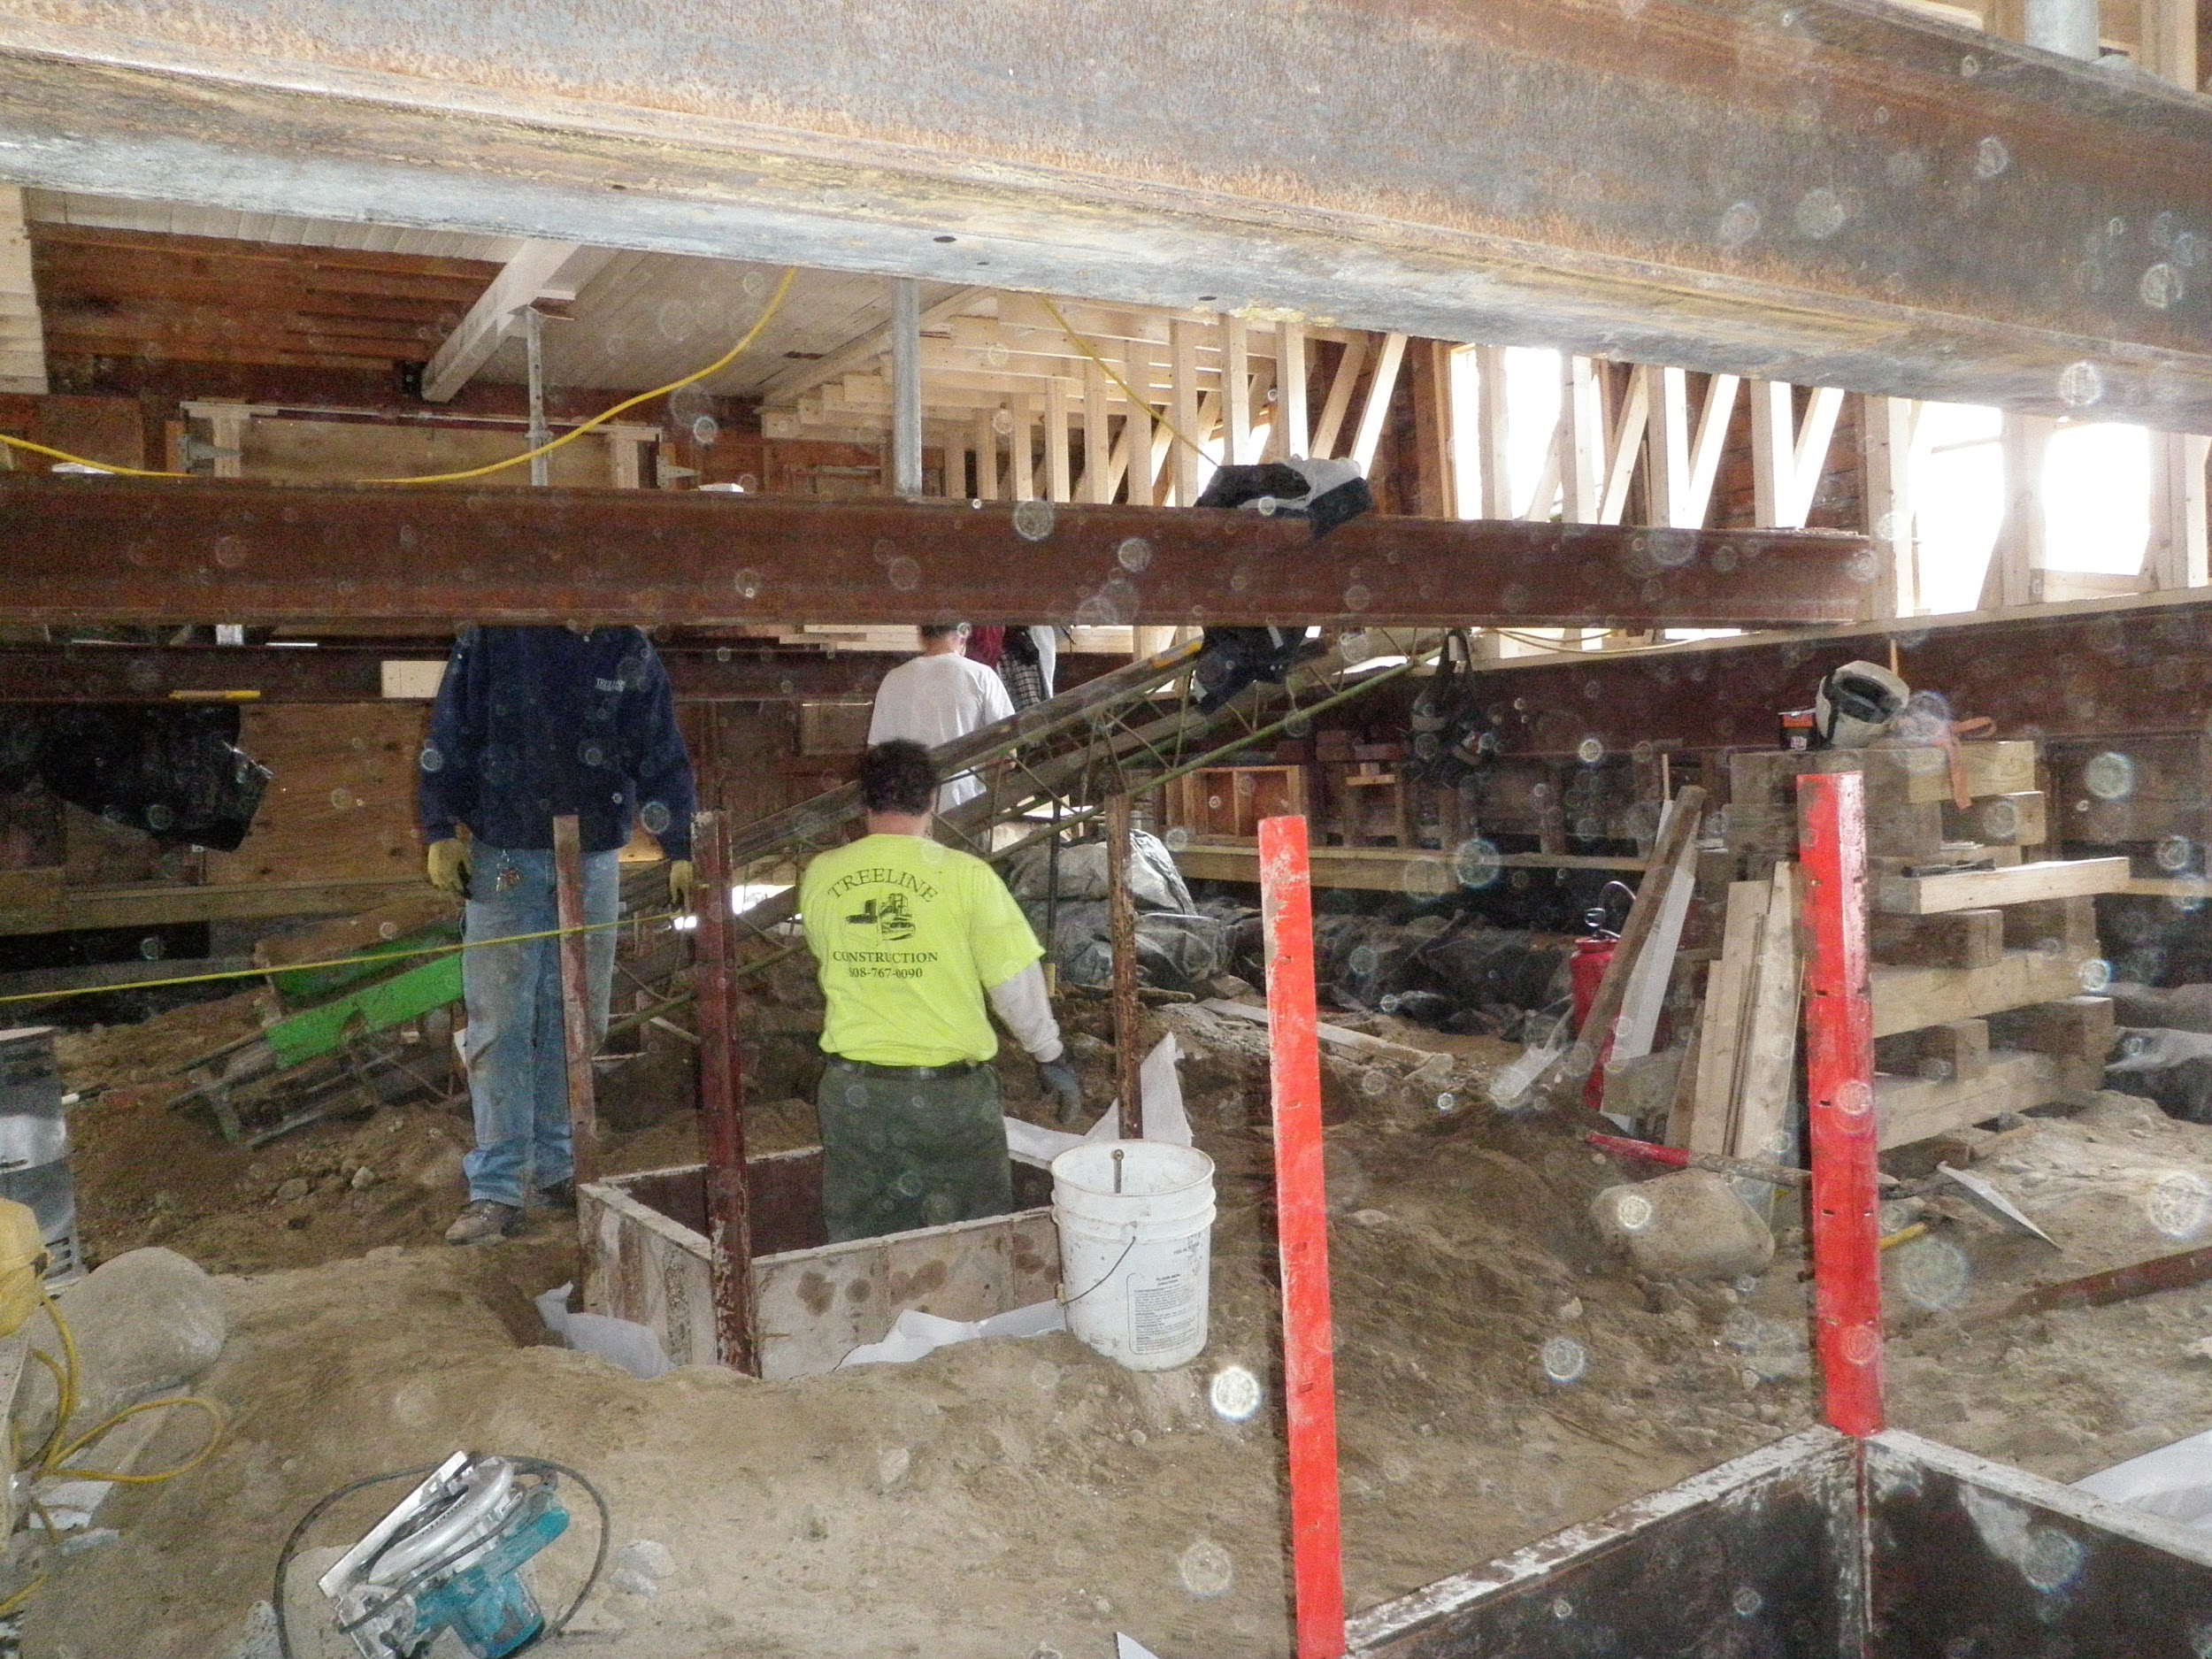

Slide 24
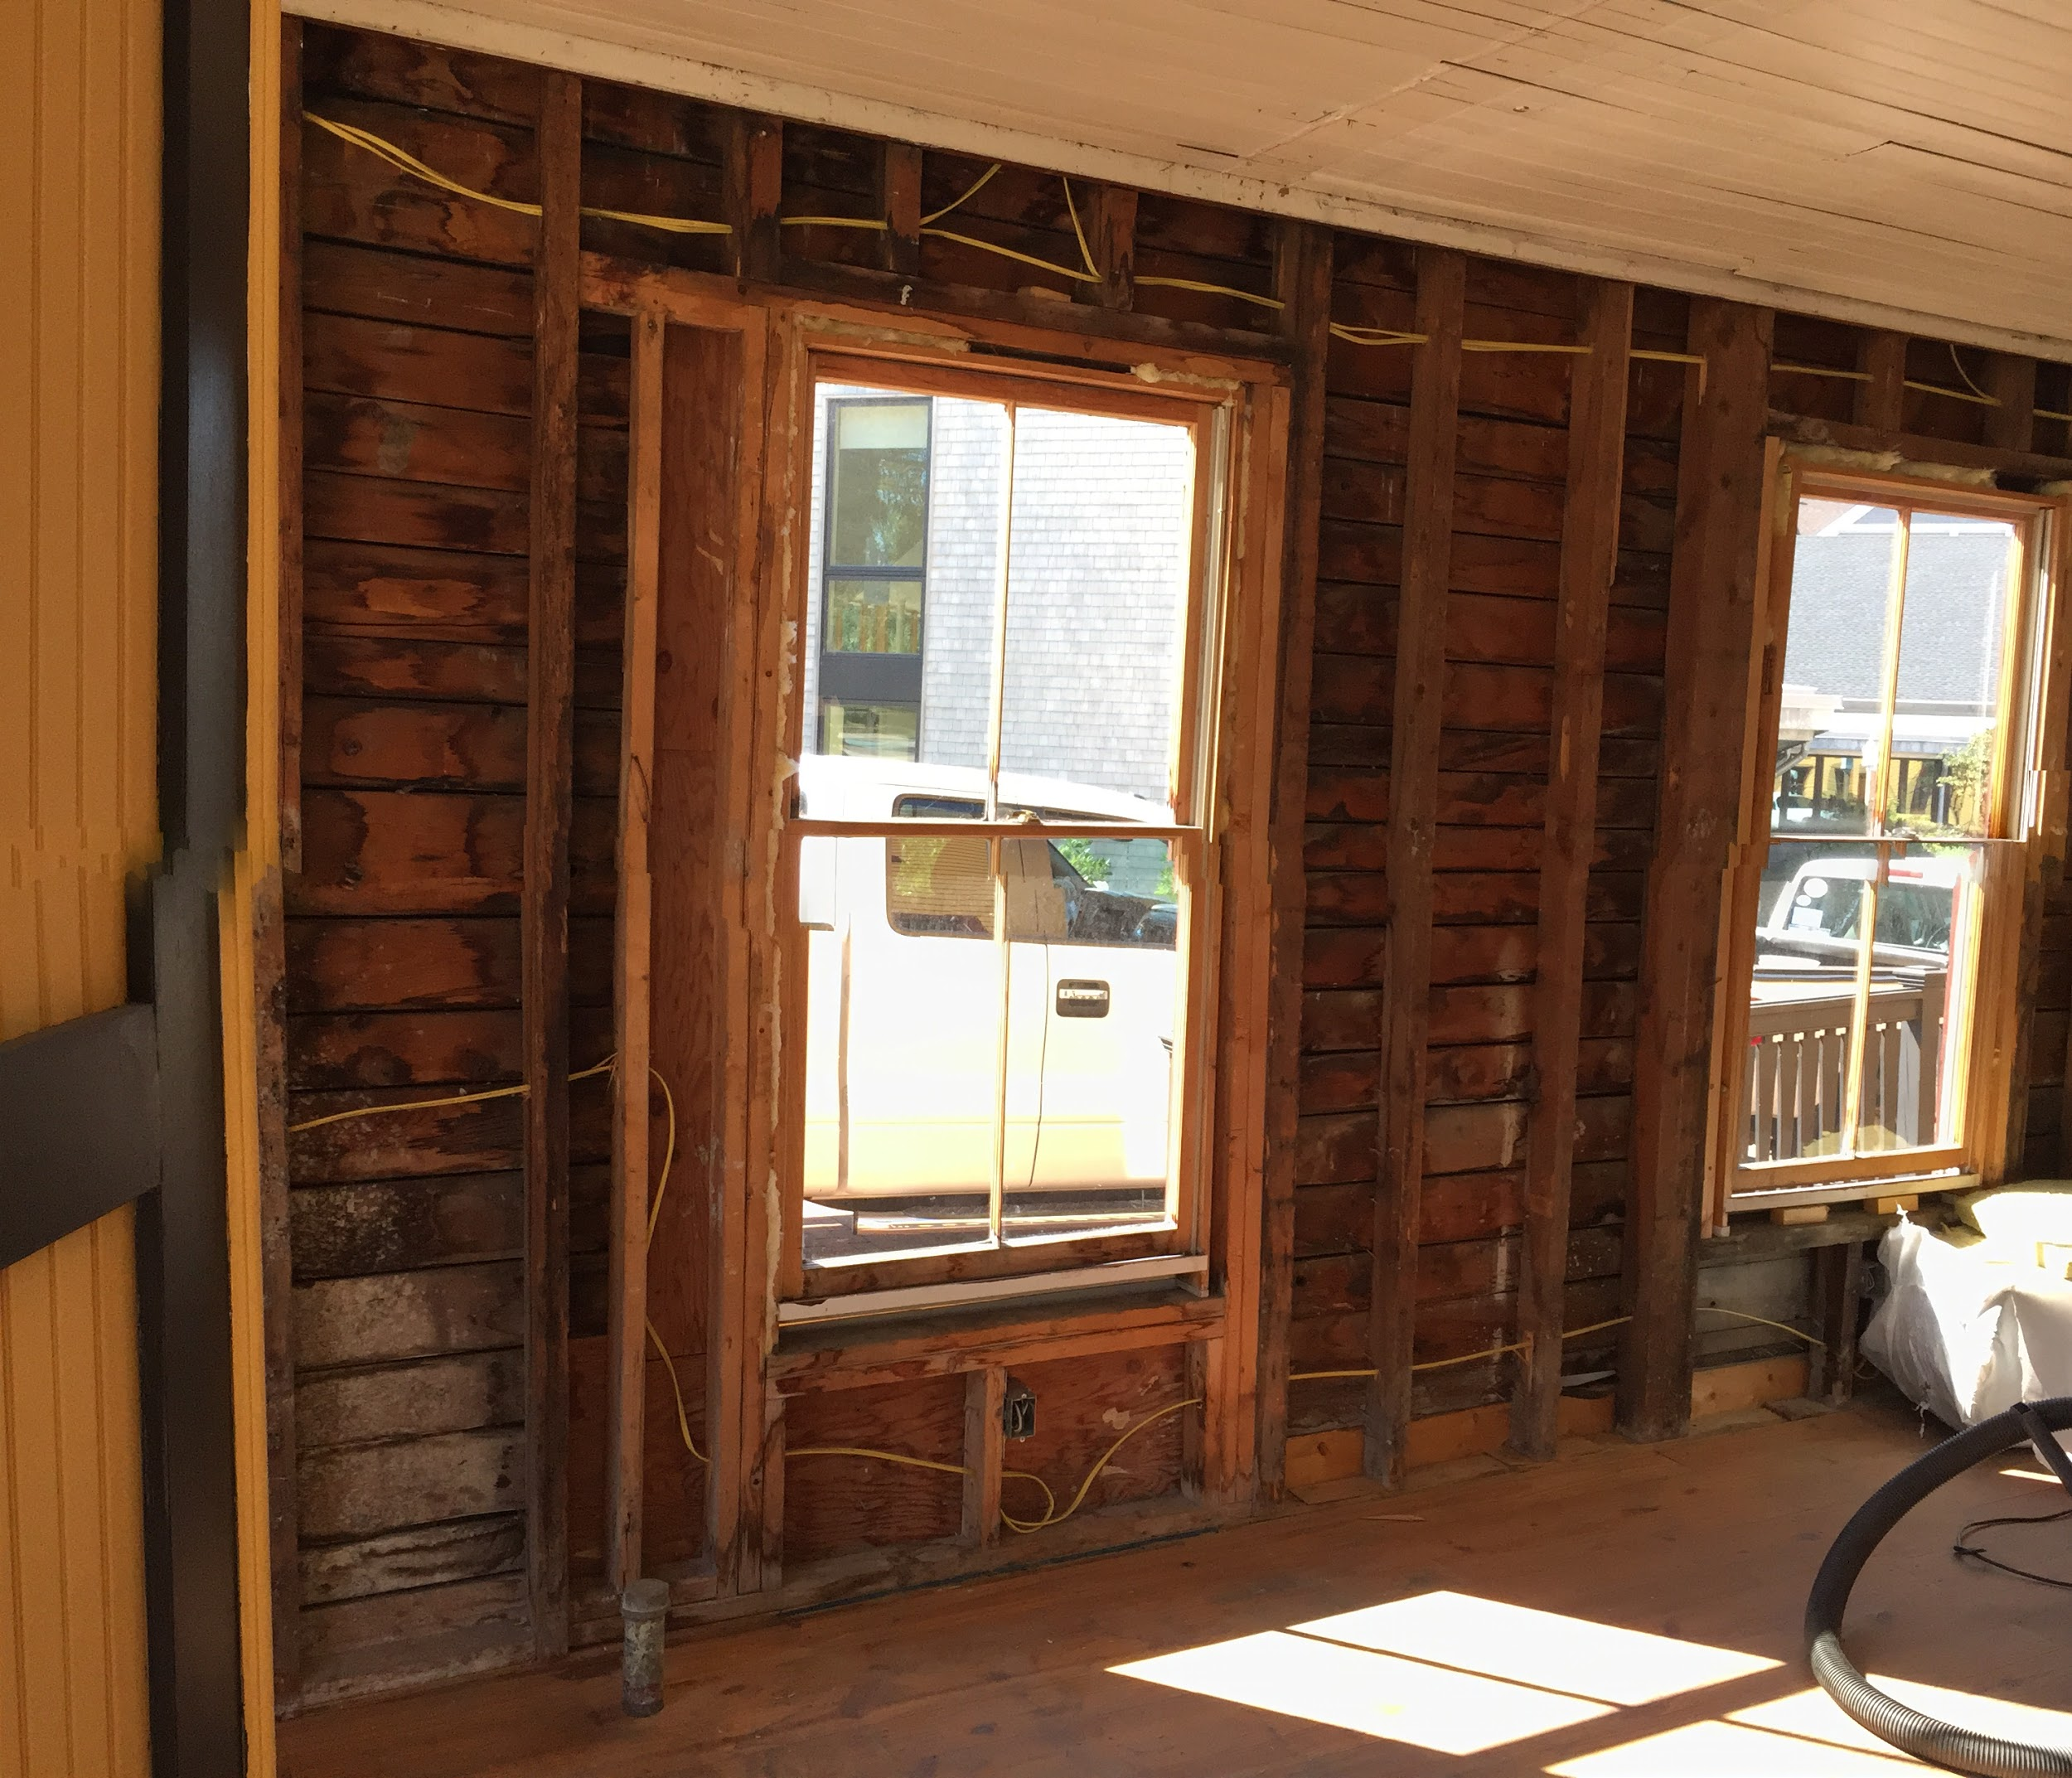
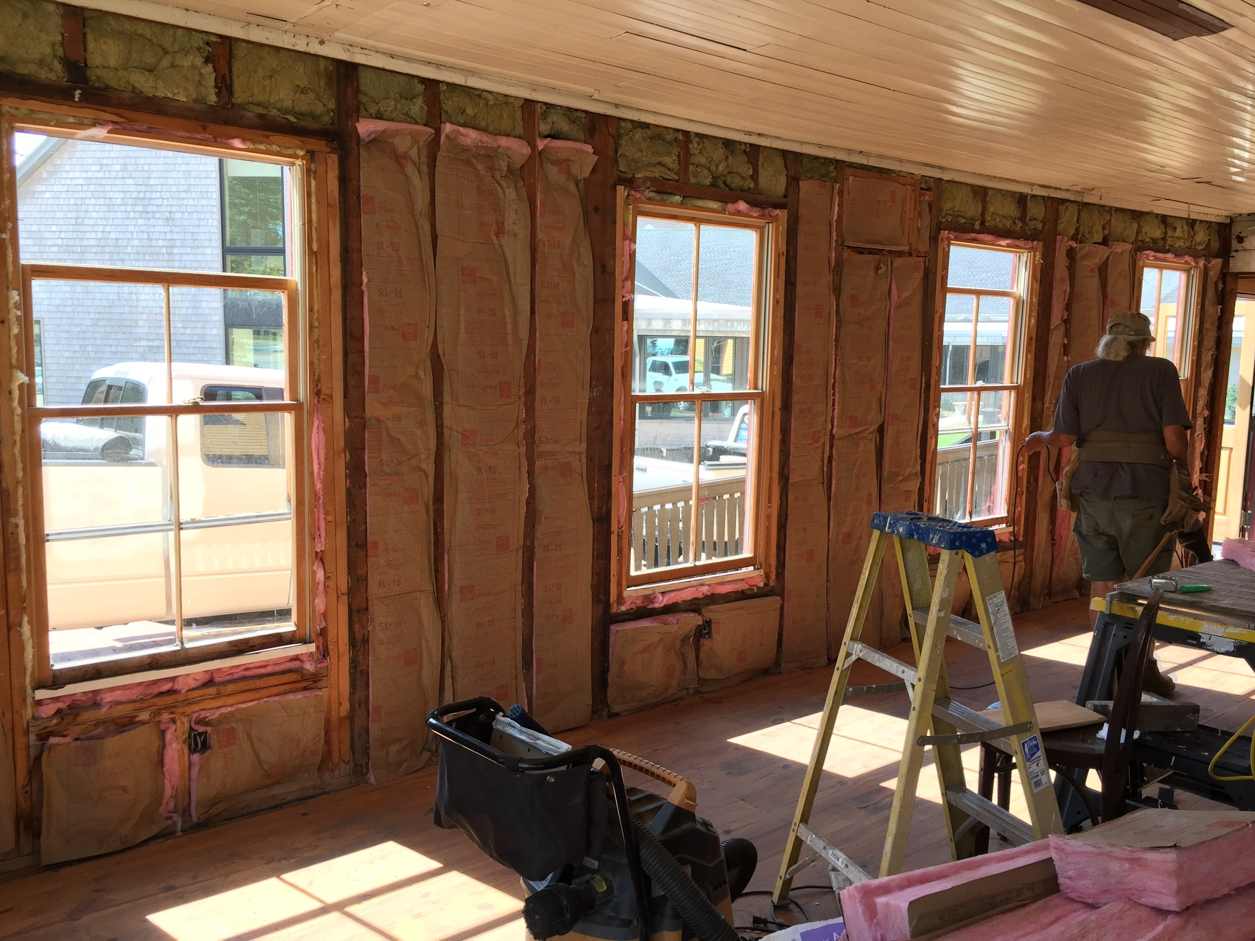

Slide 25
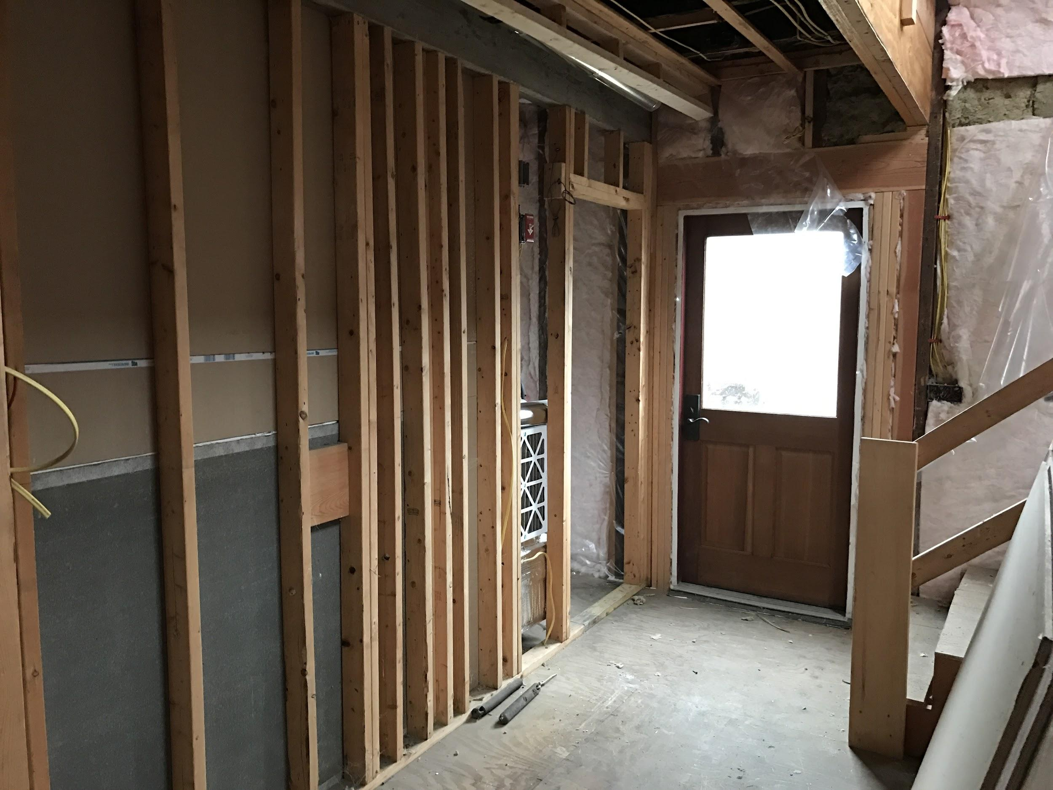

Slide 26
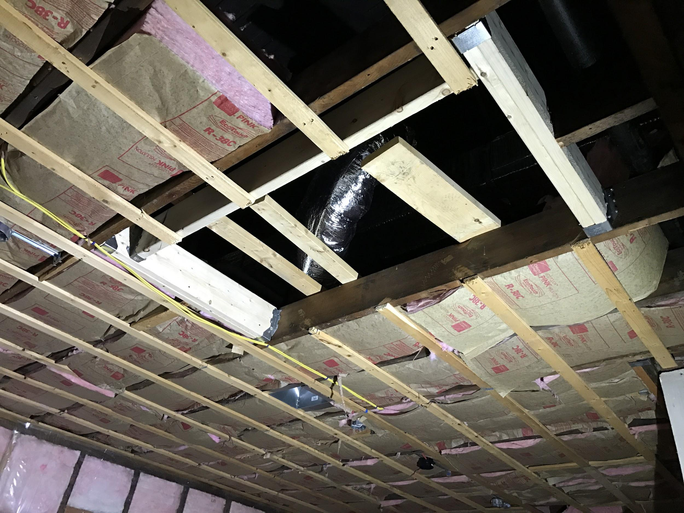

Slide 27
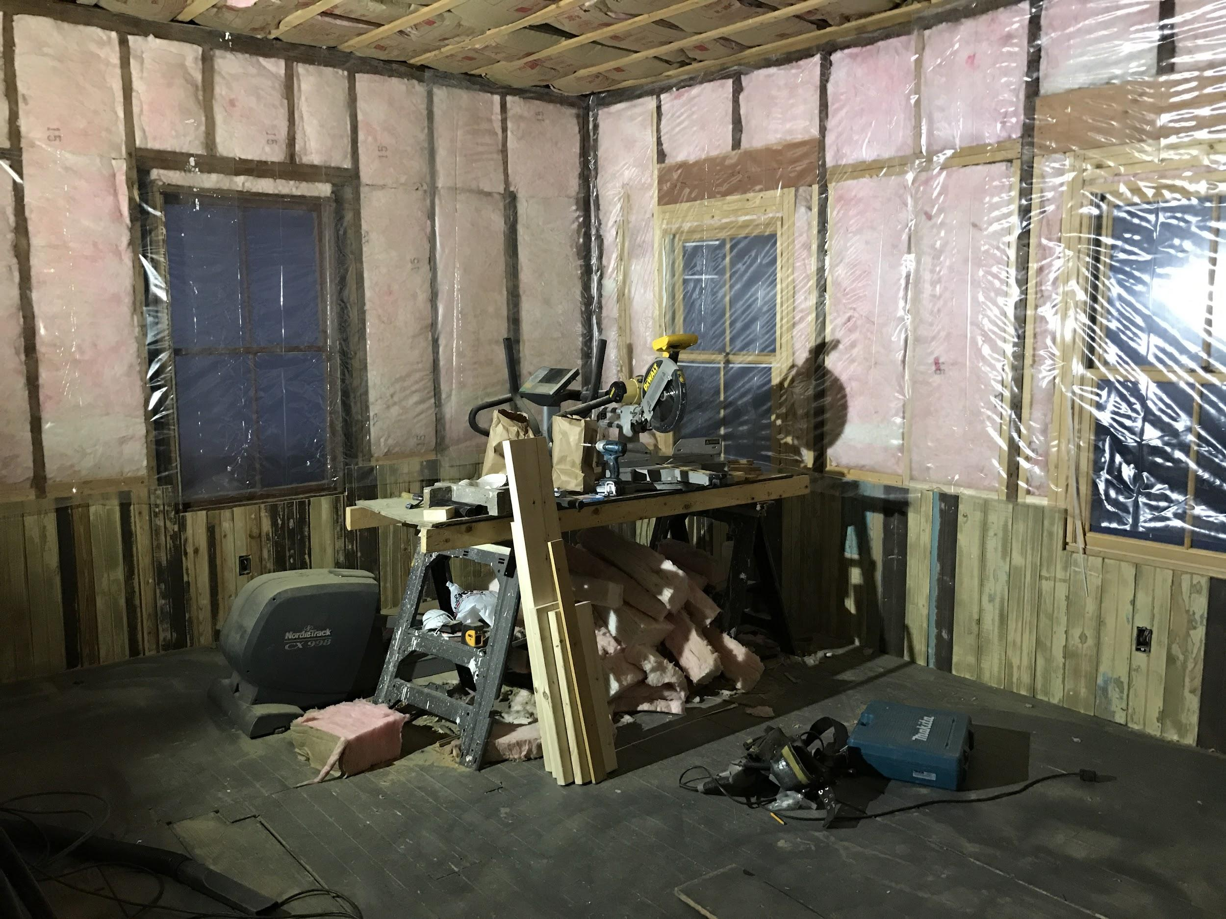
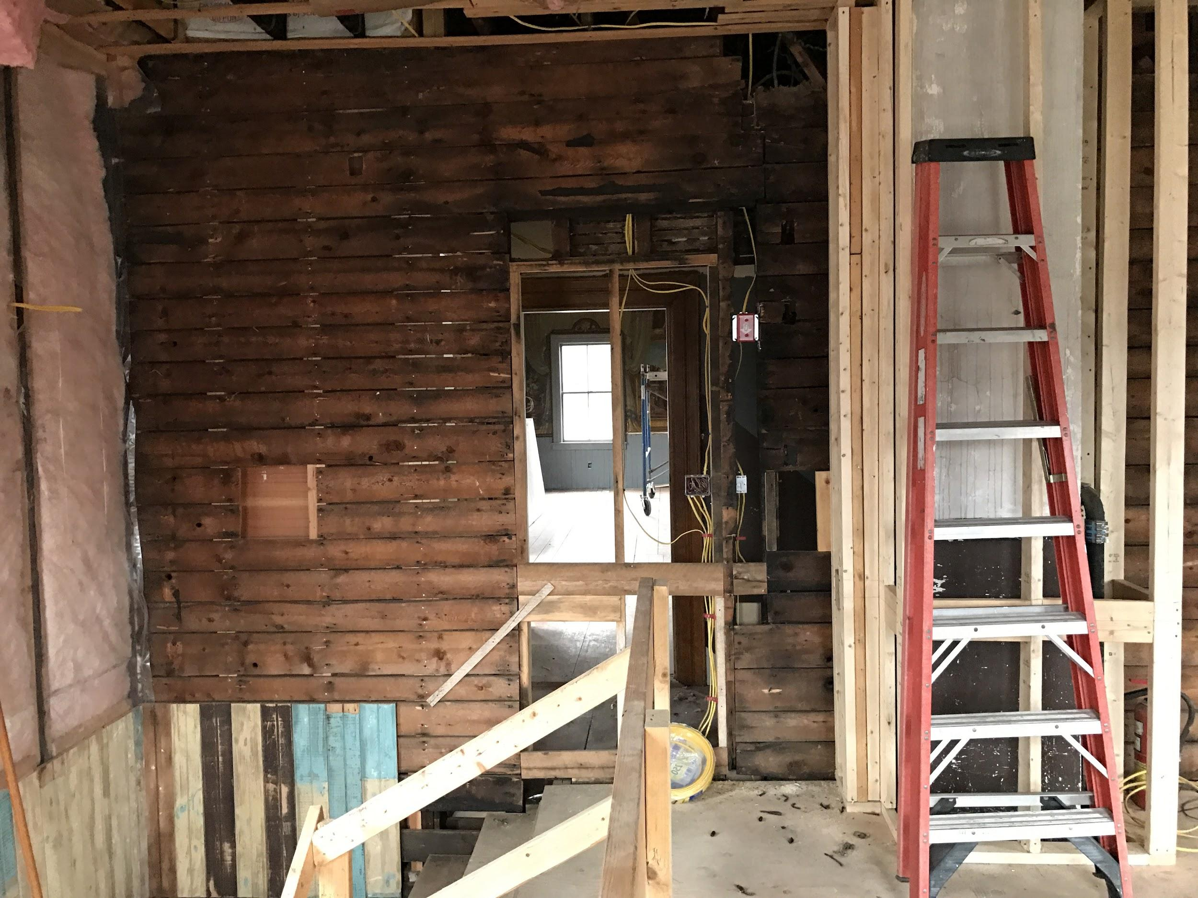

Slide 28
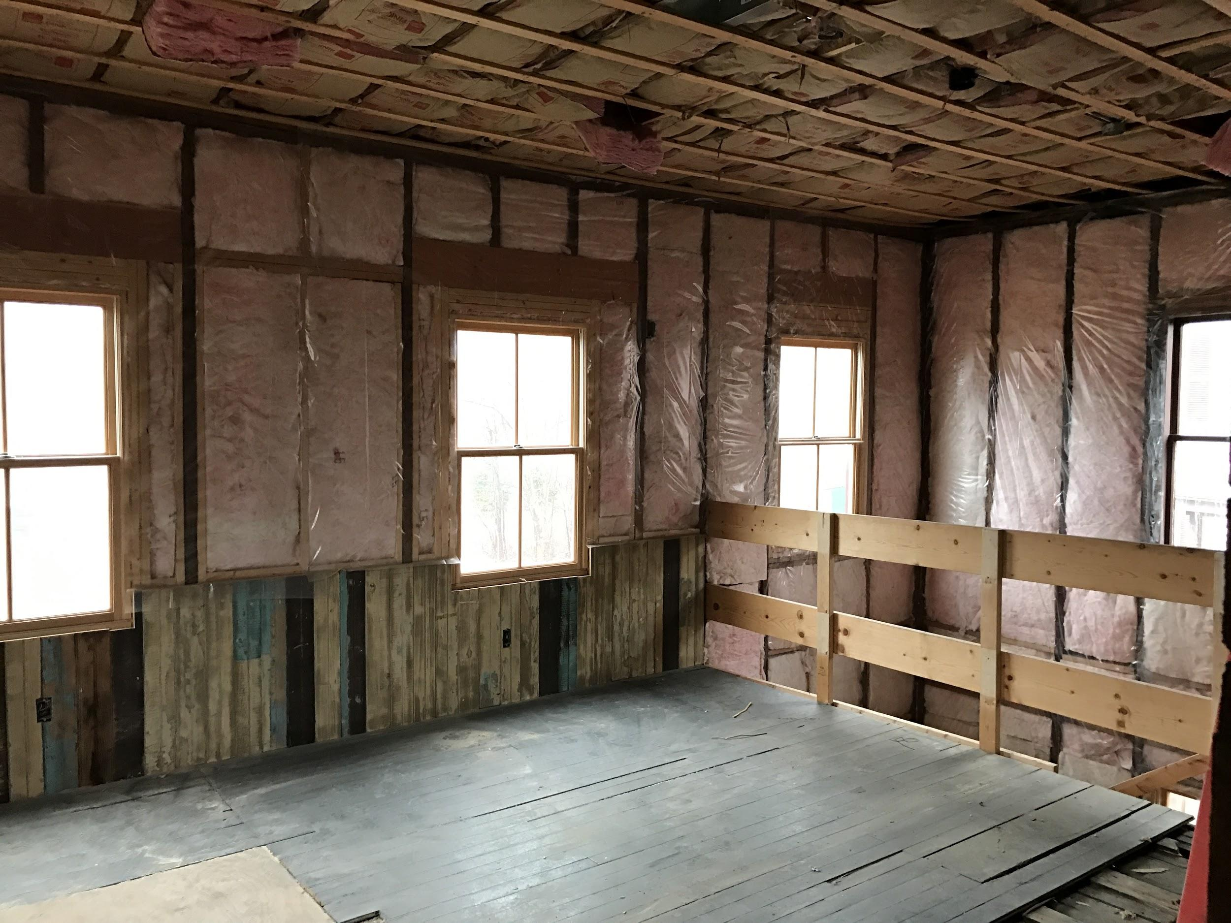

Slide 29
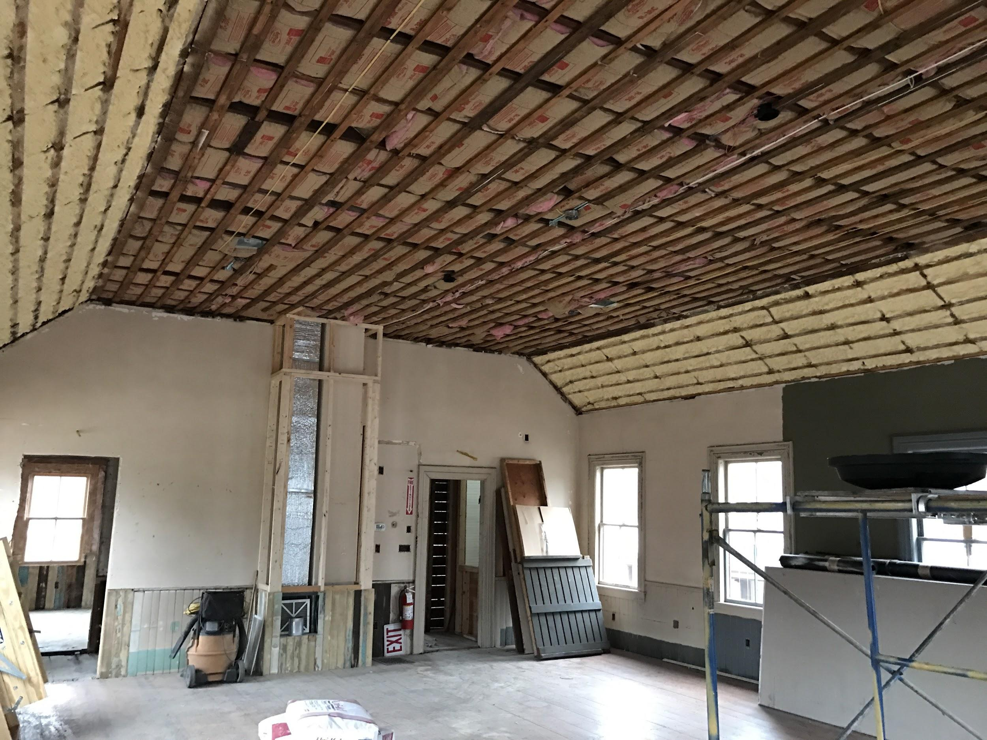

Slide 30
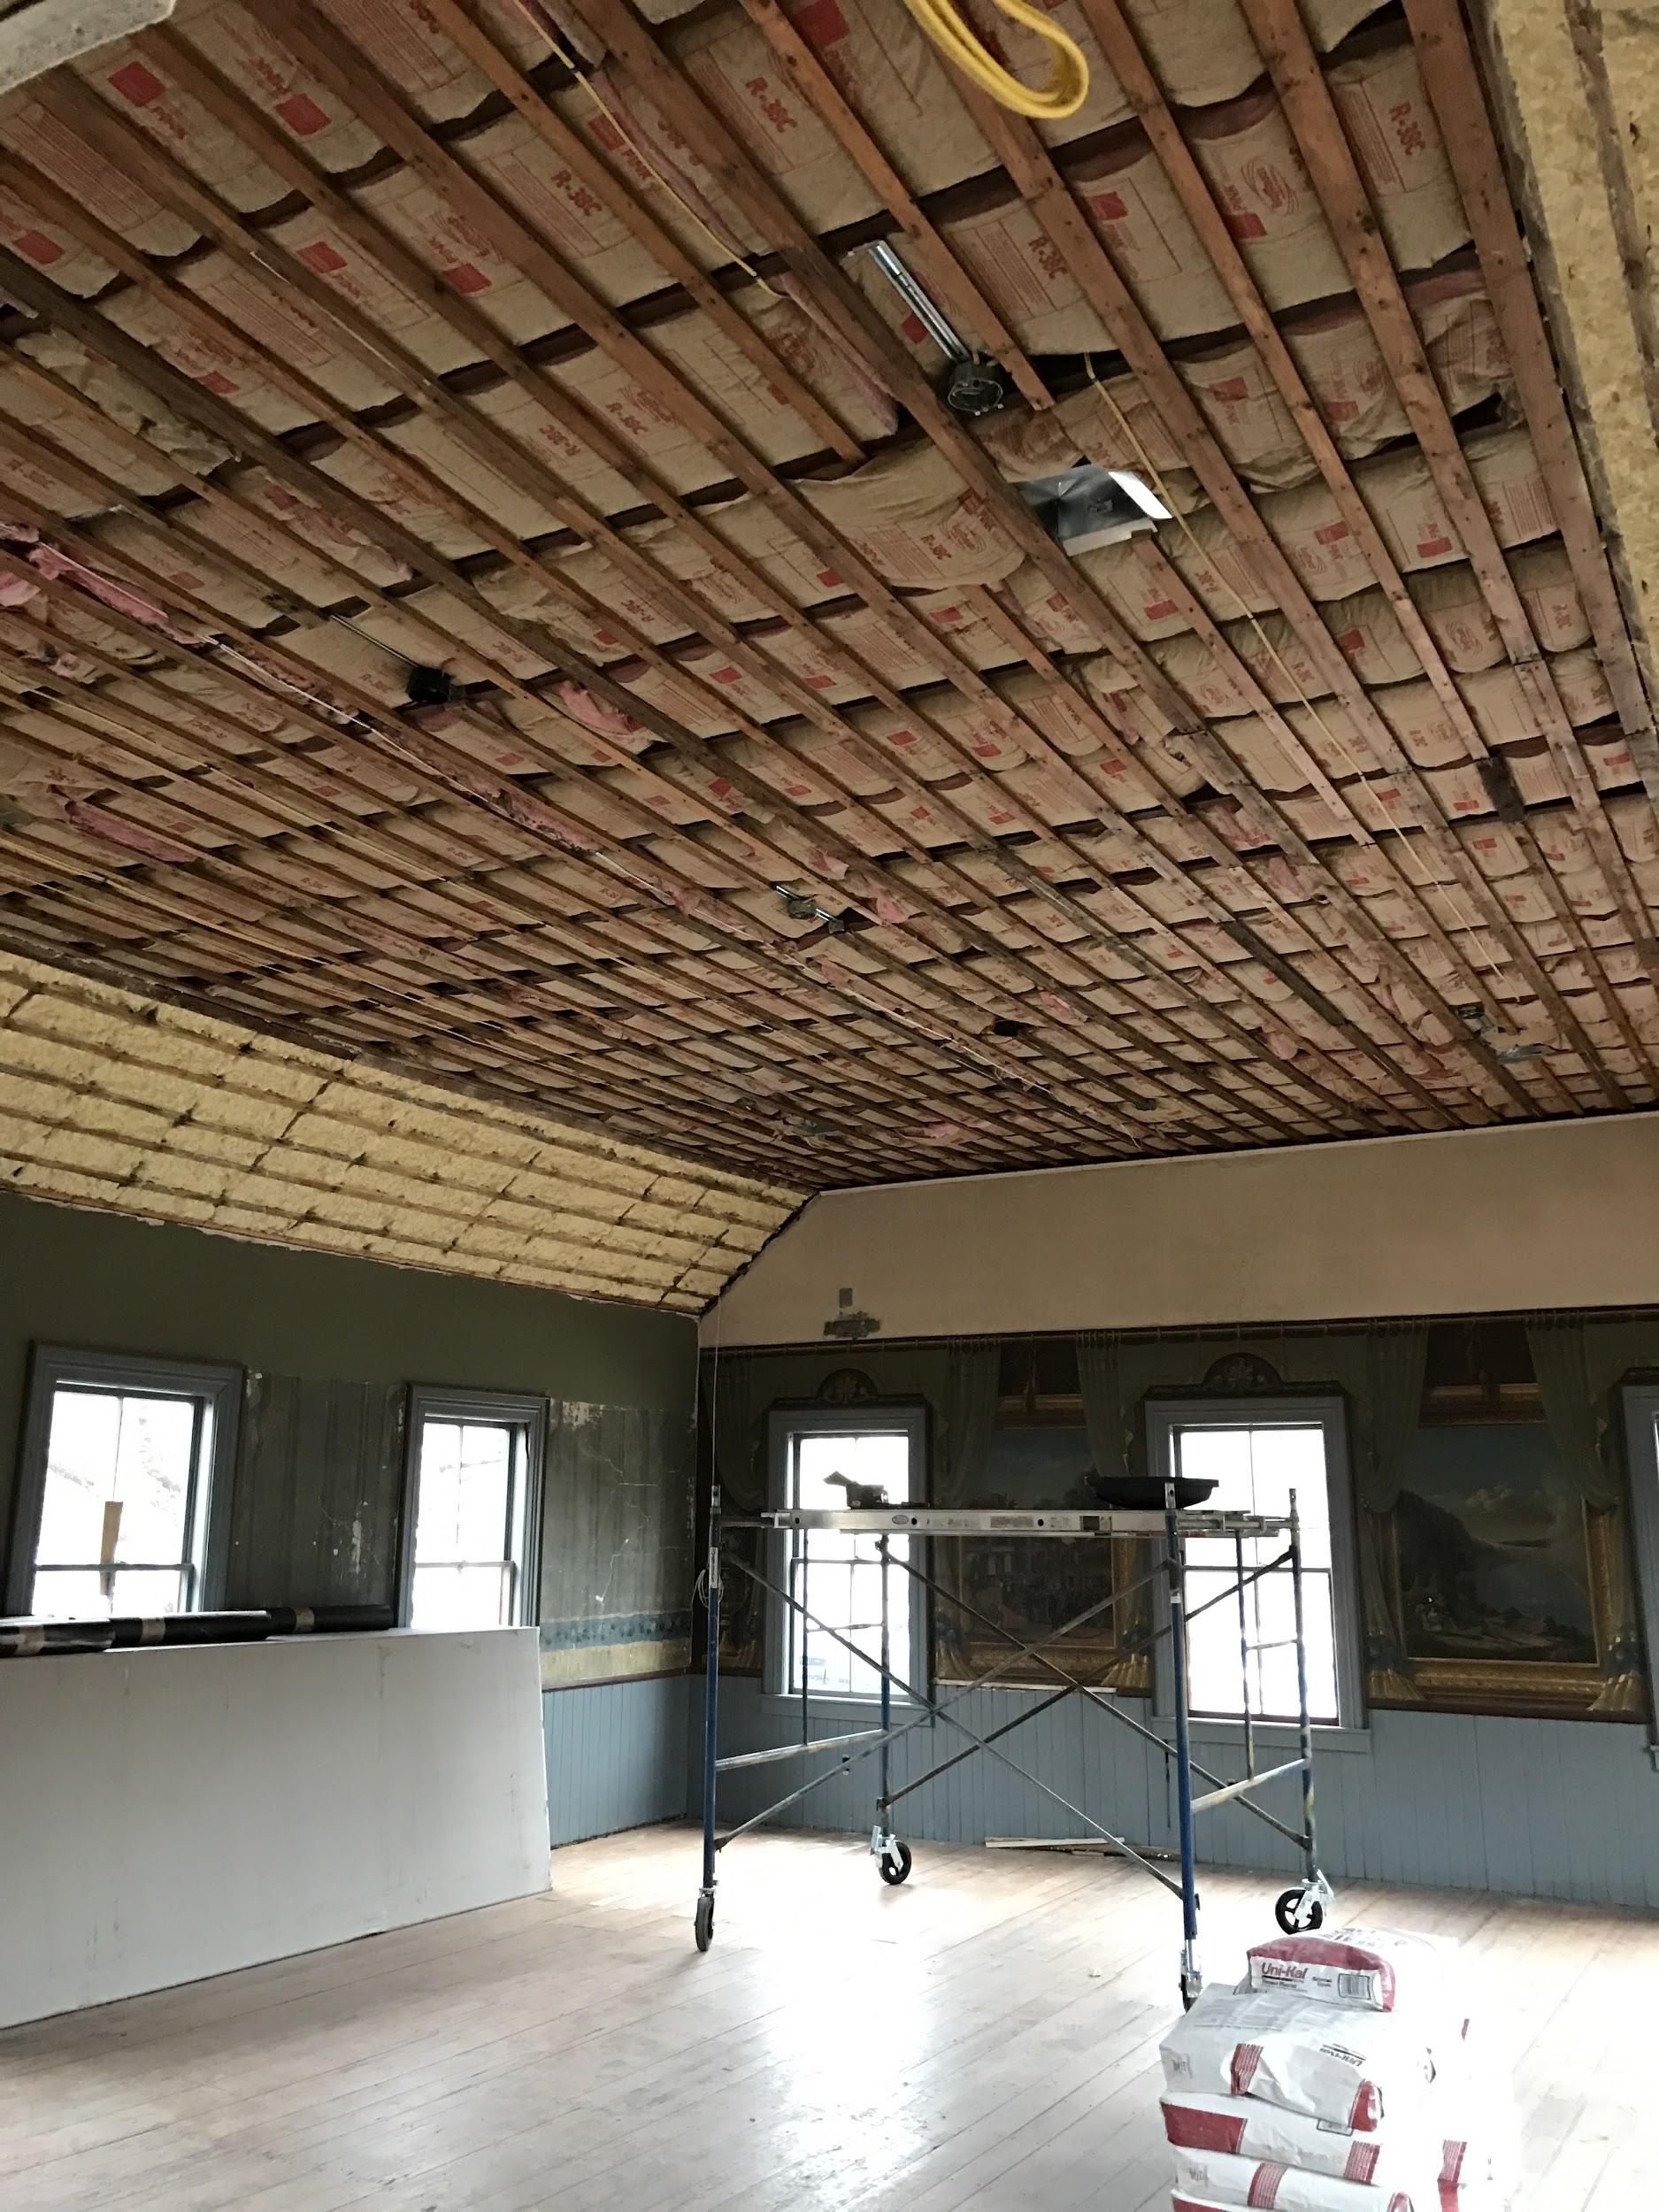

Slide 31
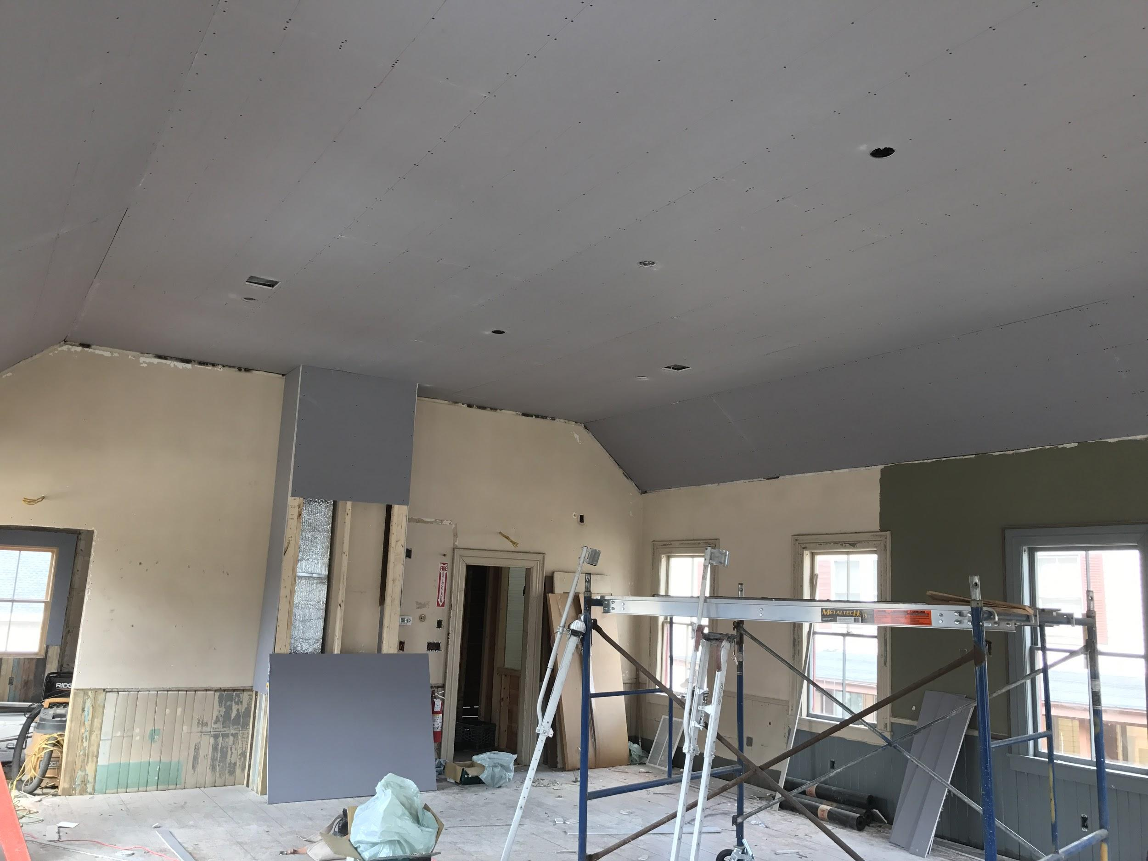

Slide 32
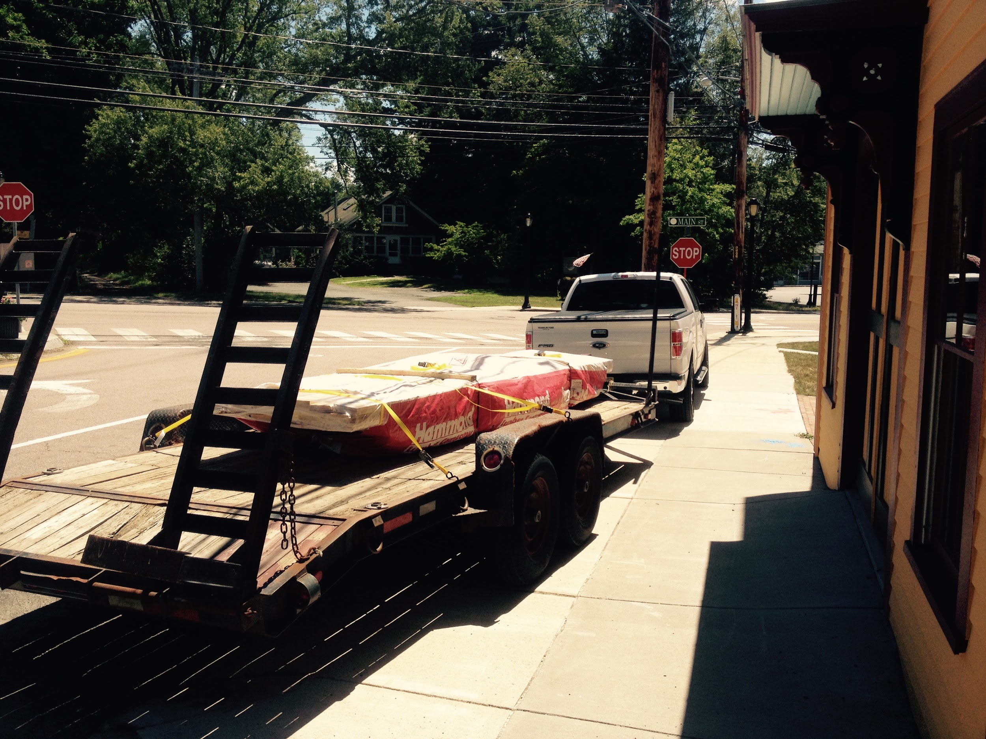

Slide 33
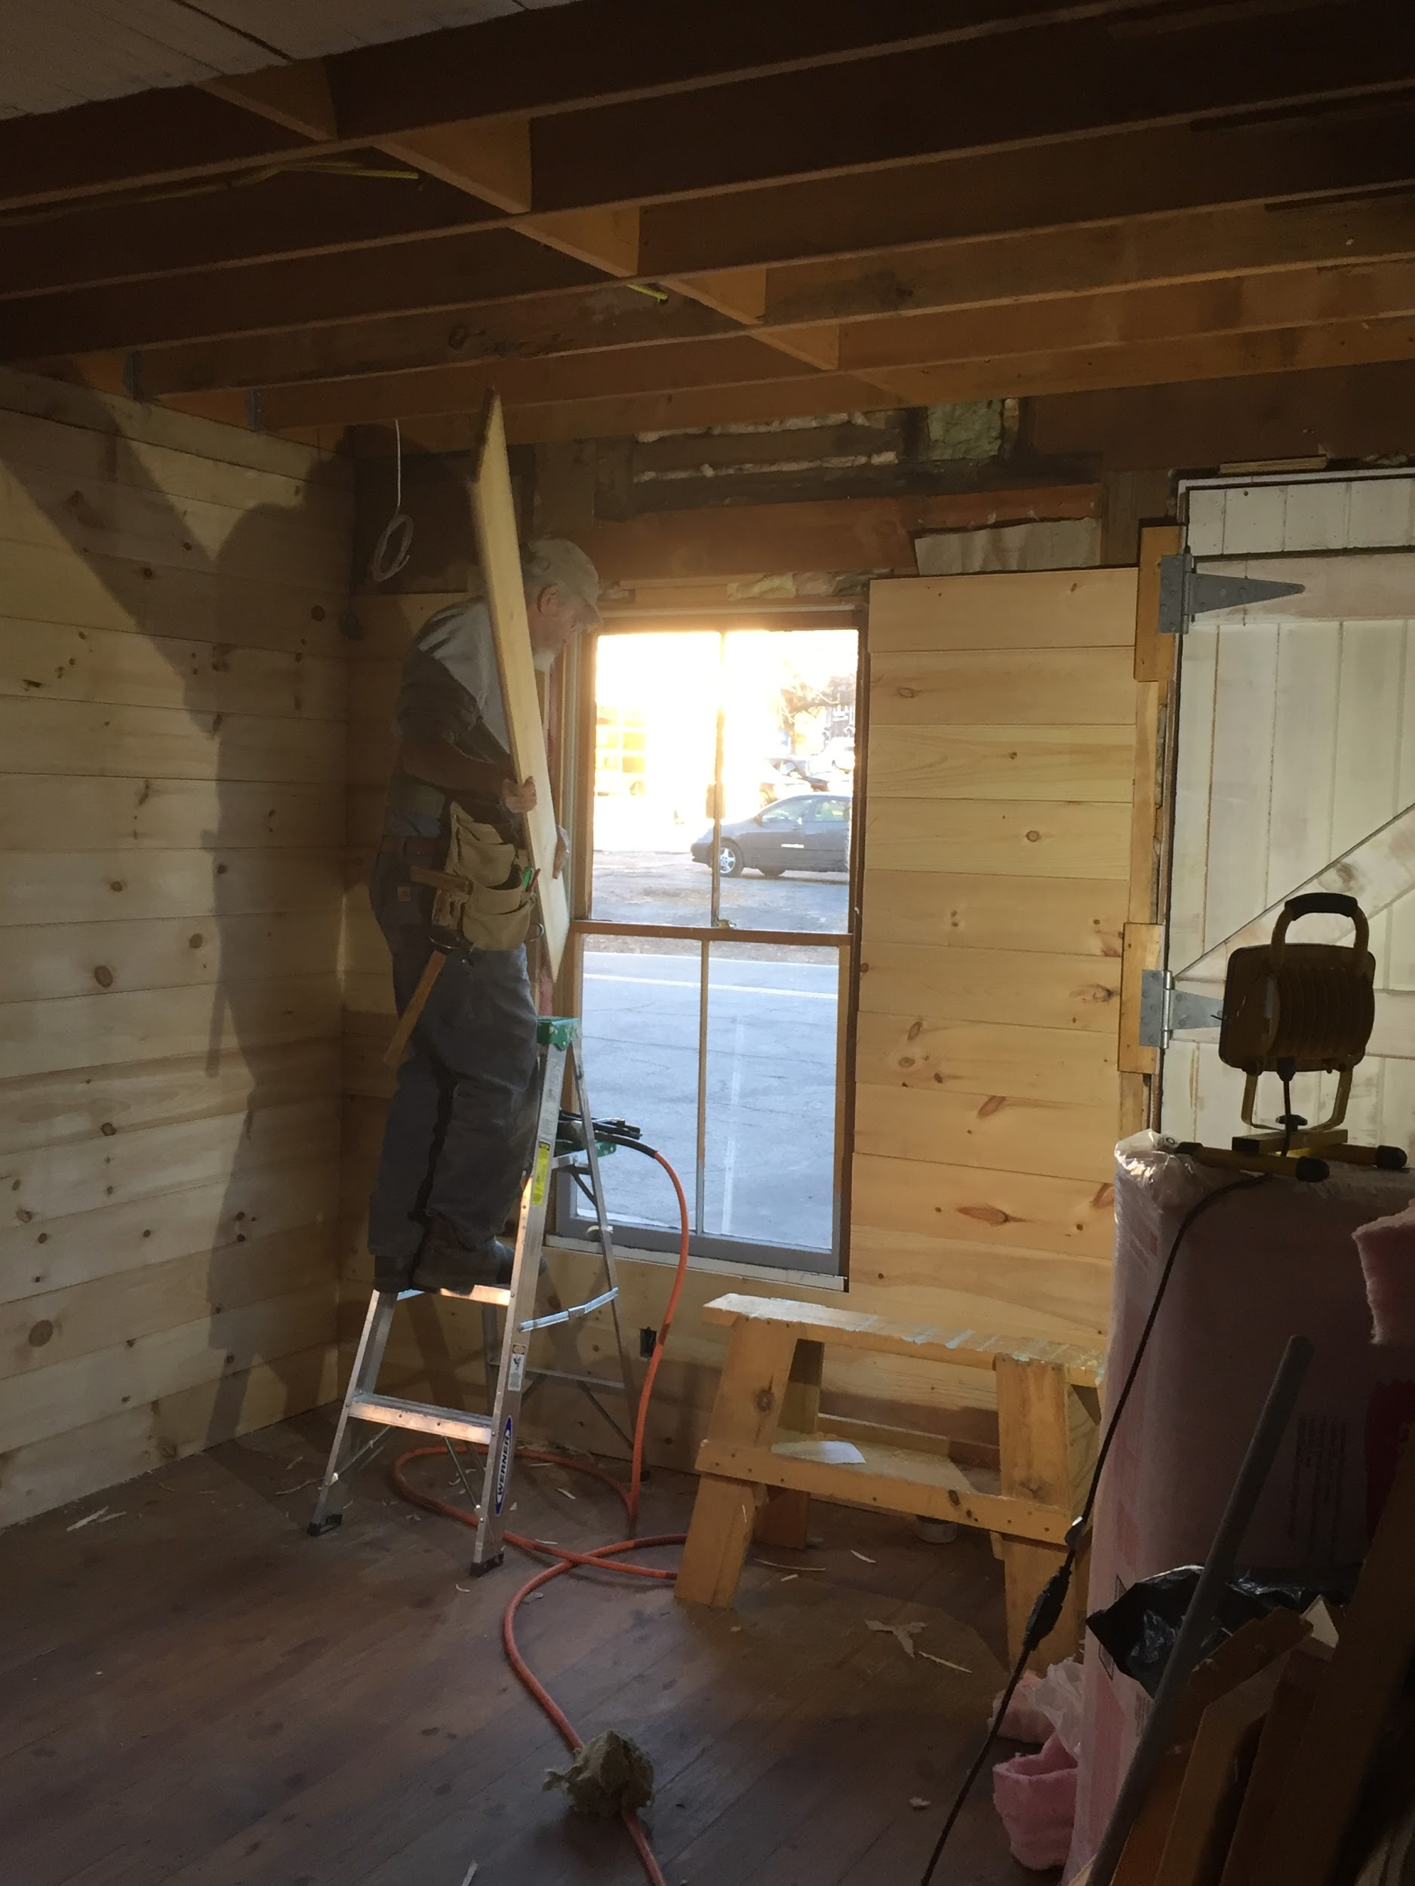

Slide 34
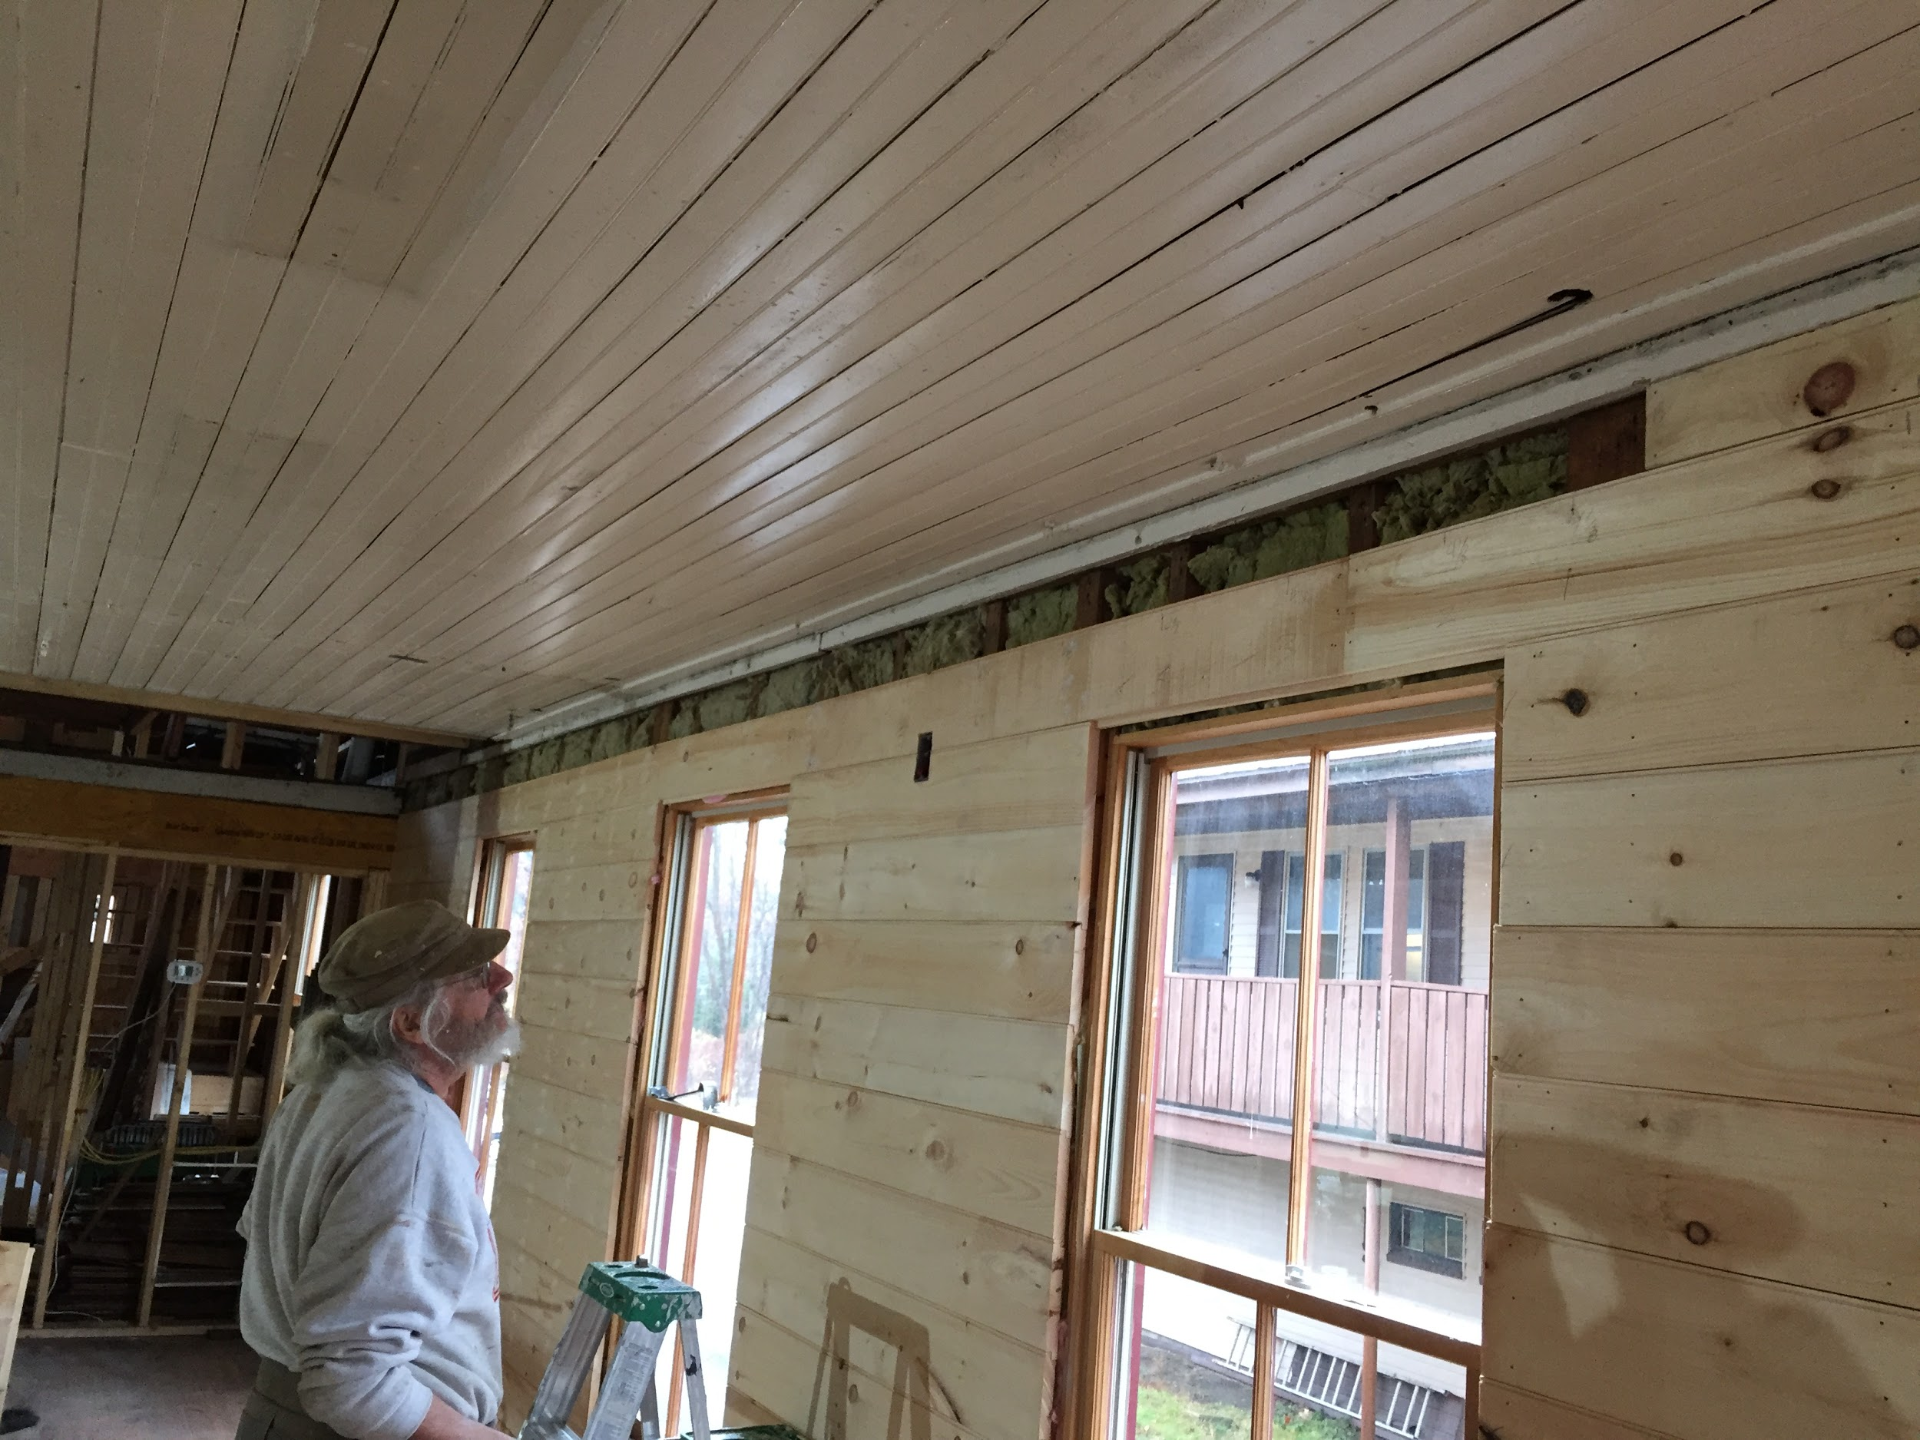

Slide 35
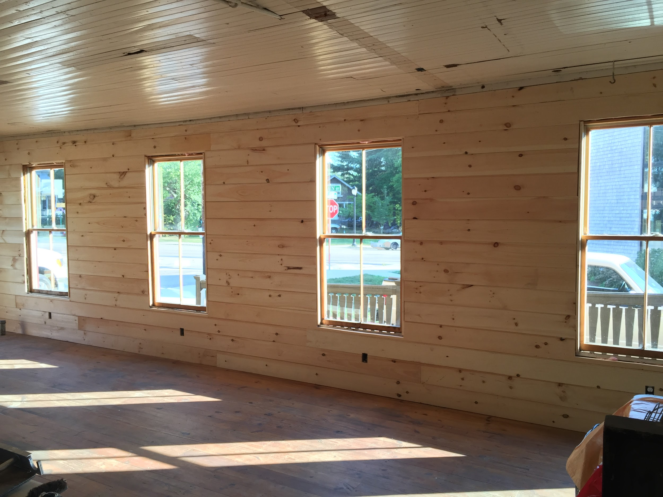

Slide 36
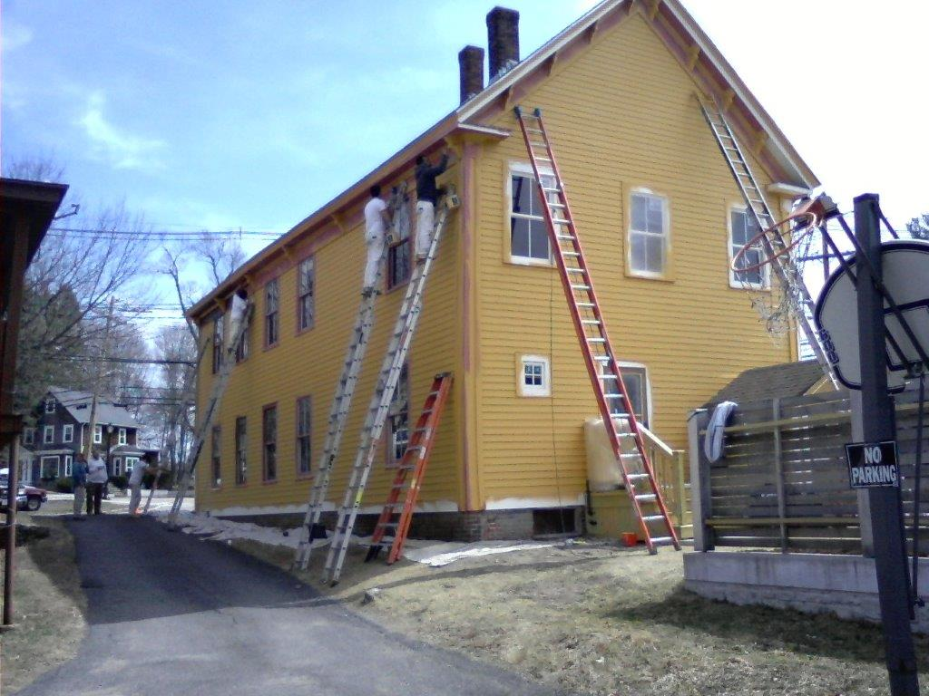

Slide 37
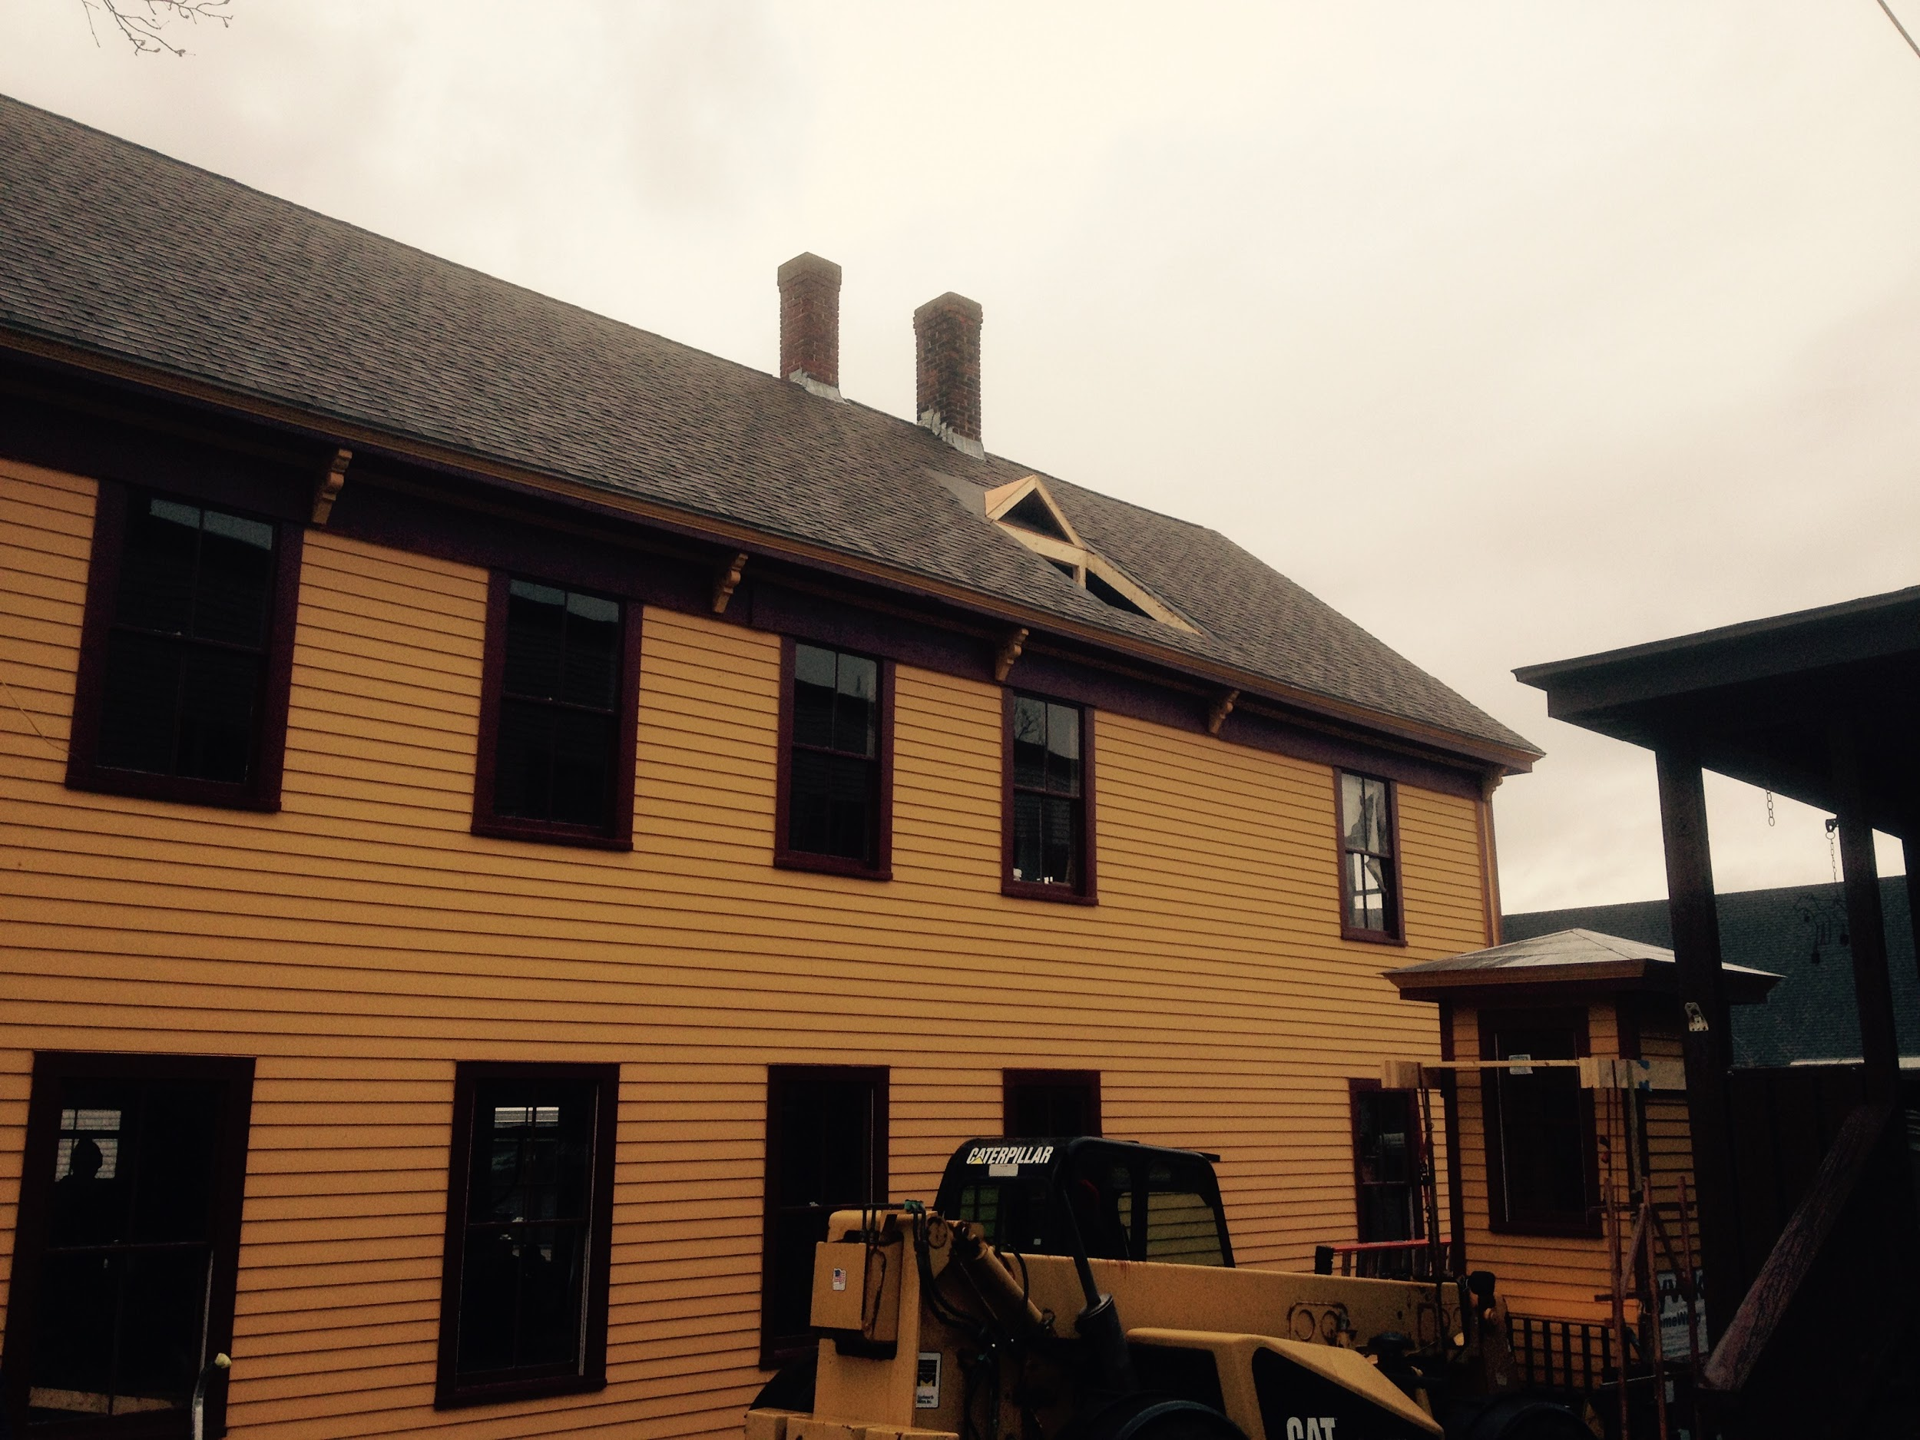

Slide 38
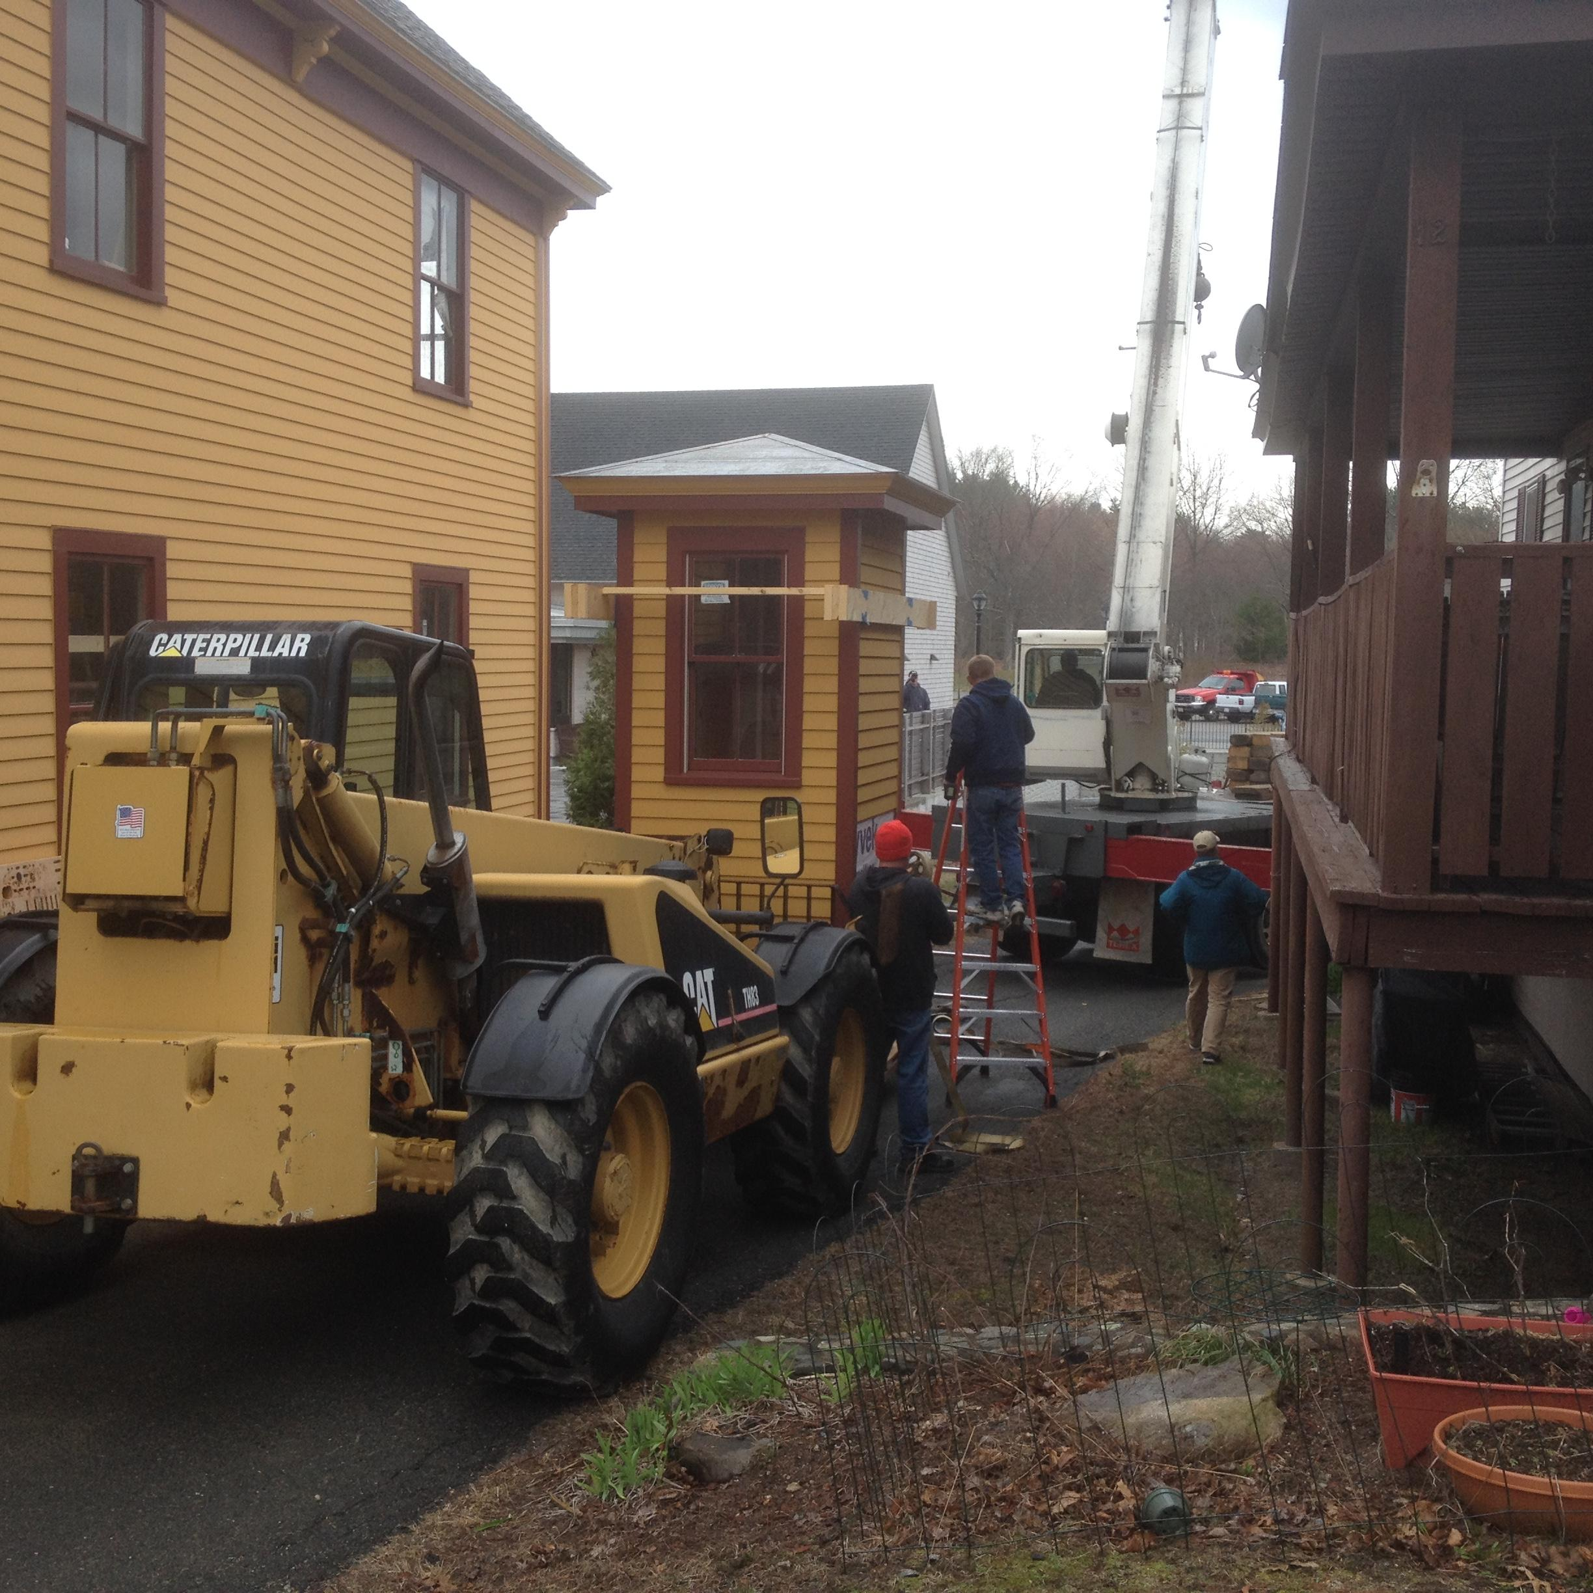
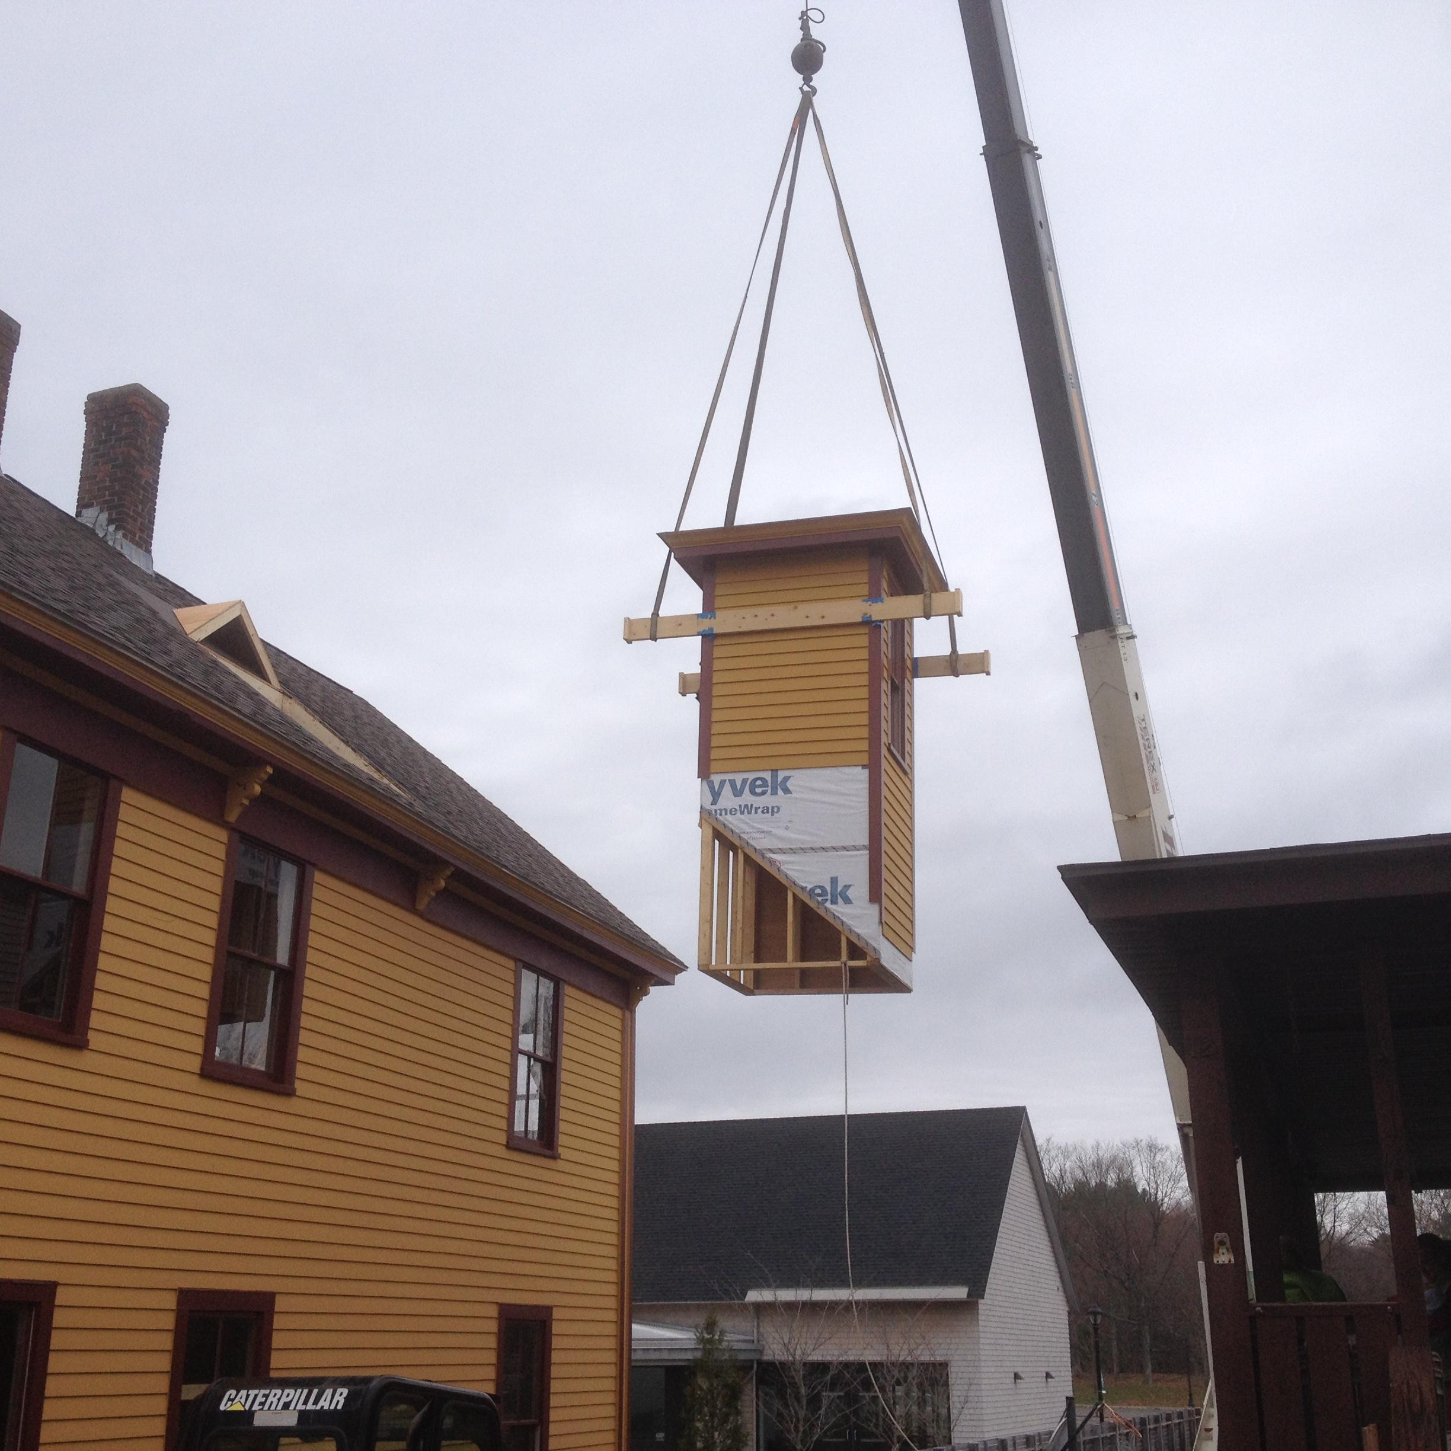
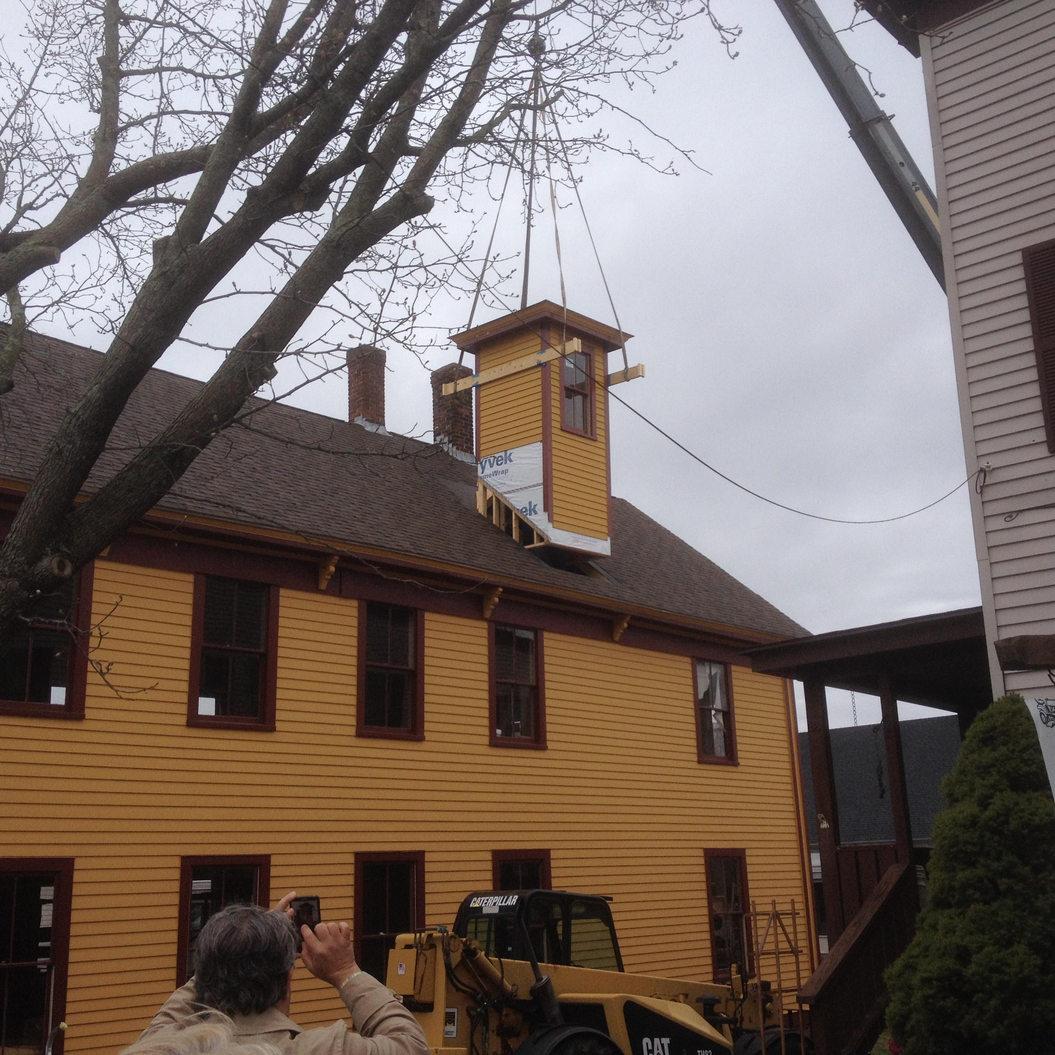

Slide 39
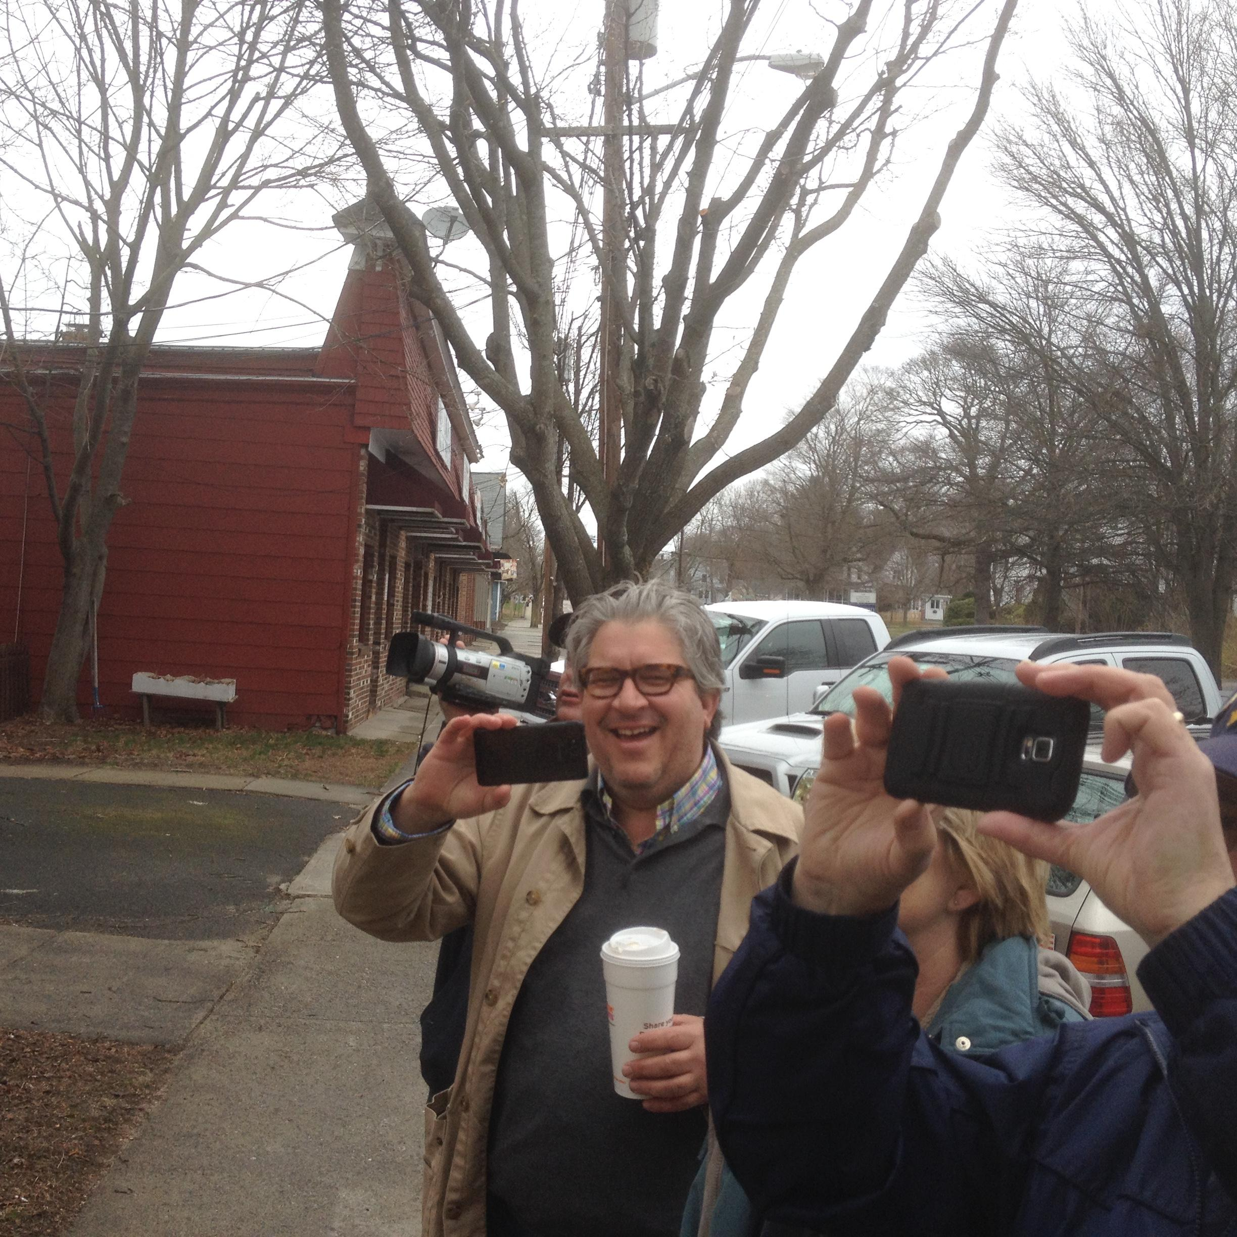

Slide 40
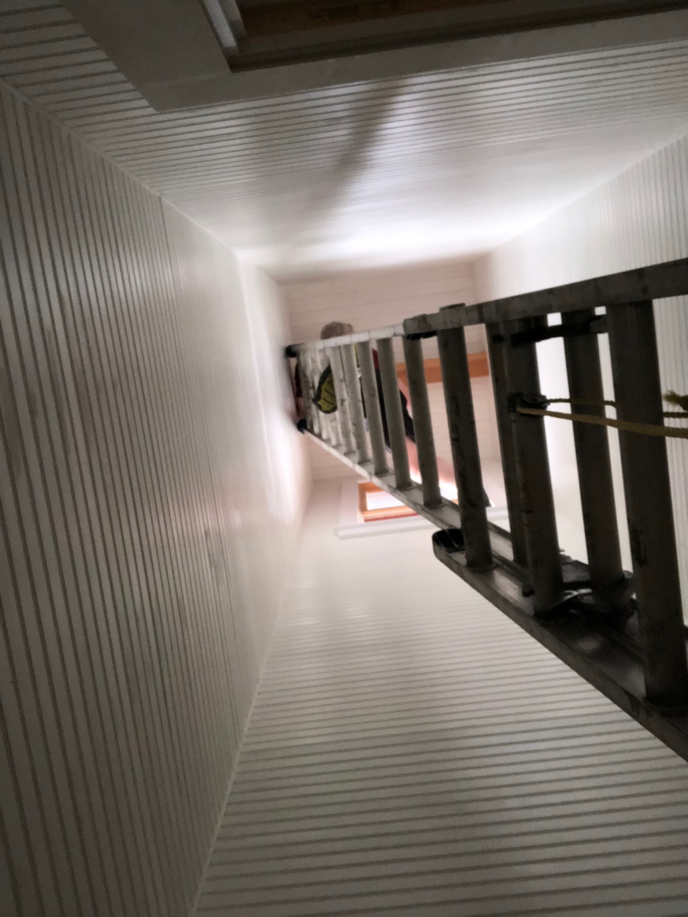

Slide 41
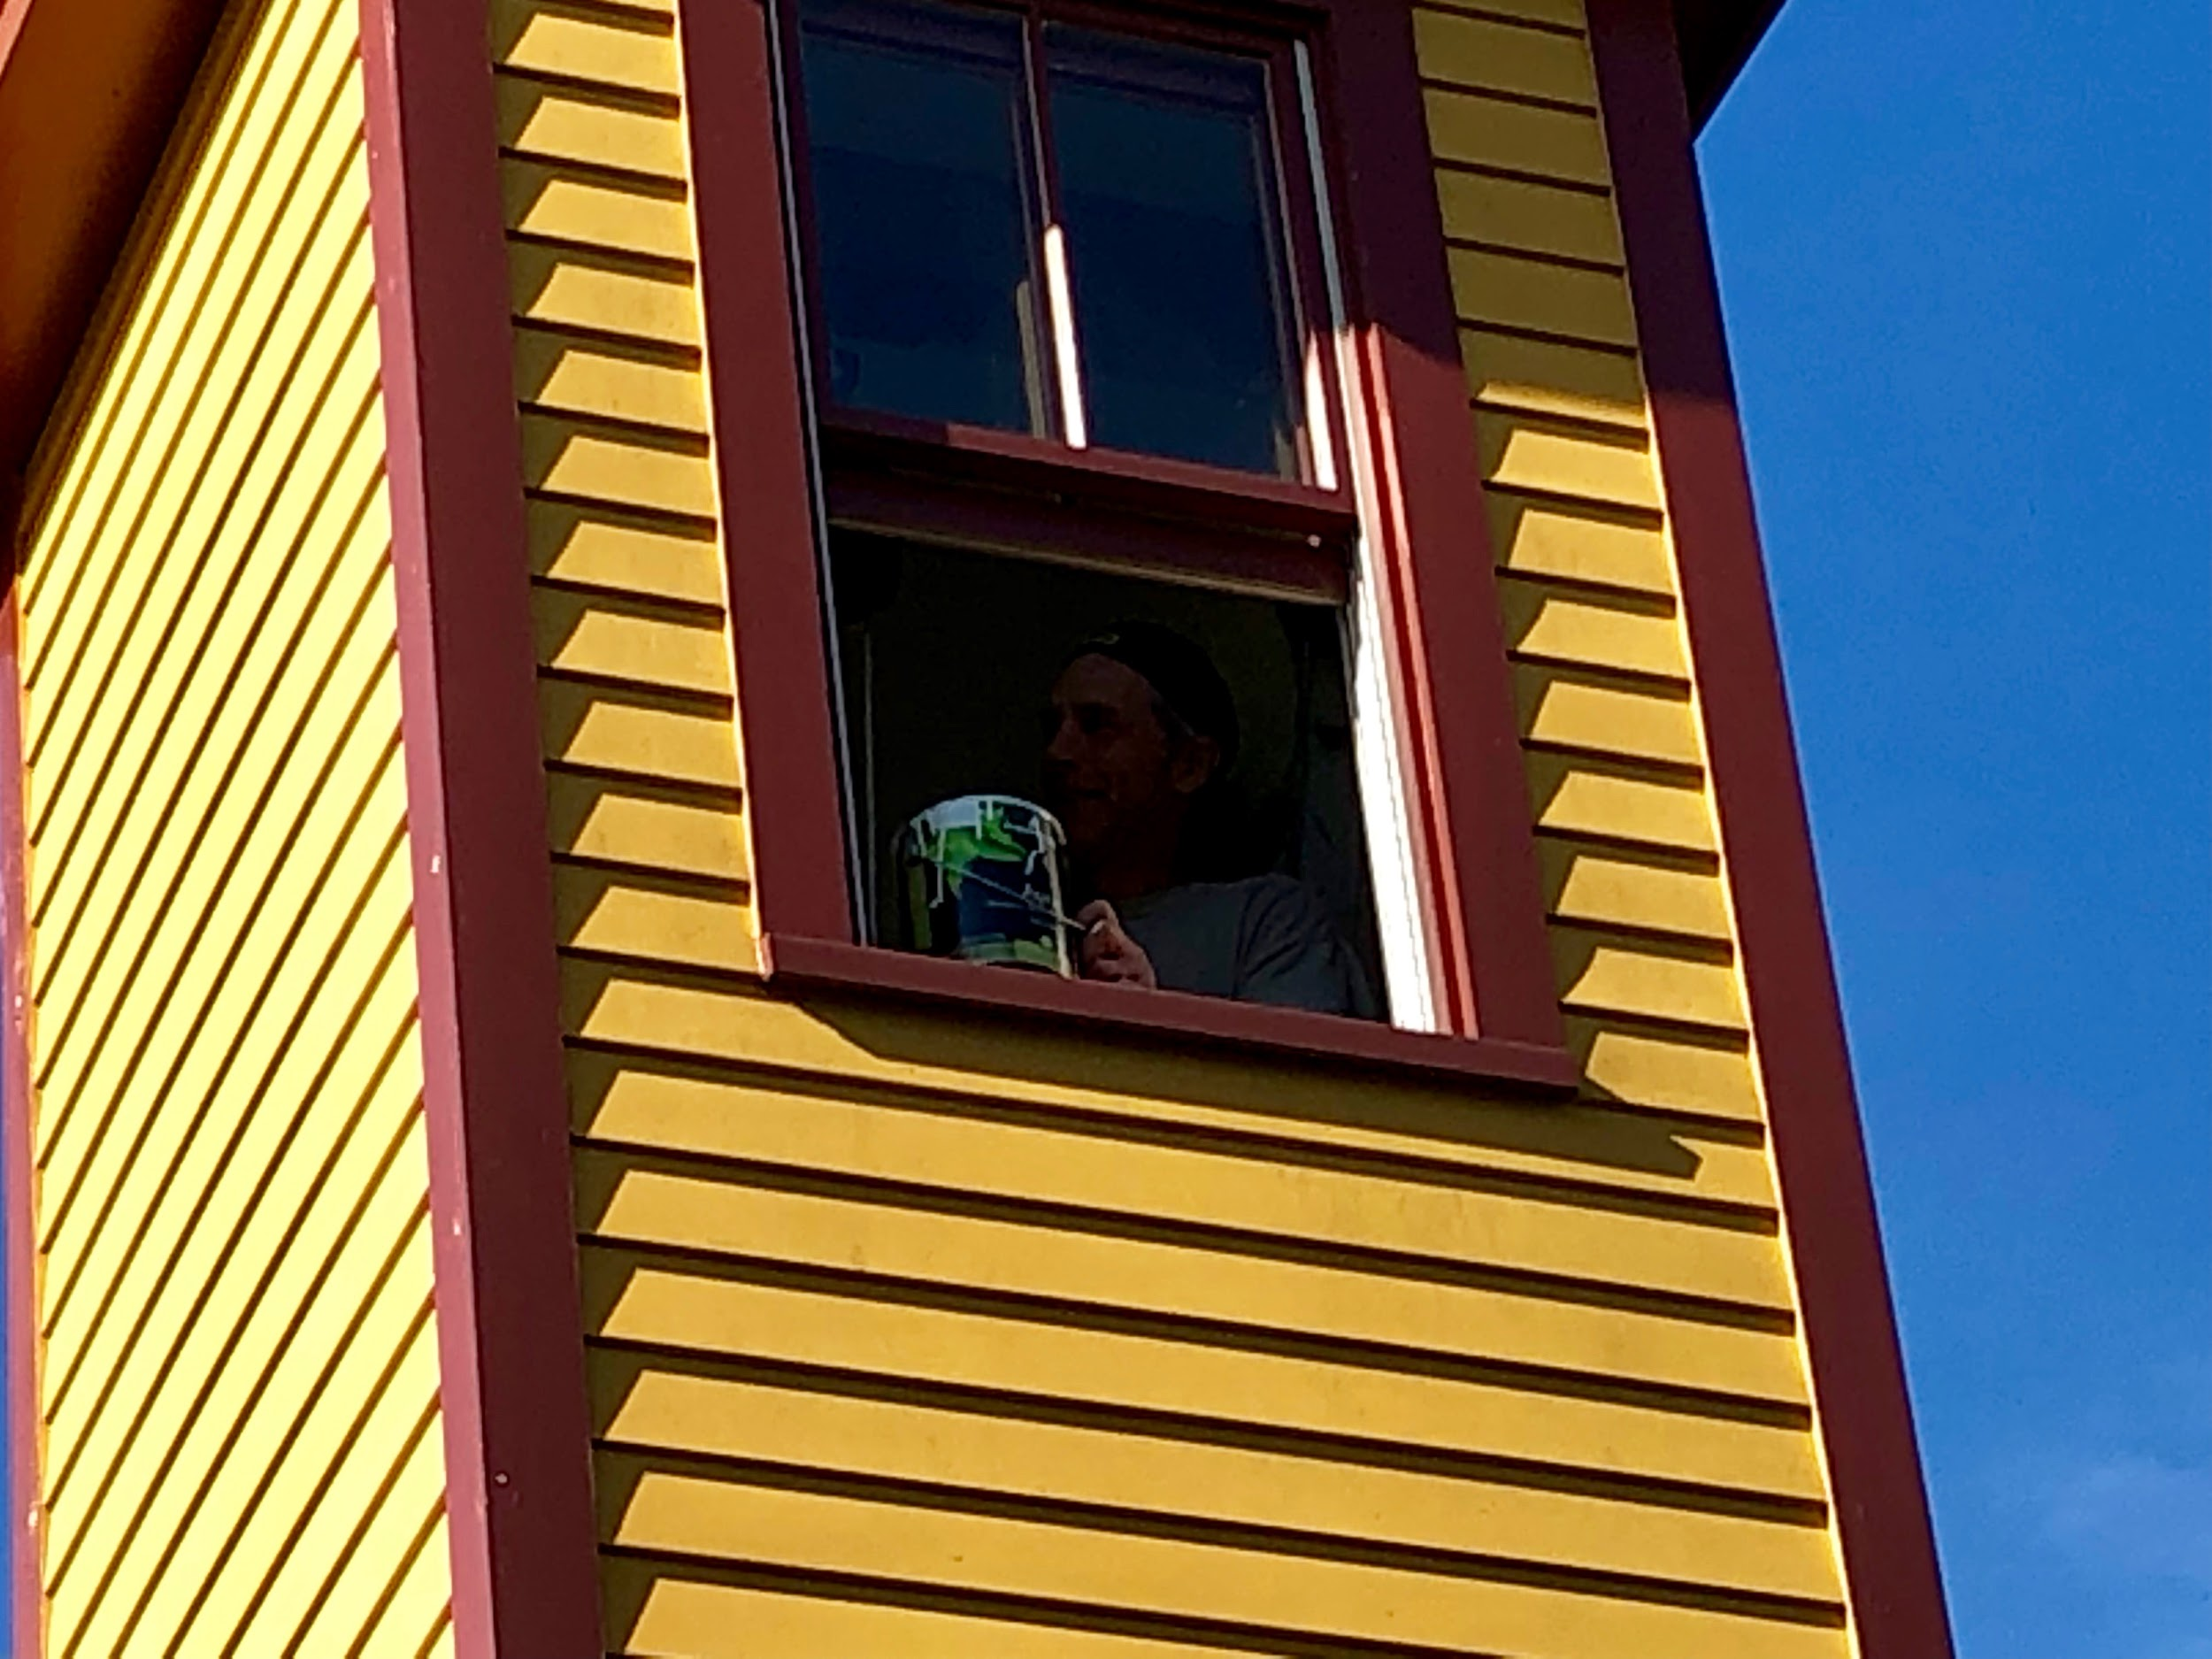

Slide 42
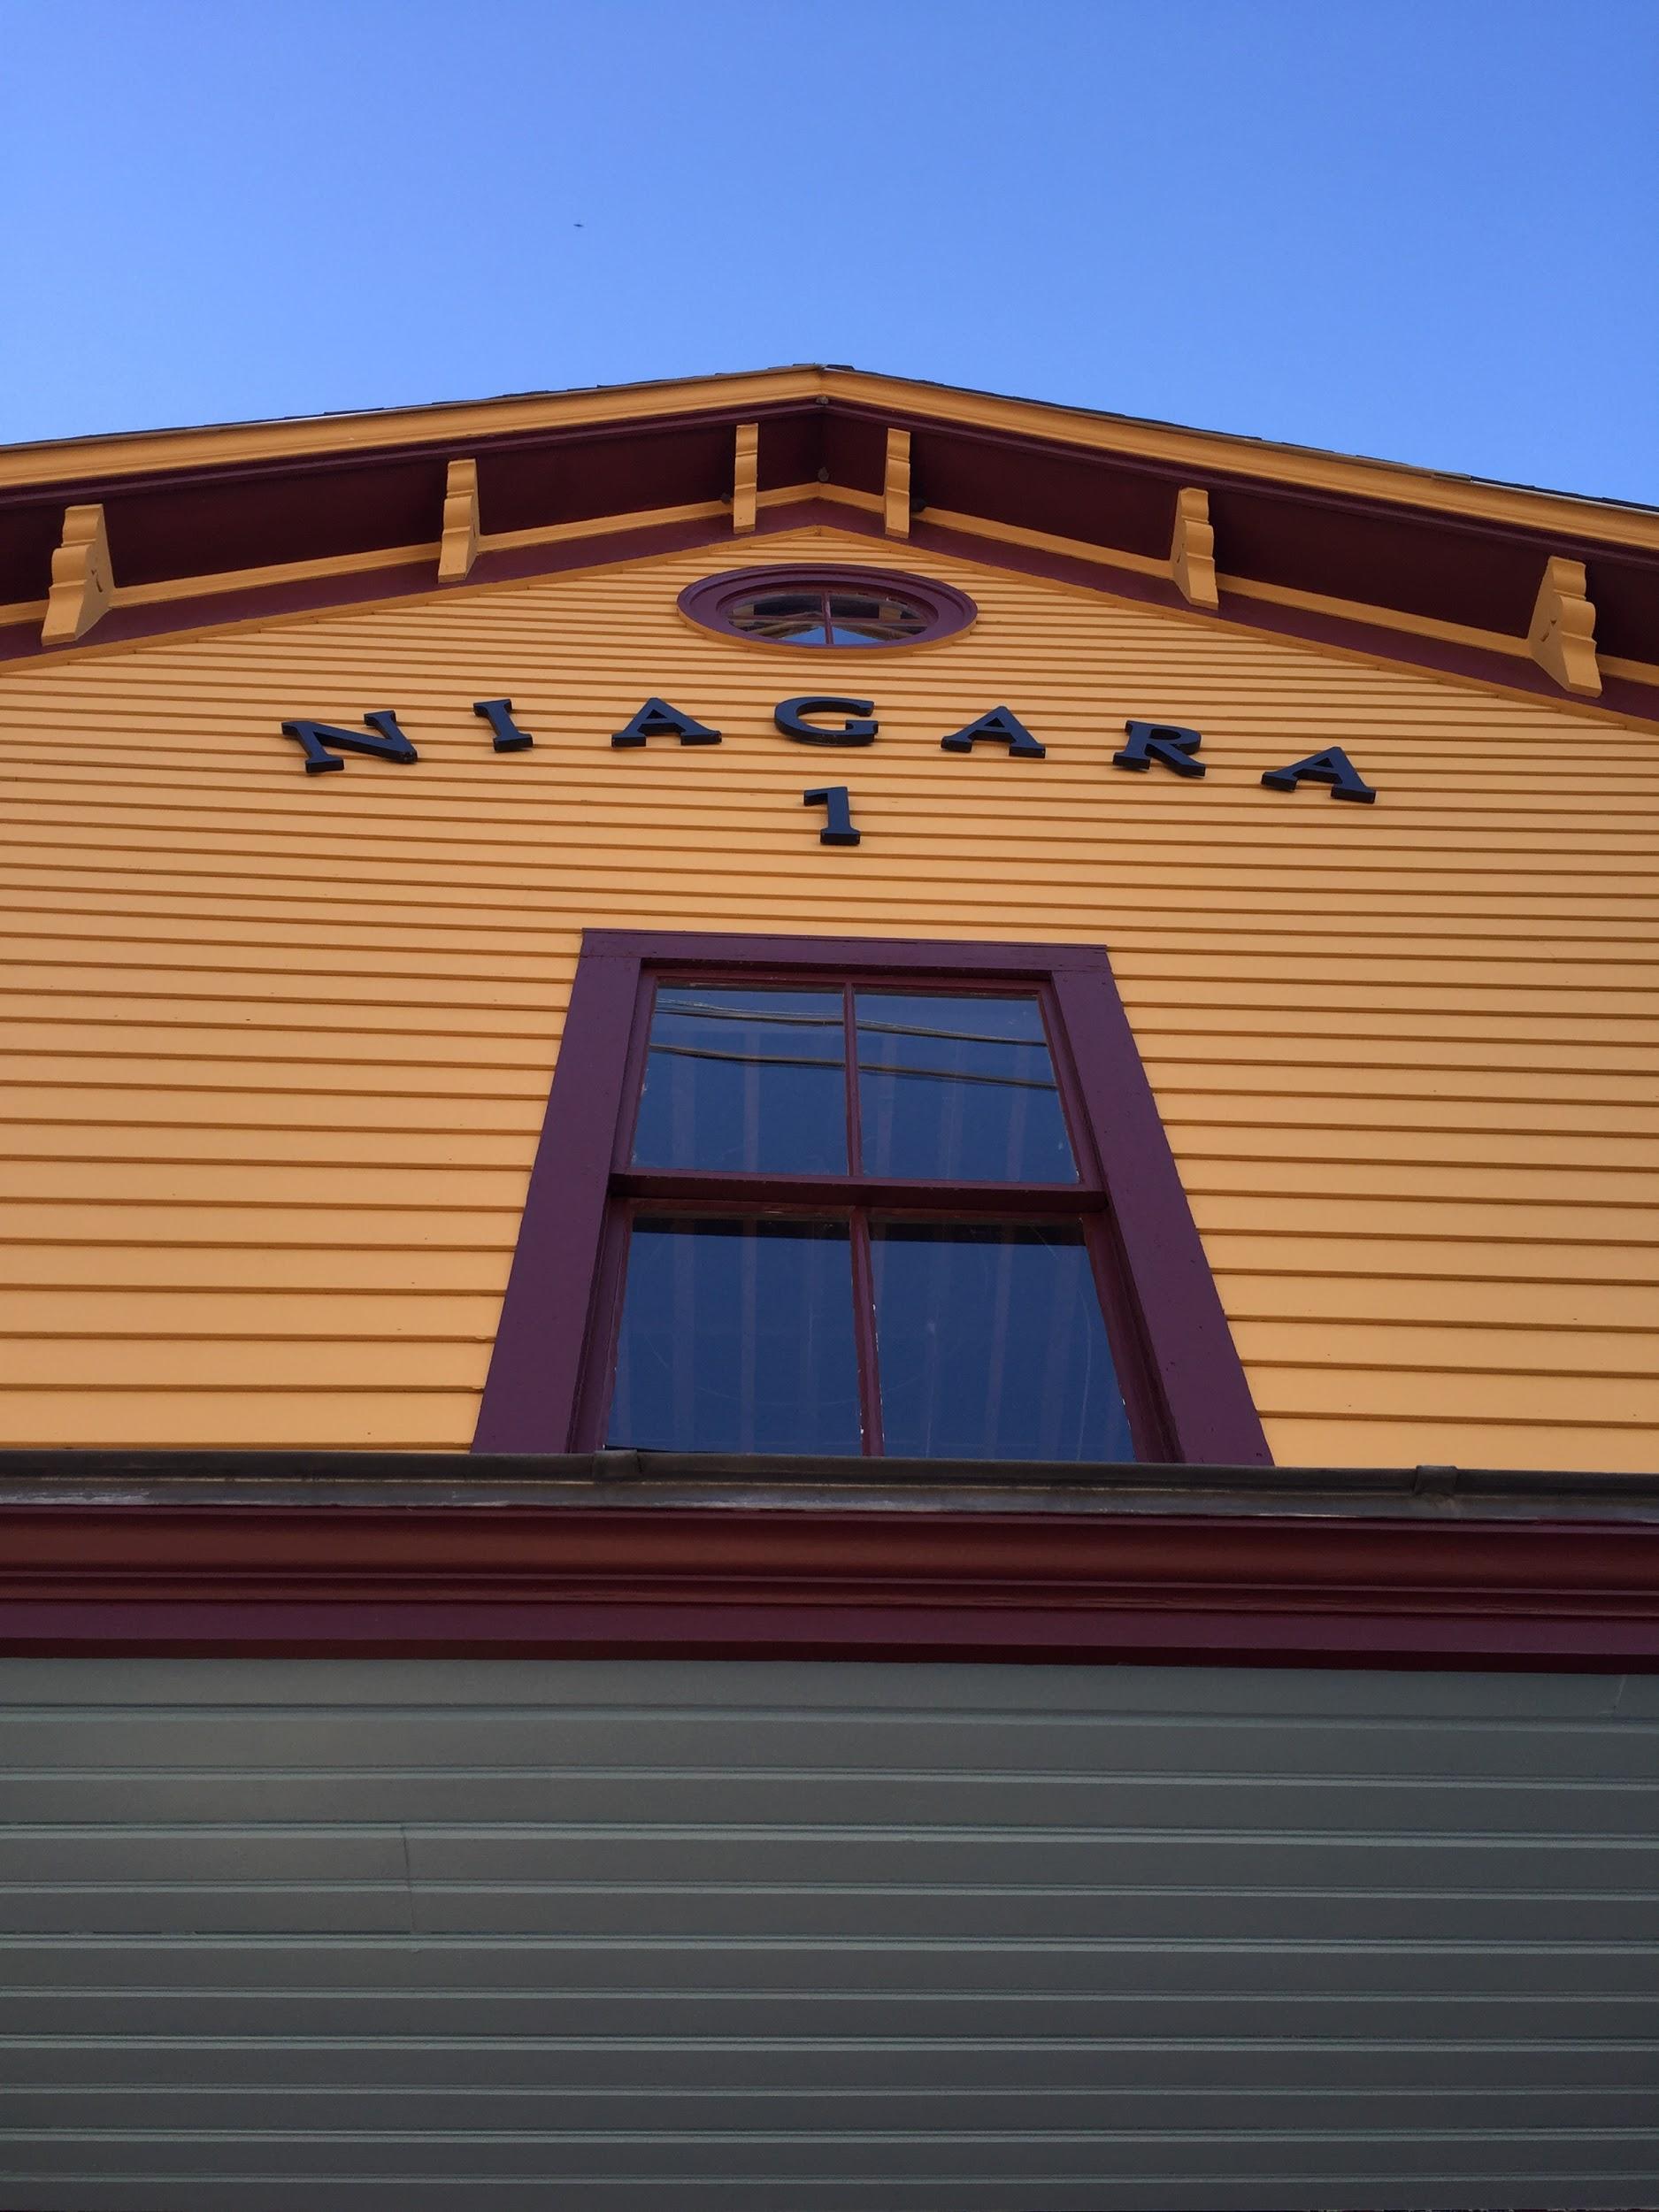

Slide 43
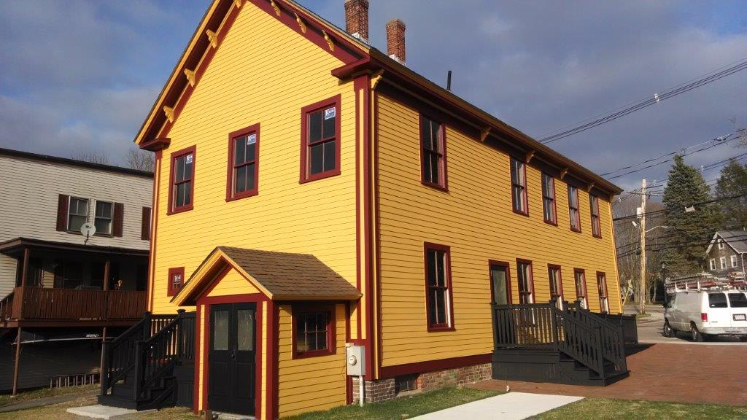

Slide 44
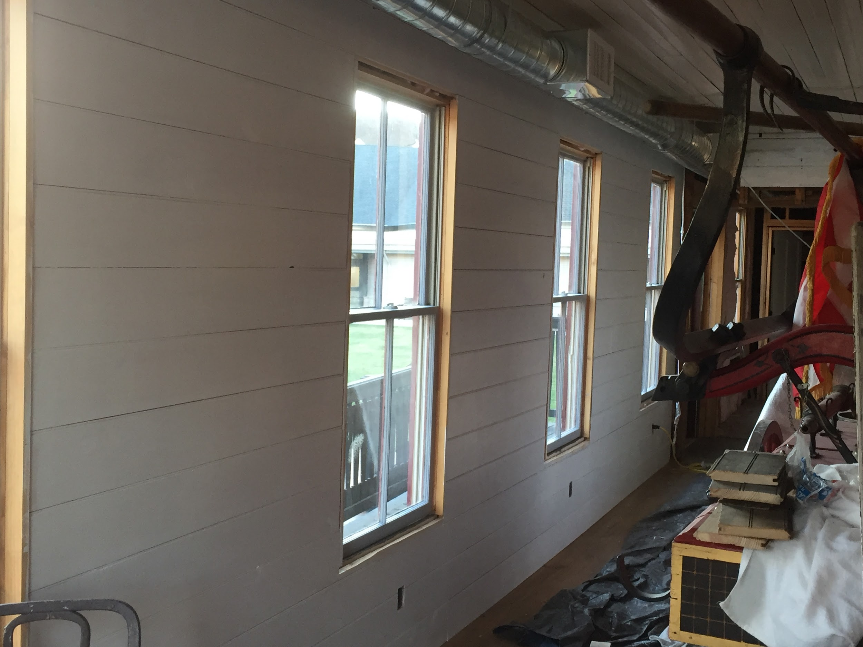

Slide 45
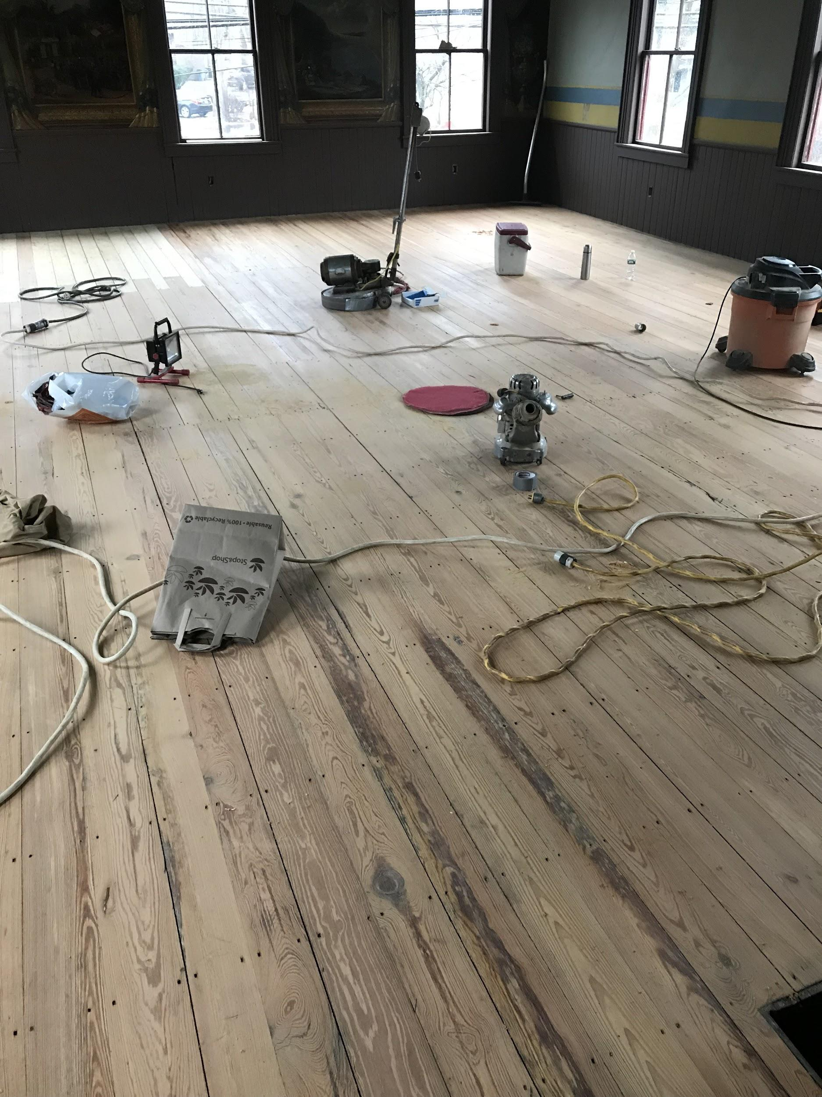
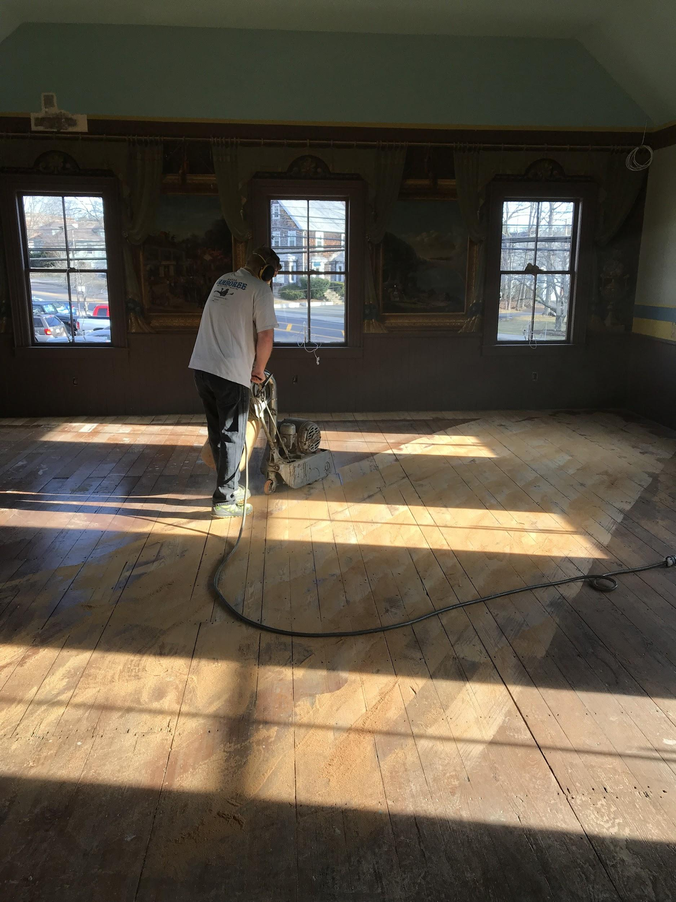

Slide 46
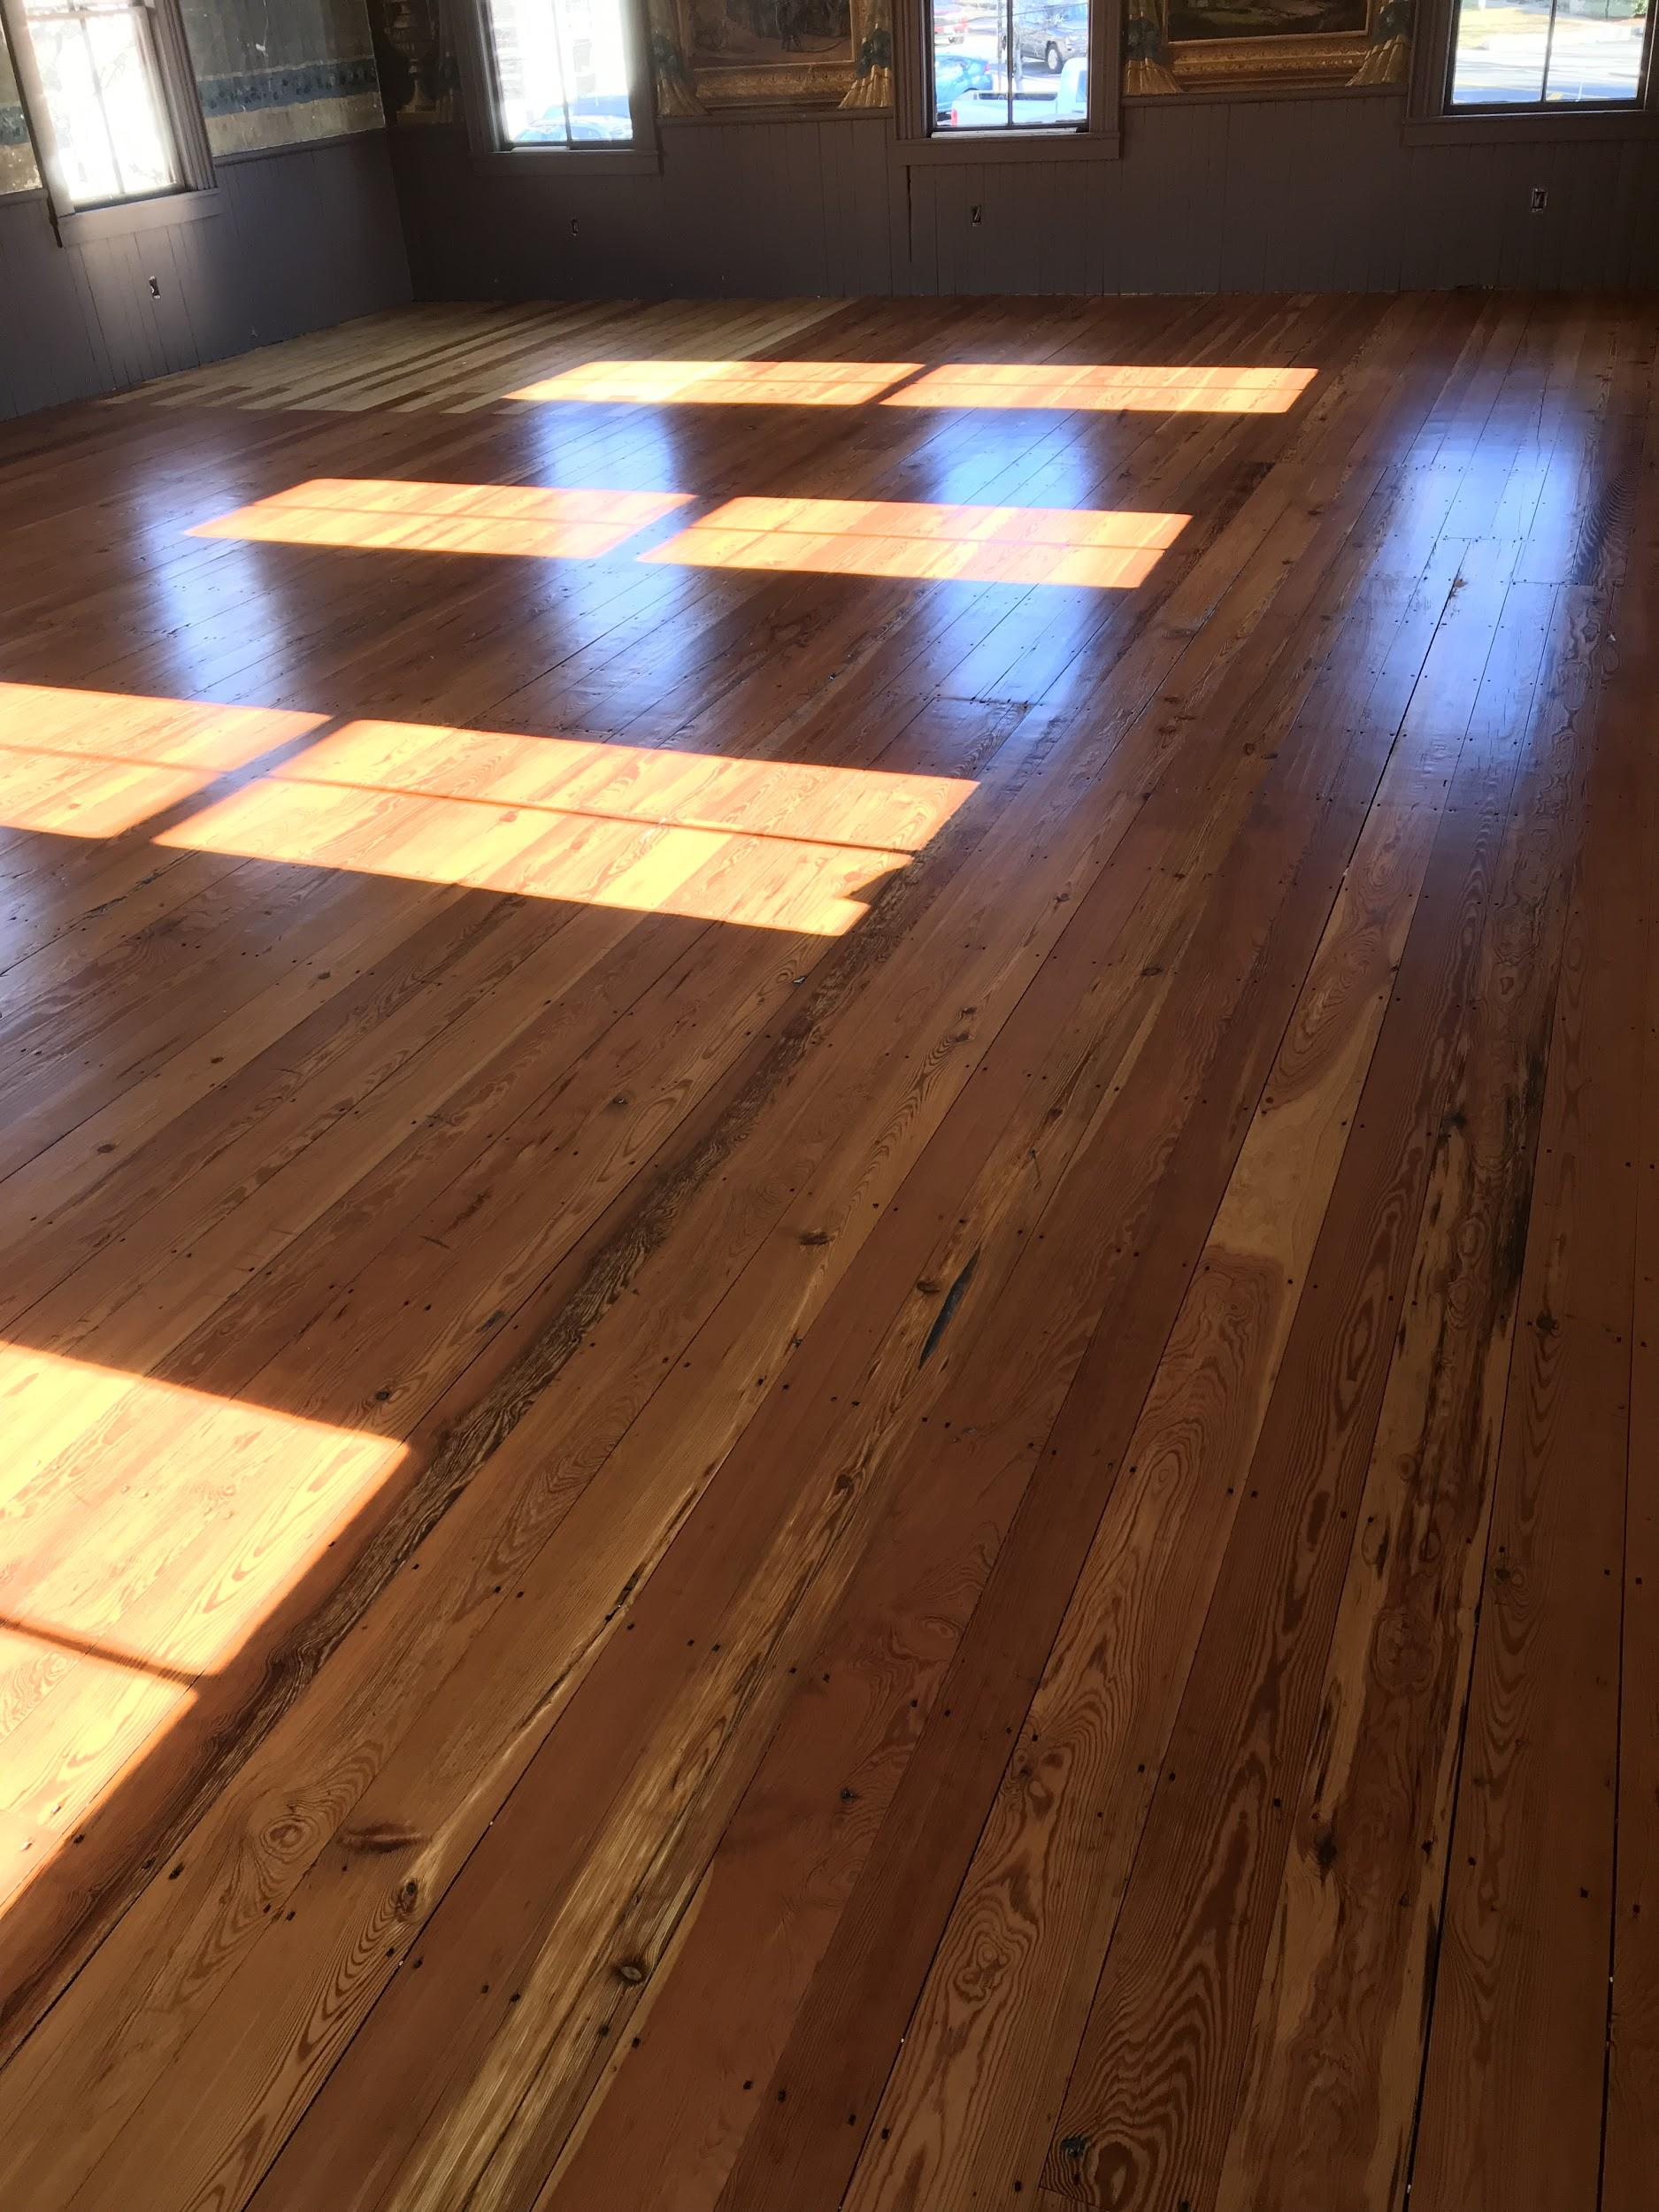
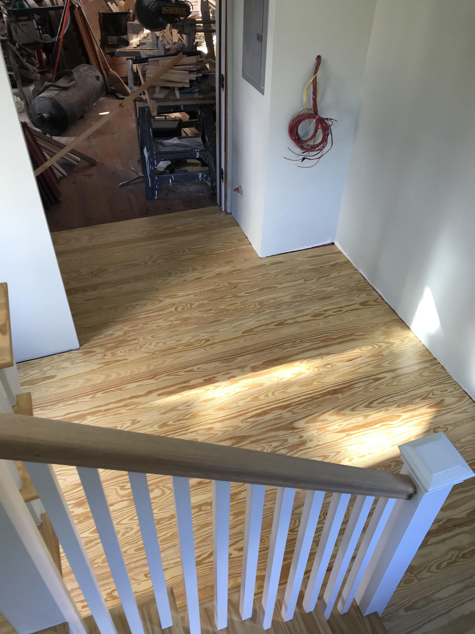

Slide 47
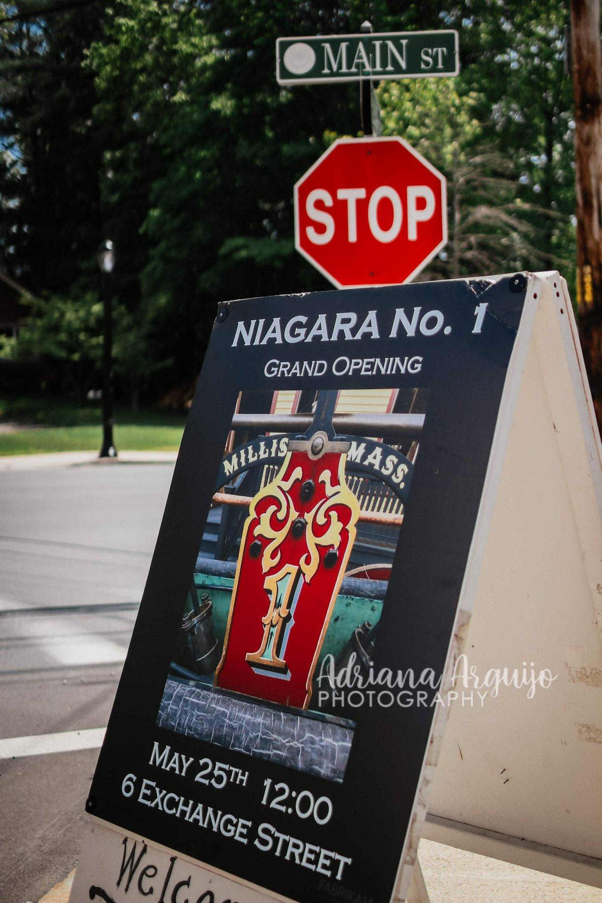

Slide 59
Thank you to...
Millis Community Preservation Committee
Millis Historical Commission
Millis Building Department
Millis Select Board
Millis Fire Department and Chief Barrett
Millis Police Department and Chief Soffayer
Paul Sims
Karen Bouret
Frasca Plumbing
Jose Reyes Electrical
Kevin & Lauree Ricciardelli
Guzman Prufer Architects
Adriana Arguijo Photography
The Niagara Team
Bob Fogarty- D&B Construction
Beth Krimmel
Tri-County Voc. HS Students and Donna Cabbibo
Foreign Car Repair and John Santos
Jane and Lisa Hardin & Family
Judy O’Gara
Jeff Hardin
To the residents of Millis for your continued support over the past twenty years

